Slide 1
Arenes and Aromaticity

Slide 2
Heat of hydrogenation (Δh_{hydro} or ΔHº) of an alkene is the standard enthalpy of catalytic hydrogenation of an alkene. Catalytic hydrogenation of an alkene is always exothermic. Therefore, heat of hydrogenation of alkenes is always negative. For example,
Heat of hydrogenation of alkenes is a measure of the stability of carbon-carbon double bonds. All else being the same, the smaller the numerical value of heat of hydrogenation of an alkene, the more stable the double bond therein. Based on heats of hydrogenation of alkenes, the trend in the stability of carbon-carbon double bonds is tetrasubstituted > trisubstituted > disubstituted > monosubstituted > unsubstituted.
The heat of hydrogenation of benzene is less than expected because benzene is stabilized by resonance. The molar heat of combustion (He) is the heat released when one mole of a substance is completely burned. The heat of combustion of benzene in a bomb calorimeter is found to be 3263.9kj/mole at 25 degree celsius.
Cyclohexene has one double bond, and its heat of hydrogenation is -120 kJ/mol.
Benzene has three double bonds, so we might expect its heat of hydrogenation to be -360 kJ/mol.However, its measured heat of hydrogenation is only -208 kJ/mol.
Benzene is more stable than expected by 152 kJ/mol. This difference is called its resonance energy.

Slide 3
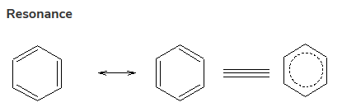
There are two Lewis structures for benzene, differing only in the positions of the electrons. Whenever we can do this, the correct structure is neither of the two. It is a resonance hybrid of them both. Such a structure is more stable than either of the contributors, and the extra stabilization is called the resonance energy of the compound.
The carbon atoms in benzene are sp² hybridized, and the unhybridized Pz orbitals overlap side-on to form the π-clouds of the C=C double bonds. All six p orbitals can overlap side-on to form a "delocalized" π cloud of electrons around the ring.
Whenever electrons can spread out or "delocalize", they are at lower energy levels.

Slide 4
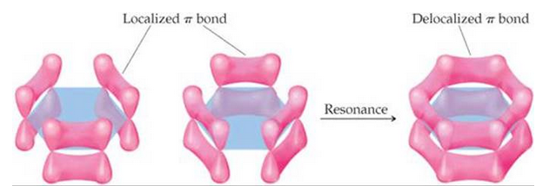
The orbital explanation of benzene
Benzene reactions
Benzene is highly prone to electrophilic substitution reactions compared to addition reactions as it loses its aromaticity during addition reaction. As benzene contains delocalized electrons spanning over carbon atoms in the ring, it is highly attractive to electrophiles and is also highly stable to electrophilic substitutions. Generally, electrophilic substitution reaction is a three-step process involving:
Generation of electrophile.
Intermediate carbocation formation.
Removal of proton from carbocation intermediate.

Slide 5
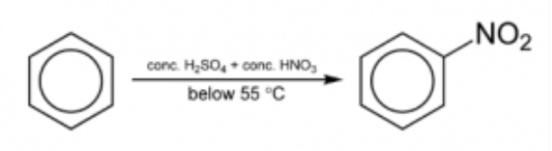
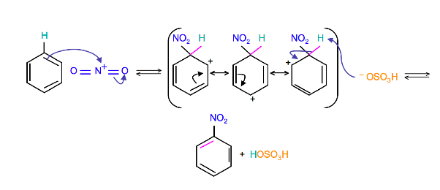
Nitration of Benzene
Benzene reacts with concentrated nitric acid at 323-333k in the presence of concentrated sulphuric acid to form nitrobenzene. This reaction is known as nitration of benzene.
Step 1: Nitric acid accepts a proton from sulphuric acid and then dissociates to form nitronium ion. Step 2: The nitronium ion acts as an electrophile in the process which further reacts with benzene to form an arenium ion. Step 3: The arenium ion then loses its proton to Lewis base forming nitrobenzene.

Slide 6
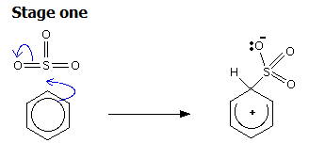
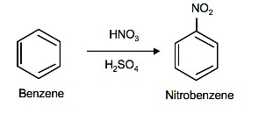
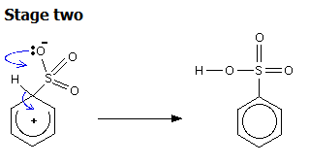
Sulfonation of Benzene
Sulfonation of benzene is a process of heating benzene with fuming sulphuric acid (H2SO4 +SO3) to produce benzenesulfonic acid. The reaction is reversible in nature. Due to higher electronegativity, oxygen present in sulphuric acid pulls an electron towards itself, generating an electrophile. This attacks the benzene ring, leading to the formation of benzenesulfonic acid.

Slide 7


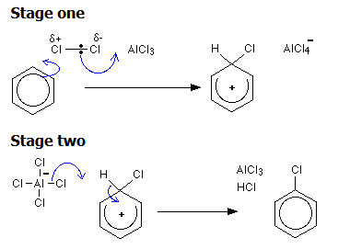
Halogenation of Benzene
Benzene reacts with halogens in the presence of Lewis acid like FeCl3, FeBr3 to form aryl halides. This reaction is termed as halogenation of benzene. Step 1: Being a Lewis acid, FeBr3 helps in the generation of electrophile bromine ion by combining with the attacking reagent. Step 2: The bromine ion acts as an electrophile in the process which further reacts with benzene to form arenium ion which finally converts to bromobenzene.

Slide 8

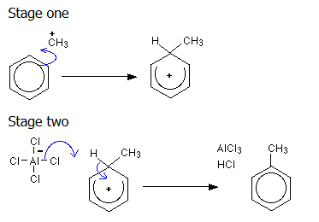
Friedel-Crafts Alkylation of Benzene
Alkylation means substituting an alkyl group into something - in this case into a benzene ring. A hydrogen on the ring is replaced by a group like methyl or ethyl and so on.Benzene is treated with a chloroalkane (for example, chloromethane or chloroethane) in the presence of aluminum chloride as a catalyst. Substituting a methyl group, but any other alkyl group could be used in the same way. Substituting a methyl group gives methylbenzene - once known as toluene.

Slide 9
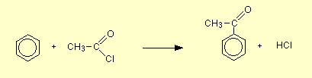
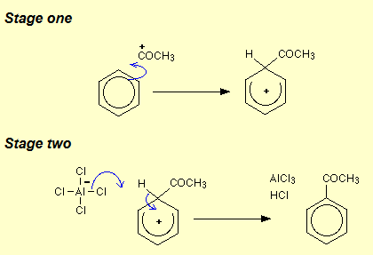
Friedel-Crafts Acylation of Benzene
An acyl group is an alkyl group attached to a carbon-oxygen double bond. If "R" represents any alkyl group, then an acyl group has the formula RCO-. Acylation means substituting an acyl group into something - in this case, into a benzene ring. The most commonly used acyl group is CH₃CO-. This is called the ethanoyl group.

Slide 10
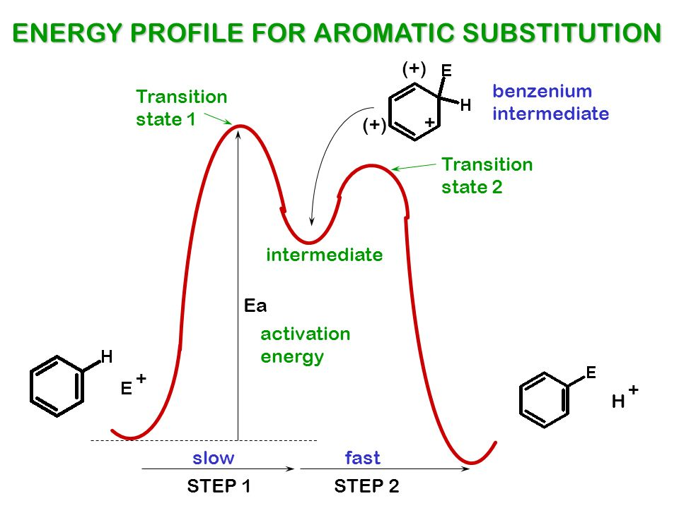

Slide 11
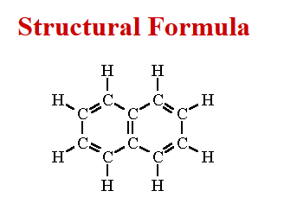
Naphthalene
Naphthalene is a white, volatile, solid polycyclic hydrocarbon with a strong mothball odor. Naphthalene is obtained from either coal tar or petroleum distillation and is primarily used to manufacture phthalic anhydride, but is also used in moth repellents. Naphthalene is an aromatic hydrocarbon comprising two fused benzene rings. It occurs in the essential oils of numerous plant species e.g. magnolia. It has a role as a volatile oil component, a plant metabolite, an environmental contaminant, a carcinogenic agent, a mouse metabolite and an apoptosis inhibitor.
In electrophilic aromatic substitution reactions, naphthalene reacts more readily than benzene. For example, chlorination and bromination of naphthalene proceeds without a catalyst to give 1-chloronaphthalene and 1-bromonaphthalene, respectively. Likewise, whereas both benzene and naphthalene can be alkylated using Friedel–Crafts reactions, naphthalene can also be easily alkylated by reaction with alkenes or alcohols, using sulfuric or phosphoric acid catalysts.

Slide 12

Anthracene
Anthracene, also called paranaphthalene or green oil, a solid polycyclic aromatic hydrocarbon (PAH) consisting of three benzene rings derived from coal-tar, is the simplest tricyclic aromatic hydrocarbon. Anthracene is a solid polycyclic aromatic hydrocarbon consisting of three fused benzene rings derived from coal-tar or other residues of thermal pyrolysis. Anthracene is used in the artificial production of the red dye alizarin. It is also used in wood preservatives, insecticides, and coating materials.

Slide 13
AROMATICITY AND HUCKEL Rule
The aromatic compounds apparently contain alternate double and single bonds in a cyclic structure, and resembles benzene in chemical behavior. They undergo substitution rather than addition reactions. This characteristic behavior is called aromaticity. AROMATICITY is in fact a property of the Sp2 hybridized planar rings with the P orbitals(one on each atom) allow cyclic delocalization of 'pi' electrons.
Rules for compounds to be aromatic:¬
1). An aromatic ring is planar (flat) and cyclic.
2). Each atom in an aromatic ring has a P orbital. These P orbitals must be parallel so that a continuous overlap is possible around the ring. Or every atom in the ring must be conjugated.
3). The cyclic Pi molecular orbital (electron cloud) formed by the overlap of P orbitals must contain (4n+2)Pi electrons.... n=0,1,2,3....known as HUCKEL RULE.

Slide 14
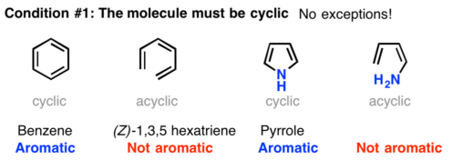
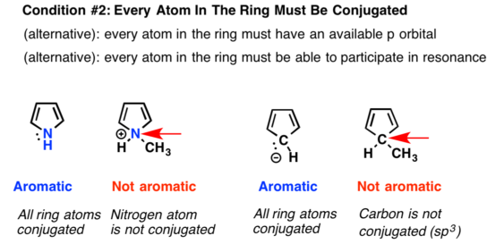

Slide 15
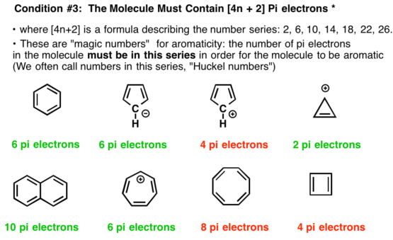

Slide 16
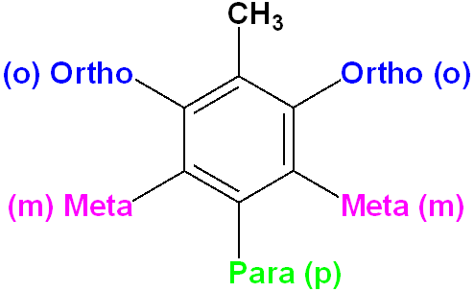
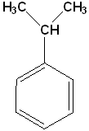
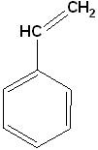





Monosubstituted Benzene
When one of the positions on the ring has been substituted with another atom or group of atoms, the compound is a monosubstituted benzene. If two positions are replaced, then it's a disubstituted, & so on. Many of the monosubstituted compounds have their own name and some of the more common ones are listed below:
Cumene
Ethyl benzene
Styrene
Phenol
Toluene
Aniline
Benzamide

Slide 17
Orientation Effects in Substituted Benzenes
Substituted rings are divided into two groups based on the type of the substituent that the ring carries:
Activated rings: the substituent on the ring are groups that donate electrons.
Deactivated rings: the substituent on the ring are groups that withdraw electrons.
Examples of activating groups in the relative order from the most activating group to the least activating:
-NH₂, -NR₂ > -OH, -OR> -NHCOR> -CH₃ and other alkyl groups
with R as alkyl groups (C_{n}H_{2n+1})
Examples of deactivating groups in the relative order from the most deactivating to the least deactivating:
-NO₂, -CF₃> -COR, -CN, -CO₂R, -SO₃H > Halogens
with R as alkyl groups (C_{n}H_{2n+1})
The order of reactivity among Halogens from the more reactive (least deactivating substituent) to the least reactive (most deactivating substituent) halogen is:
F> Cl > Br > I

Slide 18
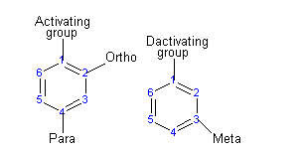
The order of reactivity of the benzene rings toward the electrophilic substitution when it is substituted with a halogen groups, follows the order of electronegativity. The ring that is substituted with the most electronegative halogen is the most reactive ring ( less deactivating substituent ) and the ring that is substituted with the least electronegatvie halogen is the least reactive ring ( more deactivating substituent ), when we compare rings with halogen substituents. Also the size of the halogen effects the reactivity of the benzene ring that the halogen is attached to. As the size of the halogen increase, the reactivity of the ring decreases.
The activating group directs the reaction to the ortho or para position, which means the electrophile substitute the hydrogen that is on carbon 2 or carbon 4. The deactivating group directs the reaction to the meta position, which means the electrophile substitute the hydrogen that is on carbon 3 with the exception of the halogens that is a deactivating group but directs the ortho or para substitution.

Slide 19
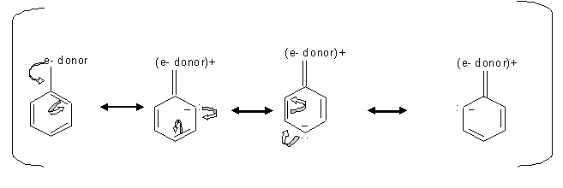
Substituents determine the reaction direction by resonance or inductive effect
Resonance effect is the conjugation between the ring and the substituent, which means the delocalizing of the π electrons between the ring and the substituent. Inductive effect is the withdraw of the sigma ( the single bond ) electrons away from the ring toward the substituent, due to the higher electro negativity of the substituent compared to the carbon of the ring.
Since the electrons locating transfer between the ortho and para carbons, then the electrophile prefer attacking the carbon that has the free electron. Inductive effect of alkyl groups activates the direction of the ortho or para substitution, which is when s electrons gets pushed toward the ring.

Slide 20
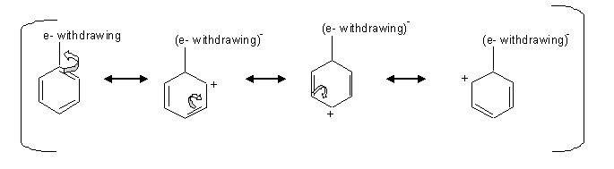
Deactivating group (meta directors)
The deactivating groups deactivate the ring by the inductive effect in the presence of an electronegative atom that withdraws the electrons away from the ring.
when there is an electron withdraw from the ring, that leaves the carbons at the ortho, para positions with a positive charge which is unfavorable for the electrophile, so the electrophile attacks the carbon at the meta positions.
Halogens are an exception of the deactivating group that directs the ortho or para substitution. The halogens deactivate the ring by inductive effect not by the resonance even though they have an unpaired pair of electrons. The unpaired pair of electrons gets donated to the ring, but the inductive effect pulls away the s electrons from the ring by the electronegativity of the halogens.

Slide 21
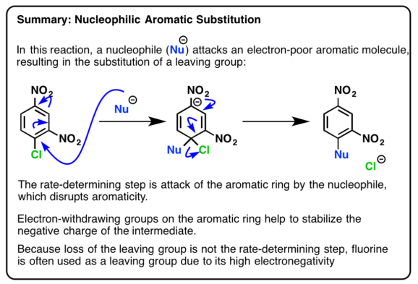
Nucleophilic Aromatic Substitution
A nucleophilic aromatic substitution reaction is a reaction in which one of the substituents in an aromatic ring is replaced by a nucleophile.

Slide 22
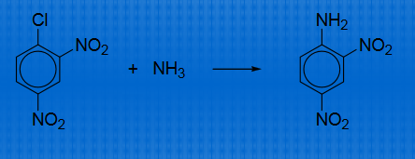
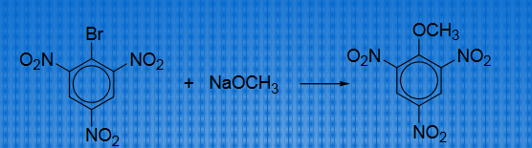
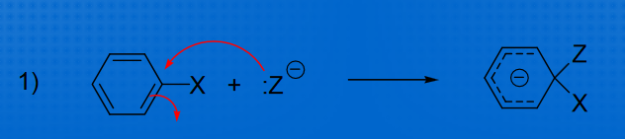
Bimolecular displacement mechanism
Aromatic ring must contain electron withdrawing group ortho or para to X (hologens).
Mechanism

Slide 23
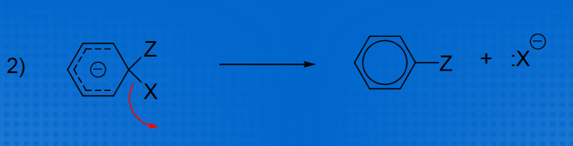
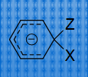
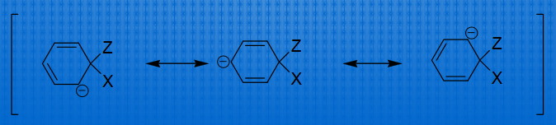
Intermediate stabilization

Slide 24
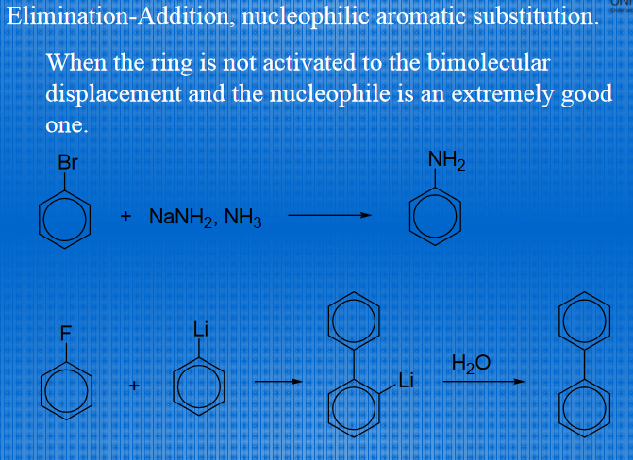

Slide 25
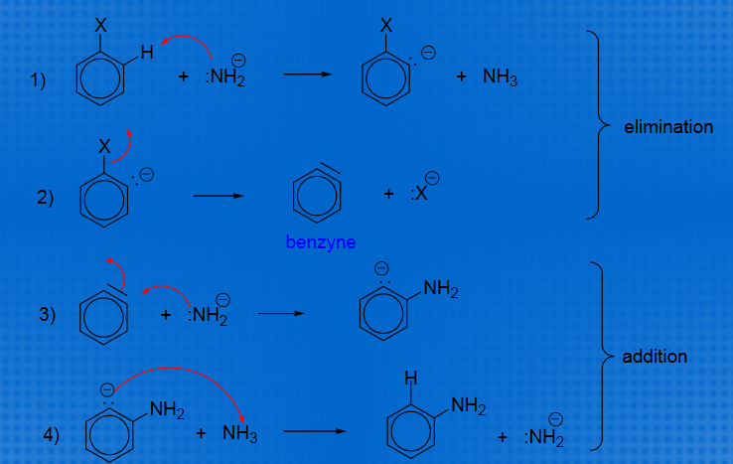
Mechanism

Slide 26
Naphthalene alkylation
Naphthalene is a fused ring compound and more reactive than benzene due to greater pi-electron density. Thus it is difficult to control regioselectivity and polyalkylation. Even monoalkylation may give a mixture of 1- and 2-alkylated naphthalene. These monoalkylated derivatives are more reactive than naphthalene (directing effect), thus favouring further alkylation. However bulky groups like tert-butyl may give 2-naphthalene as a major product. Also, application of low temperatures may overcome the poly-substitution problem. The alkylated naphthalenes are usually produced by the alkylation of naphthalene or a substituted
naphthalene in the presence of an acidic alkylation catalyst such as a Friedel-Krafts catalyst.
Zeolite catalysts can be effective for the production of mono-alkylated
naphthalenes and that good selectivity for the
mono-substituted naphthalenes may be obtained by the incorporation of cations having a radius of at least 2.5 A in large pore size zeolites such as zeolite Y. The presence of bulky cations of this type provides good selectivity for the more highly desired mono-alkylated products.

Slide 27
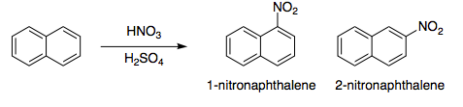
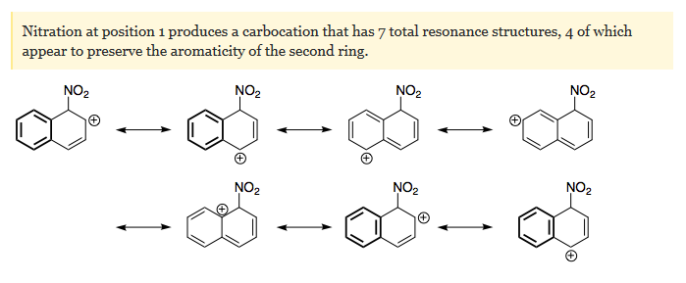
Nitration of napthalene

Slide 28
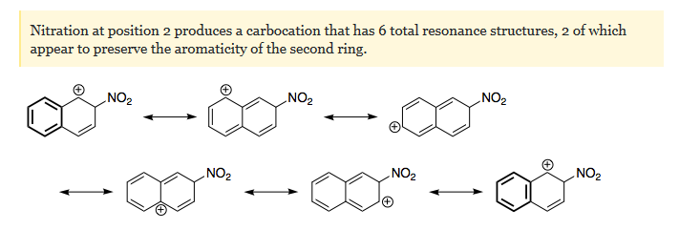
Sulphonation of napthalene
When naphthalene is sulfonated, two isomeric mono sulfonic acids are formed. The temperature of the sulfonation determines the relative amount of each obtained. It has not been possible to produce one form of the sulfonic acid alone. A mixture of the two is always formed. When the reaction is performed at 40º C., the α-mononosulfonate is the predominate form:

Slide 29

When the sulfonation is carried out at 40º C, the ratio of alpha/beta form is close to 96/4. When the sulfonation temperature is raised to 160ºC, the beta compound represents 86 per cent of the total sulfonic acids formed. A number of isomers may be formed on further sulfonation, and their separation is usually difficult. The isolation of the individual sulfonic acids have always presented a problem in industry. At present the monosulfonation of naphthalene is usually carried out with a 25 to 40 per cent excess of sulfuric acid, of 93 to 98 per cent strength.

Slide 30
Carcinogenic Arenes (polynuclear aromatic hydrocarbons, PAH)
PAHs are a class of widely spread mutagenic and tumorigenic environmental contaminants. They are produced mainly from incomplete combustion of organic materials during both natural events and human activities. These include wild fires and volcanic eruptions, and burning of fossil fuels and petroleum products during industrial production, food processing, operation of machinery including automobiles, airplanes and ships. PAHs are carbon compounds with two or more annelated aromatic rings.
PAHs are thought to induce cancer tumors, primarily in the lungs, bladder and in the skin. The International Agency for Research on Cancer and the United States Environmental Protection Agency have classified some of these compounds as probable human carcinogens.
PAHs themselves are relatively non-reactive chemicals toward biological macromolecules under physiological conditions. Rather, they require metabolic activation in order to exert genotoxicity, including mutagenicity and tumorigenicity.

Slide 31
Upon entering the body, the cellular defense system attempts to “remove” these foreign substances by metabolism. PAH metabolism in a mammalian system is principally in the liver and is catalyzed mainly by the cytochrome P450 enzymes, although other metabolizing enzymes are also involved. Upon metabolism, PAHs become more polar and water-soluble to be excreted out of the body, thus completing the removal or the biological “detoxification” process. However, metabolism of some PAHs also generates reactive intermediates that are capable of forming covalent adducts with nucleic acids, leading to genotoxicity.

