Slide 1
Organic photochemical reactions
and dyes

Slide 2
Photochemical reaction, a chemical reaction initiated by the absorption of energy in the form of light.
The consequence of molecules’ absorbing light is the creation of transient excited states whose chemical and physical properties differ greatly from the original molecules.
These new chemical species can fall apart, change to new structures, combine with each other or other molecules, or transfer electrons, hydrogen atoms, protons, or their electronic excitation energy to other molecules.
Excited states are stronger acids and stronger reductants than the original ground states.

Slide 3
Photochemistry is the branch of chemistry concerned with the chemical effects of light.
Generally, this term is used to describe a chemical reaction caused by absorption of ultraviolet (wavelength from 100 to 400 nm), visible light (400–750 nm) or infrared radiation (750–2500 nm)
The chemical reaction which was initiated using supply of heat energy from outside is called as thermal reaction. Example:
Decomposition of Calcium carbonate was initiated by supply of heat energy. During this reaction Calcium oxide and Cabon dioxide (CO₂)are formed. CaCO₃ + (Heat energy) → CaO + CO₂

Slide 4
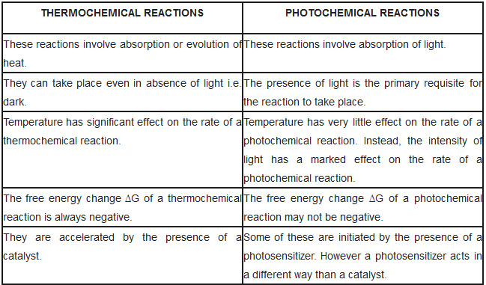

Slide 5
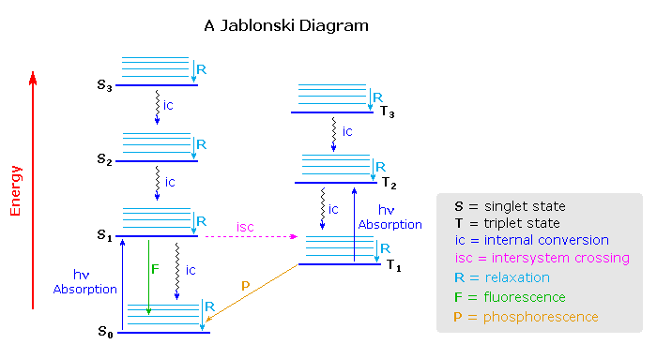
Mechanistic Background

Slide 6
Photosensitized reactions are photochemical reactions in the presence of sensitizers. The function of a sensitizer is to transfer energy or to participate in photochemical reactions to form a radical which then reacts with reactants and converts back to the sensitizer. In many inorganic photochemical reactions, mercury is a common sensitizer. Upon light irradiation, mercury is excited and becomes excited mercury. The excited mercury collides with reactant molecules and transfers the energy to the reactant molecules to make them more reactive. Molecular photosensitizers: benzophenone, sulphur dioxide.
Photochemical reactions of olefins: Simple olefins interact photochemically with carbonyl compounds possessing n-π* lowest triplets to give both cis-trans isomerization and oxetane formation. It was thought that electronic energy transfer from the carbonyl triplet to give the olefin triplet (reactions 2-4) was the mechanism of isomerization. It is thought that a 1,4 biradical (I) is an intermediate in oxetane formation. Also benzophenone gives the same initial cis- trans ratio of oxetanes with both cis- and trans-2- butene that either I or some other intermediate capable of losing stereochemical integrity must surely be involved. Further studies has suggested that I may also undergo cleavage to give back- isomerized olefin (eq. 6 and 7)

Slide 7
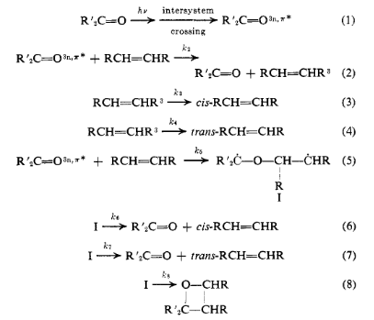

Slide 8
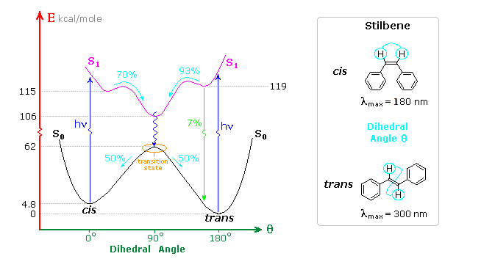
Alkene Isomerization
Both cis and trans-stilbene undergo π → π* electron excitation by absorption of uv light. Whereas isolated double bonds (for cis) require 180 nm light for such excitation, conjugation with the phenyl substituent's lowers the transition energy to about 300 nm, a more easily achieved source.

Slide 9
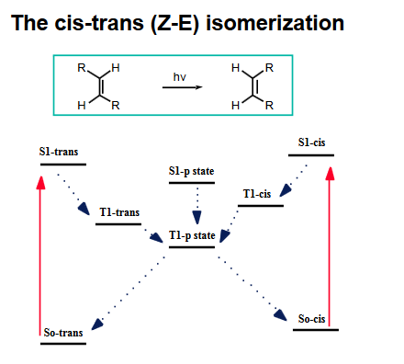
T1-triplet state
S1-singlet state

Slide 10
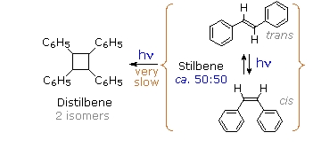
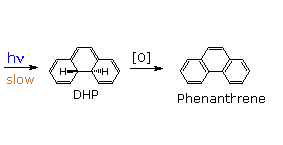
Photo dimerisation

Slide 11
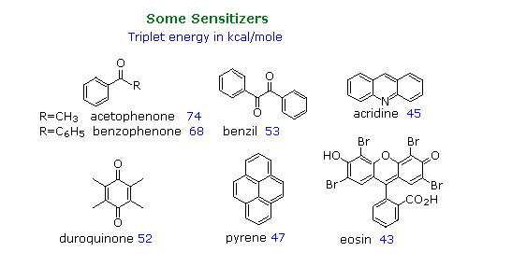
Sensitization reaction: The ideal sensitizer (Z) absorbs light preferentially with respect to the substrate (M), and undergoes efficient intersystem crossing to a triplet excited state (T₁).
This energetic state then serves to activate a substrate molecule to a lower energy triplet state by collisional exothermic energy and spin exchange, returning the sensitizer to its ground state. A variety of useful sensitizers have been identified

Slide 12
Norrish type reactions
The Norrish reaction in organic chemistry describes the photochemical reactions taking place with ketones and aldehydes.
This type of reaction is subdivided in Norrish type I reactions and Norrish type II reactions.
The reaction is named after Ronald George Wreyford Norrish.

Slide 13
The Norrish type I reaction is the photochemical cleavage or homolysis of aldehydes and ketones into two free radical intermediates.
The carbonyl group accepts a photon and is excited to a photochemical singlet state.
Through intersystem crossing the triplet state can be obtained.
On cleavage of the α-carbon bond from either state, two radical fragments are obtained.
The size and nature of these fragments depends upon the stability of the generated radicals; for instance, the cleavage of 2-butanone largely yields ethyl radicals in favor of less stable methyl radicals.

Slide 14
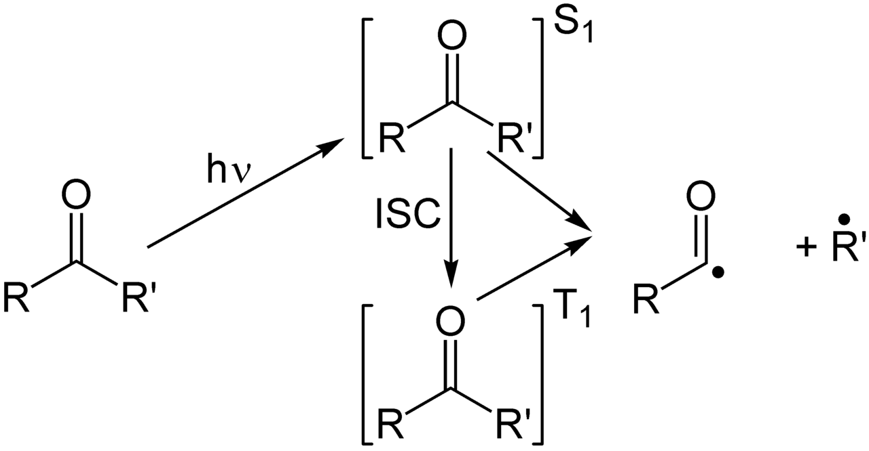
The carbonyl group accepts a photon and is excited to a photochemical singlet state. Through intersystem crossing the triplet state can be obtained. On cleavage of the α-carbon bond from either state, two radical fragments are obtained

Slide 15
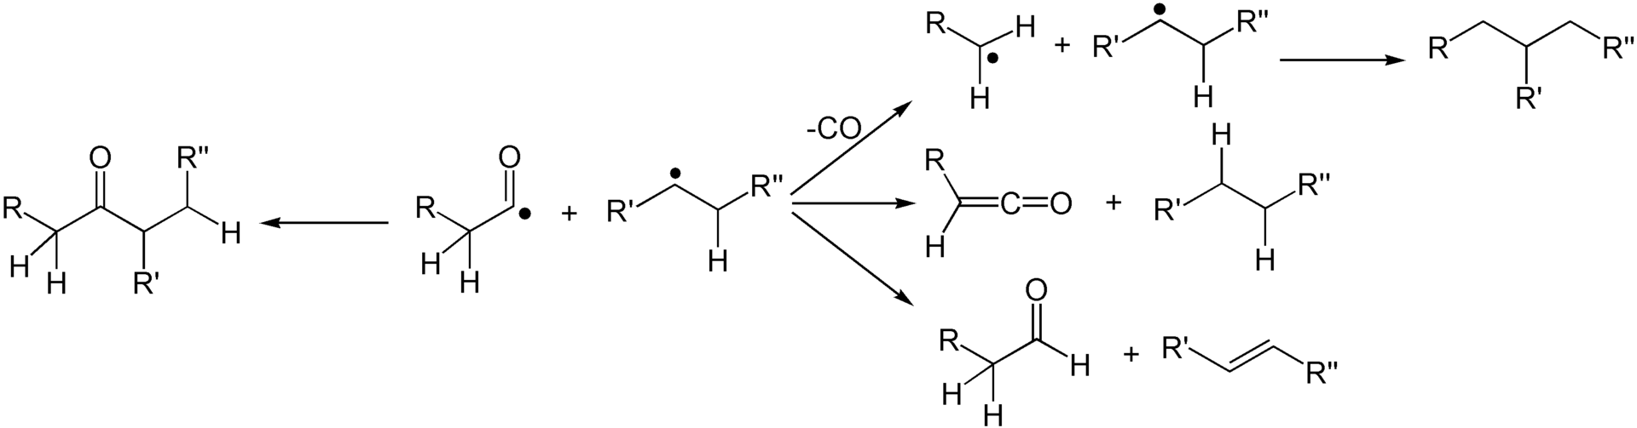
The abstraction of an α-proton from the carbonyl fragment may form a ketene and an alkane.
The abstraction of a β-proton from the alkyl fragment may form an aldehyde and an alkene.
Several secondary reaction modes are open to these fragments depending on the exact molecular structure

Slide 16
A Norrish type II reaction is the photochemical intramolecular abstraction of a γ-hydrogen (a hydrogen atom three carbon positions removed from the carbonyl group) by the excited carbonyl compound to produce a 1,4-biradical as a primary photoproduct.
Norrish first reported the reaction in 1937
Secondary reactions that occur are fragmentation to form an enol and an alkene, or intramolecular recombination of the two radicals to a substituted cyclobutane

Slide 17
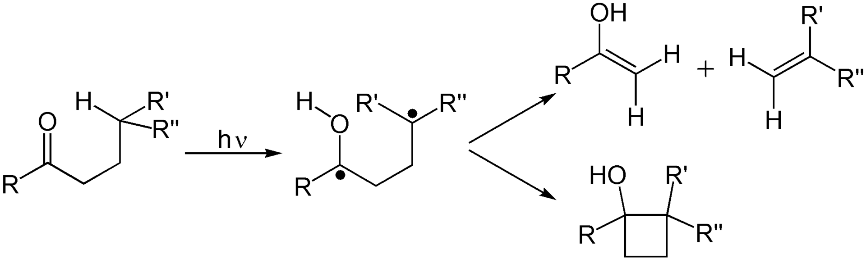
(1,4-biradical )

Slide 18
Photoreduction
Reduction reactions induced by light.
Common processes are:
1, addition of one or more electrons to a photoexcited species;
2, the photochemical hydrogenation of a substance.
Reactions in which the substrate is not electronically excited are sometimes called photoinitiated reductions.

Slide 19
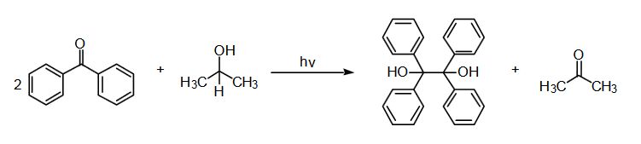
Photoreduction of benzophenone to benzopinacol
(Benzophenone)
(2-propanol)
(Acetone)
(Benzopinacol)

Slide 20
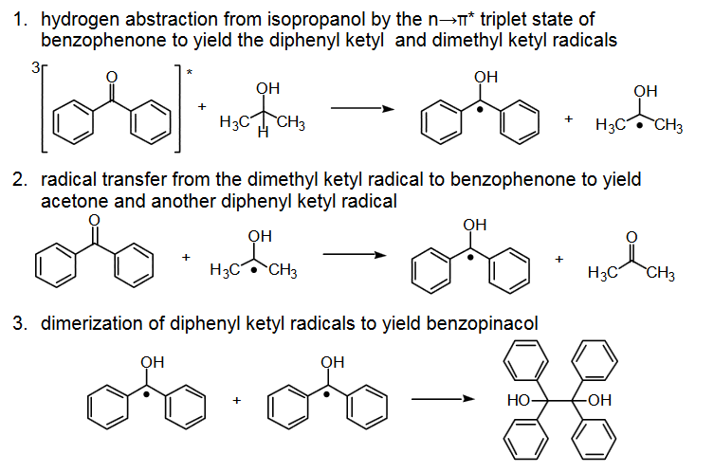
STEPS

Slide 21
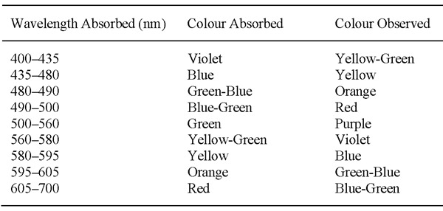
The Chemistry Of Dyes
Dyes possess colour because they 1) absorb light in the visible spectrum (400–700 nm), 2) have at least one chromophore (colour-bearing group), 3) have a conjugated system, i.e. a structure with alternating double and single bonds, and 4) exhibit resonance of electrons, which is a stabilizing force in organic compounds. In addition to chromophores, most dyes also contain groups known as auxochromes (colour helpers), examples of which are carboxylic acid, sulfonic acid, amino, and hydroxyl groups. While these are not responsible for colour, their presence can shift the colour of a colourant and they are most often used to influence dye solubility.

Slide 22
Dyes have an affinity for the substrate (fibre) they are applied to while pigments have no affinity for the substrate they are applied to, and tend to be present as an insoluble suspension in a drying oil or other resinous vehicle.
Classification Based on Origin of Dyes
Most dyes are organic molecules and are complex in nature. The synthesis of organic dyes began with azulene synthesis. Before that, colors were made from pigments.
As a result, dyes can be classified as natural and synthetic, according to their sources of origin.
Natural Dyes
Natural dyes are derived from nature through organic and inorganic materials or sources. Logwood is a natural dye obtained from plants. It saturates silk, wool, cellulose acetate, and nylon with a deep black color. Tyrian purple is obtained from animals and Prussian blue is an inorganic dye obtained from naturally occurring minerals.
Synthetic Dyes
Synthetic dyes became popular because they were easy-to-use, less expensive and had wider range of colors. Synthetic dyes are obtained by adding chemicals to natural dyes. For example, artificial alizarin is a synthetic dye synthesized from coal tar anthracene. Synthetic dyes are used for modern clothing.

Slide 23
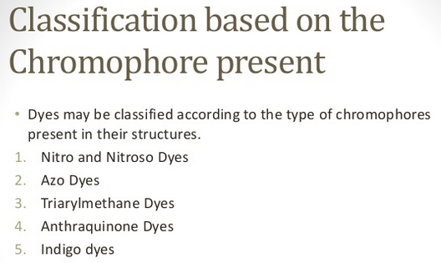
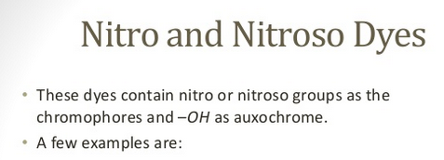
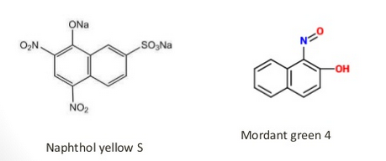

Slide 24
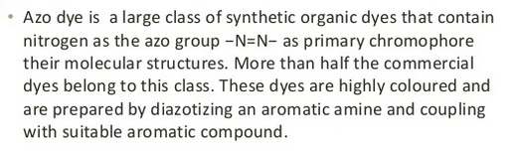
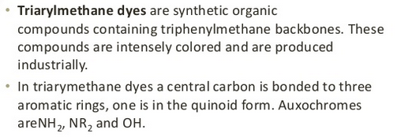



Slide 25
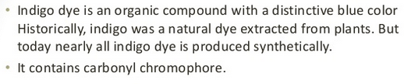

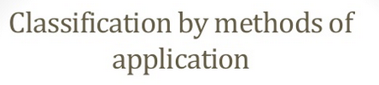
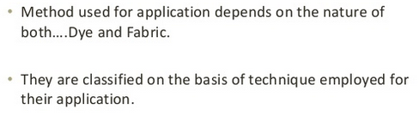

Slide 26
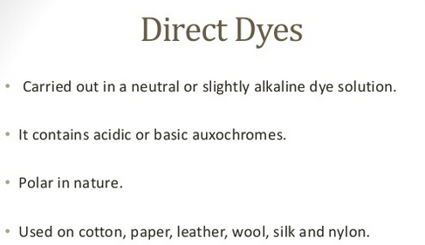
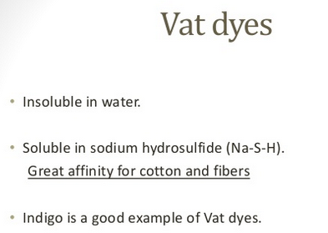

Slide 27
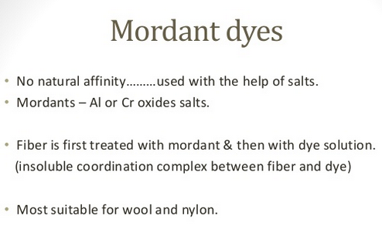
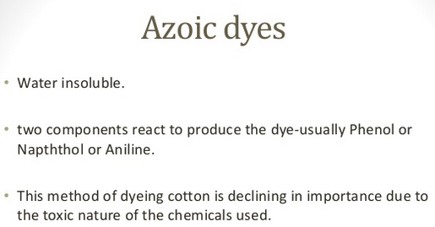

Slide 28
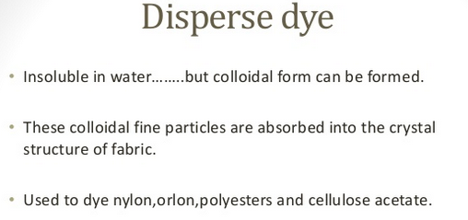
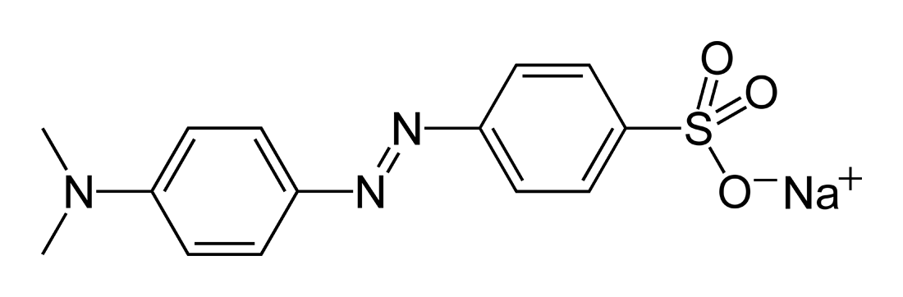
Methyl orange is a pH indicator frequently used in titration because of its clear and distinct color variance at different pH values. Methyl orange shows red color in acidic medium and yellow color in basic medium. Because it changes color at the pH of a mid strength acid, it is usually used in titration for acids. Unlike a universal indicator, methyl orange does not have a full spectrum of color change, but it has a sharp end point.

Slide 29
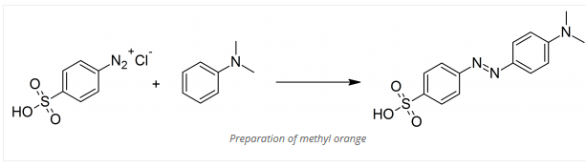
The 4-diazobenzenesulfonic acid (4-sulfobenzene-1-diazonium) is dissolved in the smallest possible quantity of dilute sodium hydroxide, kept cold with ice, and the liquid is poured into a solution of the calculated amount of dimethylaniline mixed with acetic acid. The sodium salt of the methyl orange thereupon separates in shining, reddish-yellow, laminar crystals. These crystals are filtered off and recrystallized from hot water. If a warm solution of the salt is treated with dilute hydrochloric acid in moderate excess, the free base of methyl orange is precipitated as a shining, reddish violet, crystalline powder.

Slide 30
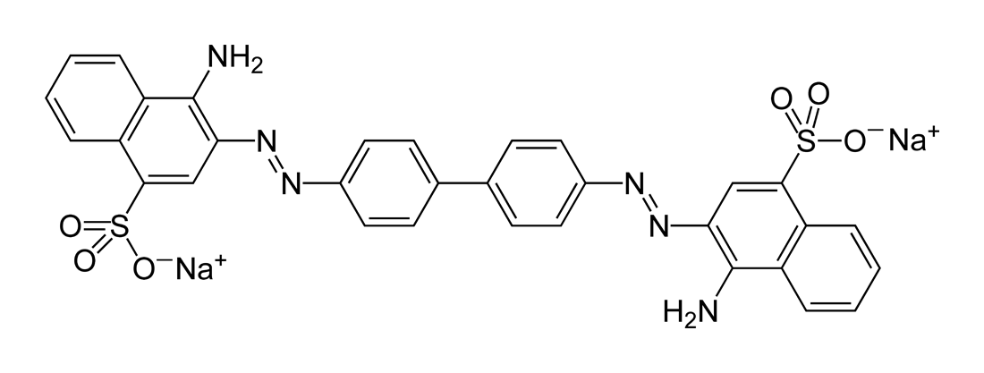
Congo red is an organic compound, the sodium salt of 3,3′-([1,1′-biphenyl]-4,4′-diyl)bis(4-aminonaphthalene-1-sulfonic acid). It is an azo dye. Congo red is water-soluble, yielding a red colloidal solution; its solubility is greater in organic solvents. However, the use of Congo red has long been abandoned, primarily because of its carcinogenic properties. Due to a color change from blue to red at pH 3.0–5.2, Congo red can be used as a pH indicator. It is prepared by azo coupling of the bis(diazonium) derivative of benzidine with naphthionic acid.
Malachite green is classified in the dyestuff industry as a triarylmethane dye and also using in pigment industry.
Malachite green is prepared by the condensation of benzaldehyde and dimethylaniline to give leuco malachite green (LMG). Second, this colorless leuco compound, a relative of triphenylmethane, is oxidized to the cation that is MG. A typical oxidizing agent is manganese dioxide.

Slide 31
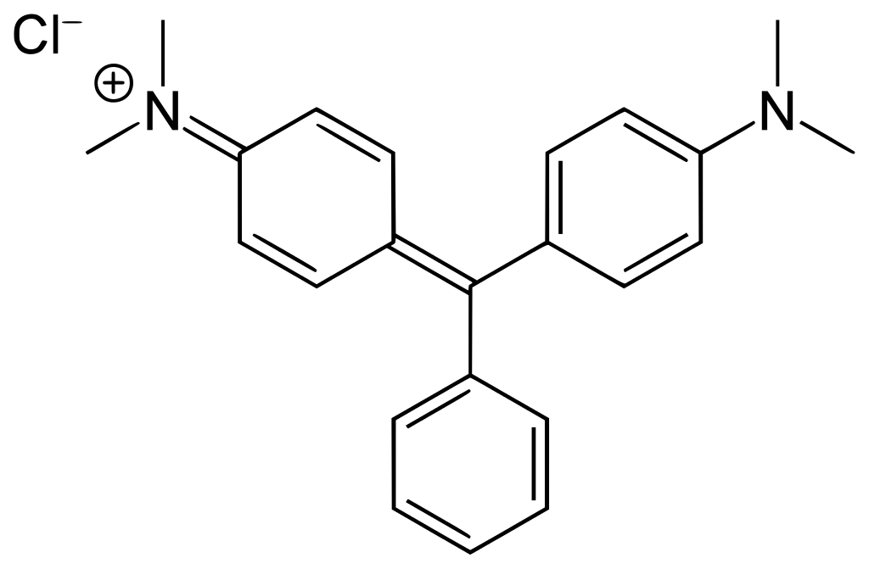
Malachite green is traditionally used as a dye for materials such as silk, leather, and paper. Used as a green-coloured dye, as a counter-stain in histology, and for its anti-fungal properties in aquaculture. It has a role as a fluorochrome, a histological dye, an antifungal drug, a carcinogenic agent, a teratogenic agent, an environmental contaminant and an antibacterial agent.
Crystal violet or gentian violet (also known as methyl violet 10B or hexamethyl pararosaniline chloride) is a triarylmethane dye used as a histological stain and in Gram's method of classifying bacteria. Crystal violet has antibacterial, antifungal, and anthelmintic properties and was formerly important as a topical antiseptic. The medical use of the dye has been largely superseded by more modern drugs, although it is still listed by the World Health Organization.

Slide 32
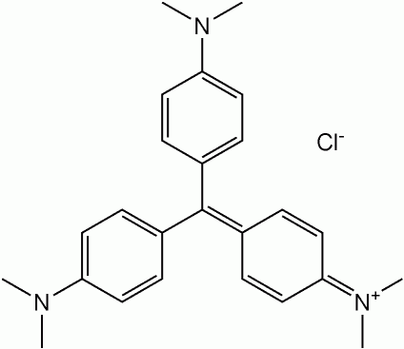
The reaction of dimethylaniline with phosgene to give 4,4′-bis(dimethylamino)benzophenone (Michler's ketone) as an intermediate. This was then reacted with additional dimethylaniline in the presence of phosphorus oxychloride and hydrochloric acid. The dye can also be prepared by the condensation of formaldehyde and dimethylaniline to give a leuco dye. This colourless compound is oxidized to the coloured cationic form.
Phenolphthalein is often used as an indicator in acid–base titrations. For this application, it turns colorless in acidic solutions and red in basic solutions.It is a weak acid, which can lose H⁺ ions in solution. The phenolphthalein molecule is colorless, and the phenolphthalein ion is red. When a base is added to the phenolphthalein, the equilibrium shifts, leading to more ionization as H⁺ ions are removed.

Slide 33
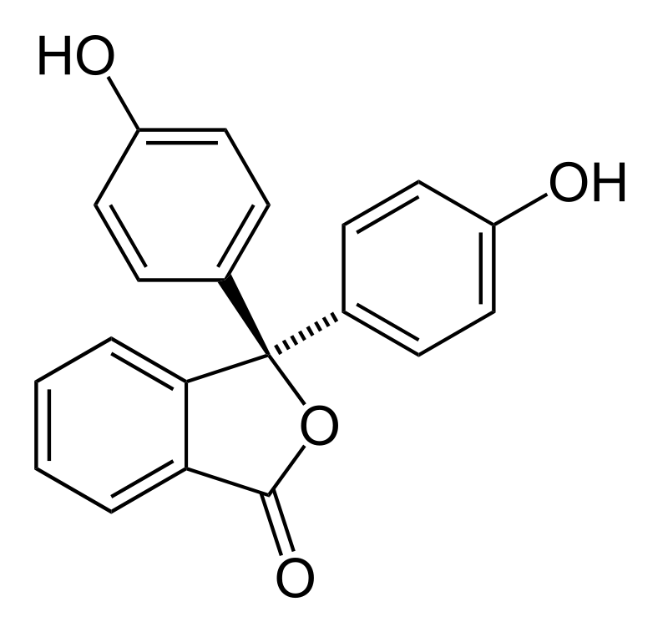
Phenolphthalein can be synthesized by condensation of phthalic anhydride with two equivalents of phenol under acidic conditions. The reaction can also be catalyzed by a mixture of zinc chloride and thionyl chloride. It also serves as a component of universal indicator, together with methyl red, bromothymol blue, and thymol blue.
Fluorescein is a manufactured organic compound and dye. It is available as a dark orange/red powder slightly soluble in water and alcohol.
Fluorescein sodium, the sodium salt of fluorescein, is used extensively as a diagnostic tool in the field of ophthalmology and optometry, where topical fluorescein is used in the diagnosis of corneal abrasions, corneal ulcers and herpetic corneal infections. It is also used in rigid gas permeable contact lens fitting to evaluate the tear layer under the lens. It is available as sterile single-use sachets containing lint-free paper applicators soaked in fluorescein sodium.

Slide 34
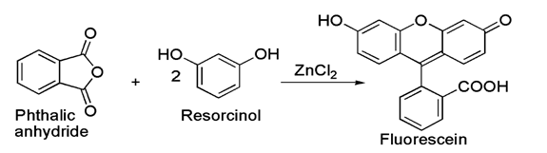
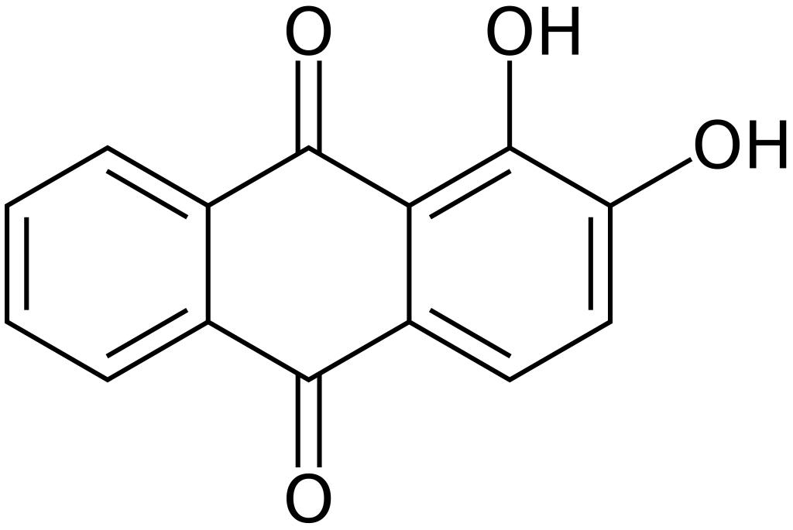
Alizarin (also known as 1,2-dihydroxyanthraquinone, Mordant Red 11) is an organic compound with formula C₁₄H₈O₄ that has been used throughout history as a prominent red dye, principally for dyeing textile fabrics. Historically it was derived from the roots of plants of the madder genus. In 1869, it became the first natural dye to be produced synthetically.

Slide 35
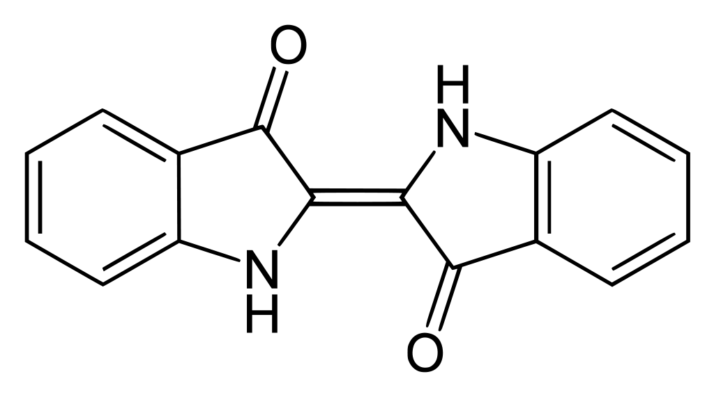
Indigo dye is an organic compound with a distinctive blue color. Historically, indigo was a natural dye extracted from the leaves of certain plants, and this process was important economically because blue dyes were once rare. A large percentage of indigo dye produced today, several thousand tonnes each year, is synthetic. It is the blue often associated with denim cloth and blue jeans. Chemical synthesis involves an aldol condensation of o-nitrobenzaldehyde with acetone, followed by cyclization and oxidative dimerization to indigo

