Slide 1
Heterocyclic compounds and
Drugs

Slide 2
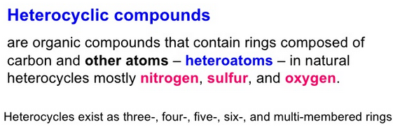
A heterocyclic compound or ring structure is a cyclic compound that has atoms of at least two different elements as members of its ring(s)

Slide 3
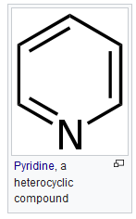
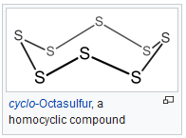
Examples of heterocyclic compounds include all of the nucleic acids, the majority of drugs, most biomass (cellulose and related materials), and many natural and synthetic dyes.

Slide 4




The most common heterocycles are those having five- or six-membered rings and containing heteroatoms of nitrogen (N), oxygen (O), or sulfur (S). The best known of the simple heterocyclic compounds are pyridine, pyrrole, furan, and thiophene.

Slide 5
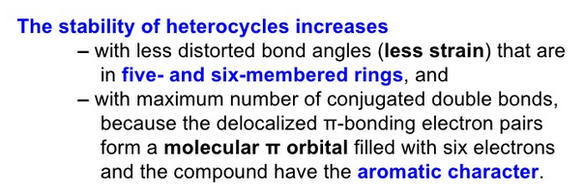
Huckel's Rule (4n+2 rule): In order to be aromatic, a molecule must have a certain number of pi electrons (electrons with pi bonds, or lone pairs within p orbitals) within a closed loop of parallel, adjacent p orbitals.
The pi electron count is defined by the series of numbers generated from 4n+2 where n = zero or any positive integer (i..e, n = 0, 1, 2, etc.).
The most common case in six pi electrons (n = 1) which is found for example in benzene, pyrrole, furan, and pyridine.

Slide 6
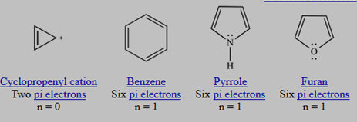
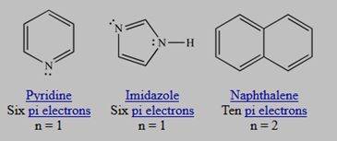
AROMATICITY examples

Slide 7
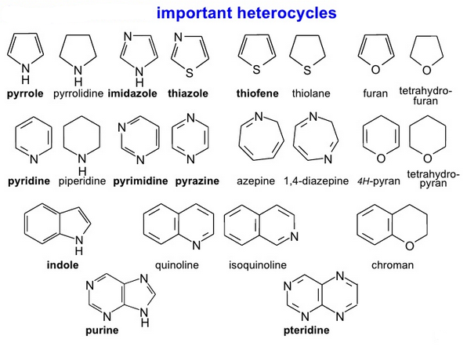

Slide 8
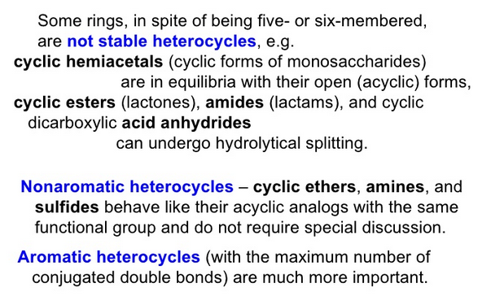

Slide 9
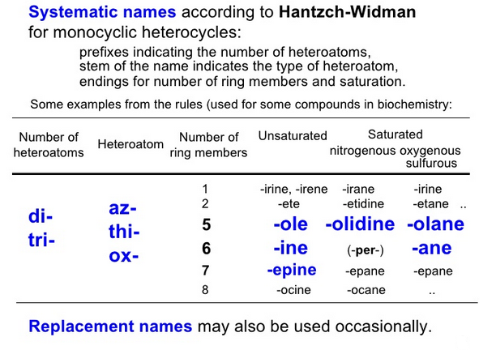
IUPAC recommends the Hantzsch-Widman nomenclature for naming heterocyclic compounds.

Slide 10
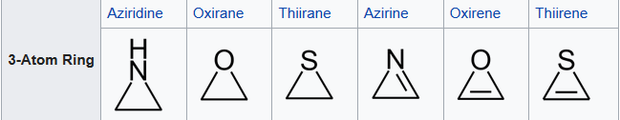
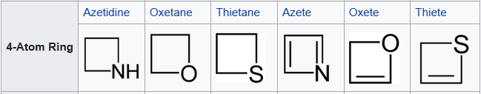
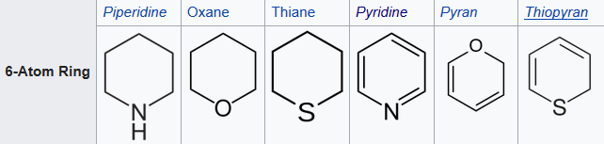
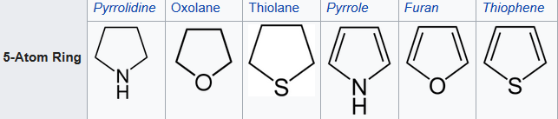
Classification
The major classes of heterocycles containing the common heteroatoms—nitrogen, oxygen, and sulfur—are reviewed in order of increasing ring size, with compounds containing other heteroatoms left to a final section.

Slide 11
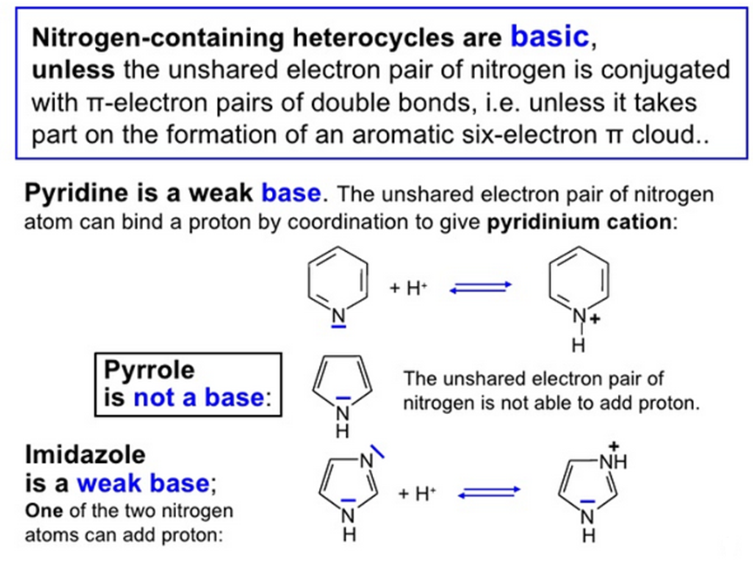

Slide 12
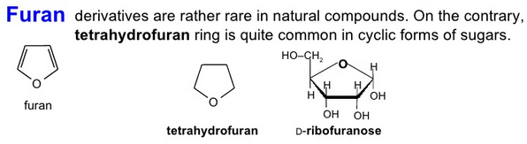
The simplest member of the furan family is furan itself, a colourless, volatile, and somewhat toxic liquid that boils at 31.36° C (88.45° F).
It is usually converted by hydrogenation to tetrahydrofuran, which is used as a solvent and for production of adipic acid and hexamethylenediamine, the raw materials for nylon-6,6.
Several other members of the furan family are produced on a large scale for use as solvents and chemical raw materials.
The aldehyde furfural, used as a solvent in petroleum refining, is manufactured from corn cobs and oat hulls by treatment with acid.

Slide 13
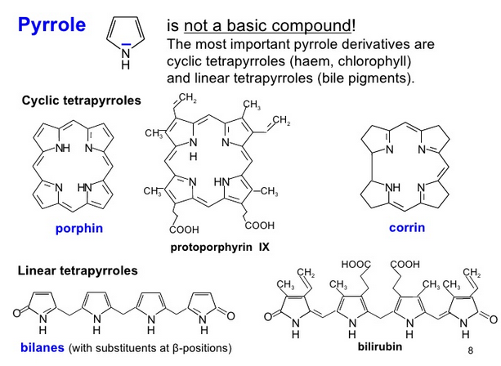

Slide 14
The simplest member of the pyrrole family is pyrrole itself, a compound with molecular formula C₄H₅N.
The pyrrole ring system is present in the amino acids proline and hydroxyproline; and in coloured natural products, such as chlorophyll, heme (a part of hemoglobin), and the bile pigments.
Pyrrole compounds also are found among the alkaloids, a large class of alkaline organic nitrogen compounds produced by plants.
In heme and chlorophyll, four pyrrole rings are joined in a larger ring system known as porphyrin.
The bile pigments are formed by decomposition of the porphyrin ring and contain a chain of four pyrrole rings.

Slide 15
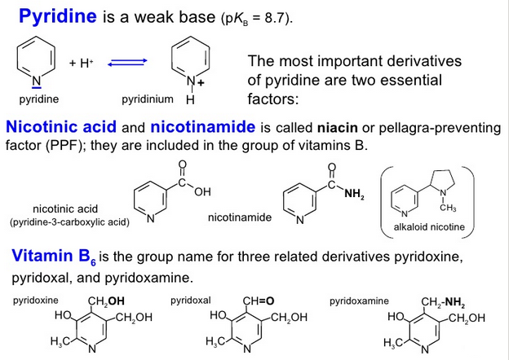

Slide 16
The simplest member of the pyridine family is pyridine itself, a compound with molecular formula C₅H₅N.
Pyridine is used as a solvent and is added to ethyl alcohol to make it unfit for drinking.
It is converted to such products as sulfapyridine, a drug active against bacterial and viral infections; pyribenzamine and pyrilamine, used as antihistaminic drugs; piperidine, used in rubber processing and as a chemical raw material; and water repellents, bactericides, and herbicides.
Compounds not made from pyridine but containing its ring structure include niacin and pyridoxal, both B vitamins; isoniazid, an antitubercular drug; and nicotine and several other nitrogenous plant products.

Slide 17
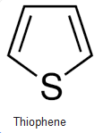
Thiophene, the simplest sulfur-containing aromatic compound, with molecular formula C₄H₄S, which closely resembles benzene in its chemical and physical properties.
It occurs with benzene in coal tar, from which source it was first isolated in 1883. Today, thiophene is prepared commercially from butane or butene and sulfur or sulfur dioxide.
Certain thiophene derivatives occur as plant pigments and other natural products. Biotin is a reduced thiophene derivative.
The antihistamine methapyrilene (Thenylene) and certain other synthetic pharmaceuticals contain the thiophene nucleus, but there are few synthetic thiophene compounds of importance.

Slide 18
Paal–Knorr synthesis
The Paal–Knorr Synthesis in organic chemistry is a reaction that generates either furans, pyrroles, or thiophenes from 1,4-diketones.
It is a synthetically valuable method for obtaining substituted furans and pyrroles, common structural components of many natural products.
It was initially reported independently by German chemists Carl Paal and Ludwig Knorr in 1884 as a method for the preparation of furans, and has been adapted for pyrroles and thiophenes.
Although the Paal–Knorr synthesis has seen widespread use, the mechanism wasn't fully understood until it was elucidated by V. Amarnath et al. in the 1990s.

Slide 19
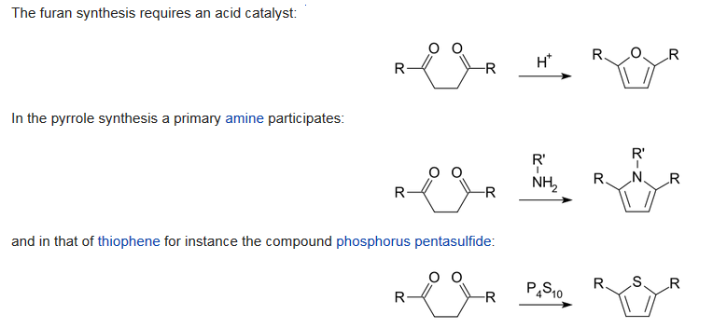

Slide 20
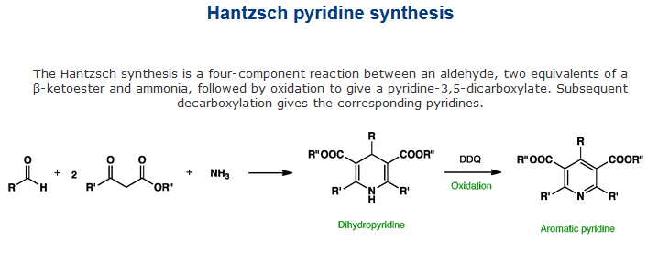
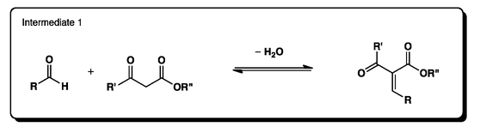
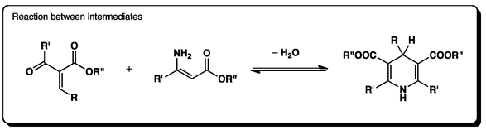
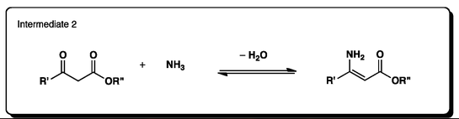
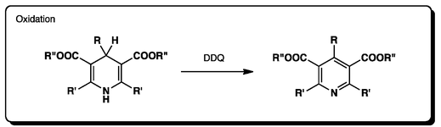

Slide 21
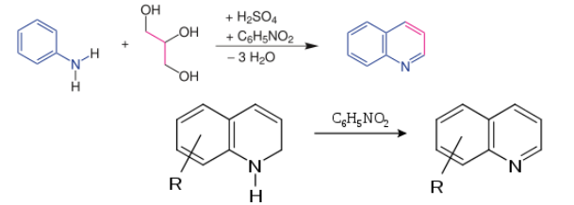
The Skraup synthesis is a chemical reaction used to synthesize quinolines. It is named after the Czech chemist Zdenko Hans Skraup (1850-1910). In the archetypal Skraup reaction, aniline is heated with sulfuric acid, glycerol, and an oxidizing agent such as nitrobenzene to yield quinoline.

Slide 22

The Bischler–Napieralski reaction is an intramolecular electrophilic aromatic substitution reaction that allows for the cyclization of β-arylethylamides or β-arylethylcarbamates.
It was first discovered in 1893 by August Bischler and Bernard Napieralski, in affiliation with Basle Chemical Works and the University of Zurich.
The reaction is most notably used in the synthesis of dihydro isoquinolines, which can be subsequently oxidized to isoquinolines.

Slide 23
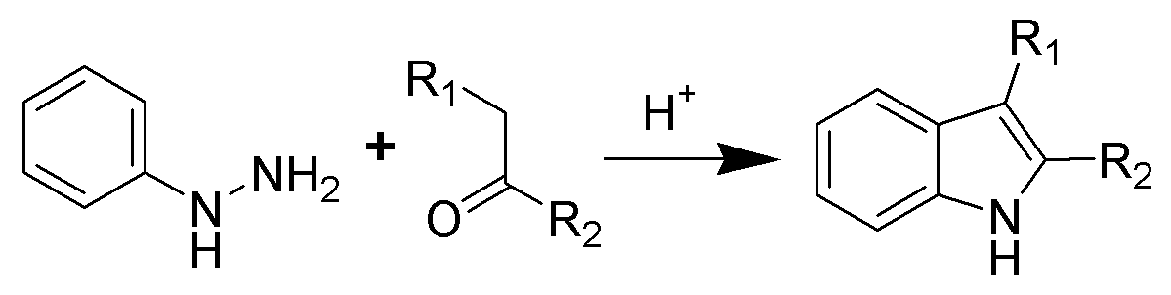
The Fischer indole synthesis is a chemical reaction that produces the aromatic heterocycle indole from a (substituted) phenylhydrazine and an aldehyde or ketone under acidic conditions.
The reaction was discovered in 1883 by Emil Fischer. Today antimigraine drugs of the triptan class are often synthesized by this method.

Slide 24
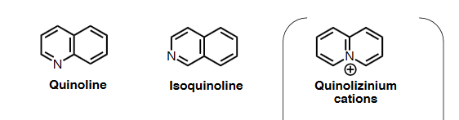
Structural elucidation of Quinoline

Slide 25
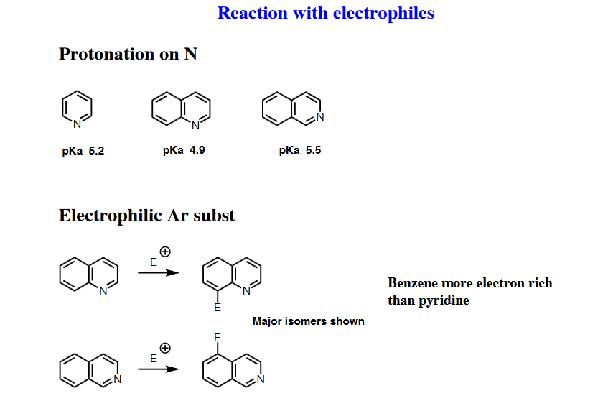

Slide 26
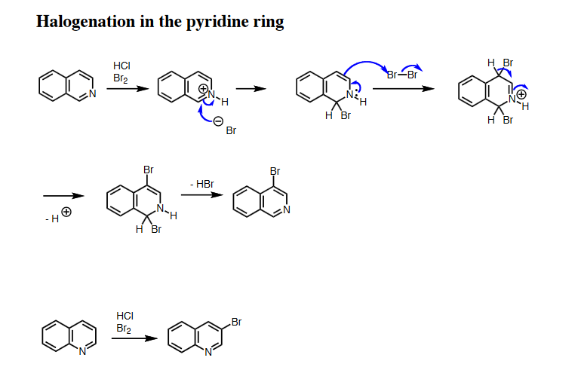

Slide 27
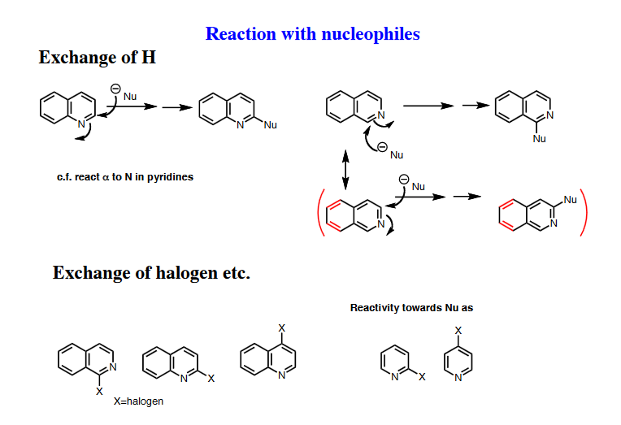

Slide 28
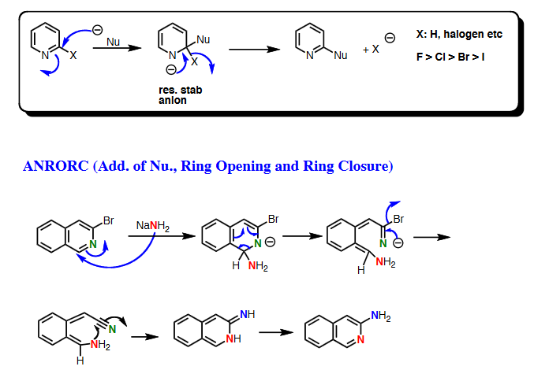

Slide 29
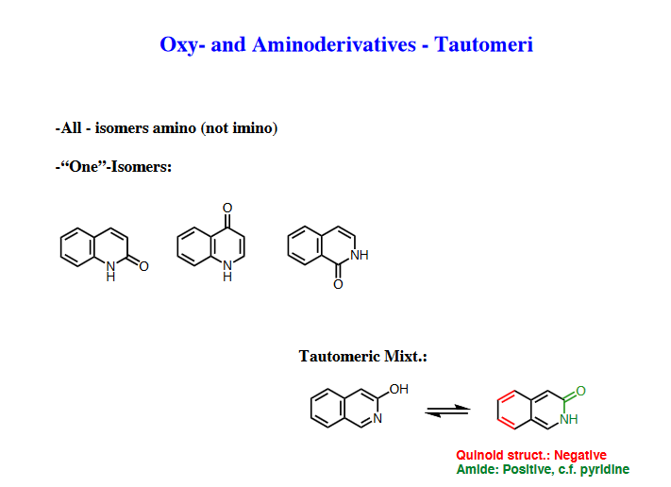

Slide 30
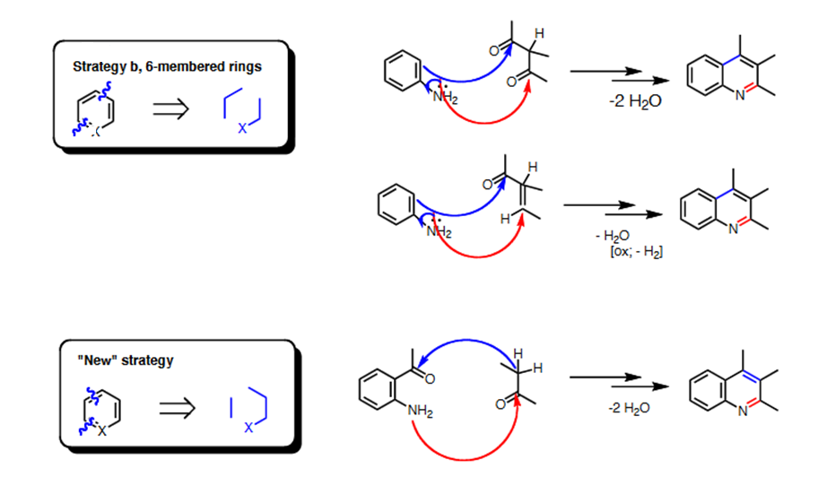

Slide 31
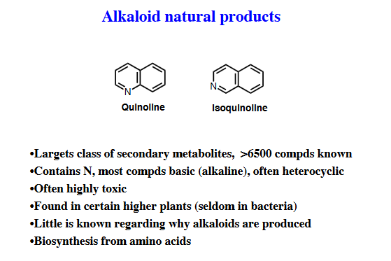

Slide 32
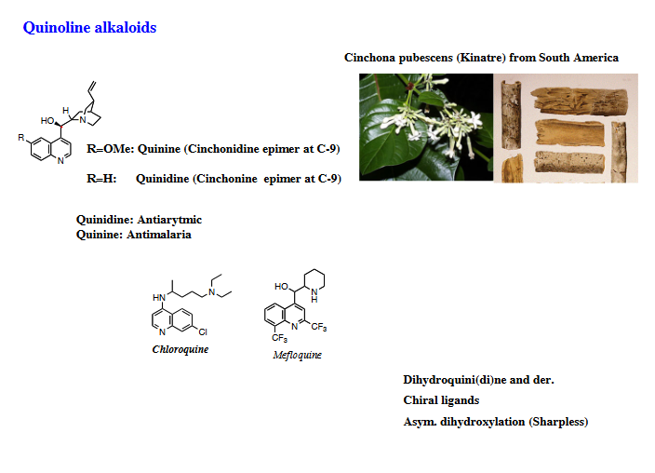

Slide 33
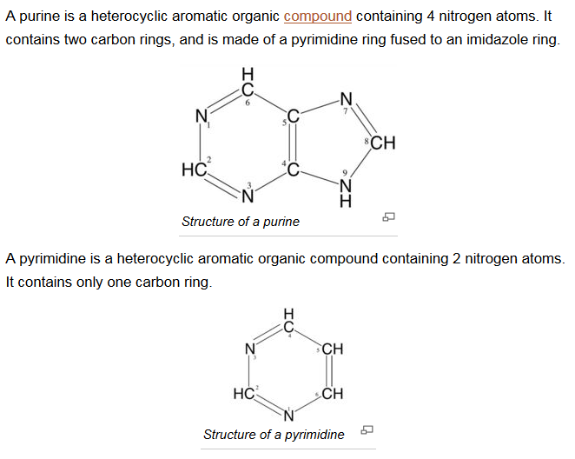

Slide 34
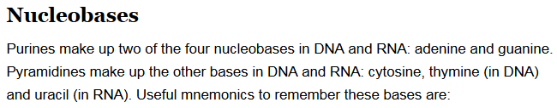
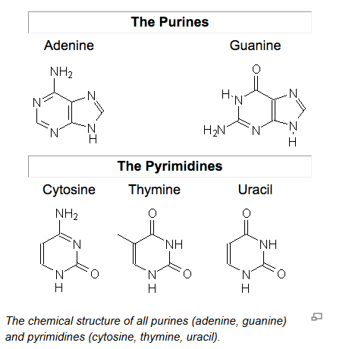

Slide 35
A drug is any substance (other than food that provides nutritional support) that, when inhaled, injected, smoked, consumed, absorbed via a patch on the skin, or dissolved under the tongue causes a physiological (and often psychological) change in the body.
Drugs may be legal (e.g. alcohol, caffeine and tobacco) or illegal (e.g. cannabis, ecstasy, cocaine and heroin).
Psychoactive drugs affect the central nervous system and alter a person's mood, thinking and behaviour.
Psychoactive drugs may be divided into five categories: narcotics, depressants, stimulants, hallucinogens and 'other'.

Slide 36
Depressants. Drugs that suppress or slow the activity of the brain and nerves, acting directly on the central nervous system to create a calming or sedating effect.
This category includes barbiturates (phenobarbital, thiopental, butalbital), benzodiazepines (alprazolam, diazepam, clonazepam, lorazepam, midazolam), alcohol, and gamma hydroxybutyrate (GHB).
Depressants are taken to relieve anxiety, promote sleep and manage seizure activity.
Stimulants. Drugs that accelerate the activity of the central nervous system. Stimulants can make you feel energetic, focused, and alert.
This class of drugs can also make you feel edgy, angry, or paranoid. Stimulants include drugs such as cocaine, crack cocaine, amphetamine, and methamphetamine.
According to the recent World Drug Report published by the United Nations Office on Drugs and Crime, amphetamine-derived stimulants like ecstasy and methamphetamine are the most commonly abused drugs around the world after marijuana.

Slide 37
Hallucinogens. Also known as psychedelics, these drugs act on the central nervous system to alter your perception of reality, time, and space.
Hallucinogens may cause you to hear or see things that don’t exist or imagine situations that aren’t real.
Hallucinogenic drugs include psilocybin (found in magic mushrooms), lysergic acid diethylamide (LSD), peyote, and dimethyltryptamine (DMT).
Opioids/narcotics. These are the drugs that act through the opioid receptors.
Opioids are one of the most commonly prescribed medicines worldwide and are commonly used to treat pain and cough.
These include drugs such as heroin, codeine, morphine, fentanyl, hydrocodone, oxycodone, buprenorphine, and methadone.

Slide 38
Legal Classifications of Drugs
Schedule I include the drugs that have a high potential for abuse, that have no currently accepted medical use in treatment. Drugs such as cannabis, ecstasy, GHB, heroin, LSD, mescaline, and methaqualone are included in Schedule I.
Schedule II includes drugs that have a high potential for abuse, that have currently accepted medical use in treatment. Drugs such as amphetamine, cocaine, fentanyl, hydromorphone oxycodone, and hydrocodone are included in Schedule II.
Schedule III includes drugs that have a potential for abuse less than the drugs or other substances in schedules I and IIDrugs such as anabolic steroids, buprenorphine, and ketamine are included in Schedule III.
Schedule IV includes drugs that have a low potential for abuse relative to the drugs or other substances in schedule III Drugs such as benzodiazepines, modafinil, and tramadol are included in Schedule IV.
Schedule V includes drugs that have a low potential for abuse relative to the drugs or other substances in schedule IV. Drugs such as diphenoxylate (in combination with atropine), lacosamide, and pregabalin are included in Schedule V.

Slide 39


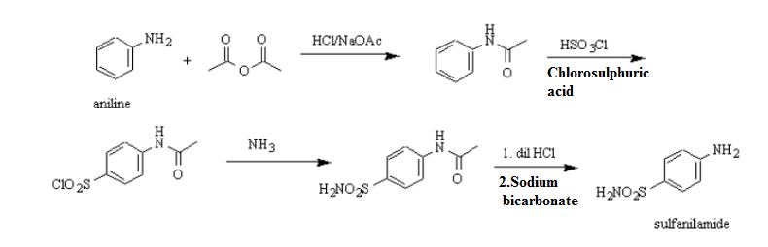
Sulfanilamide

Slide 40
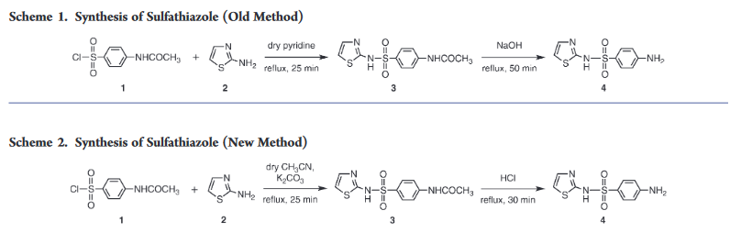
Sulfathiazole is an organosulfur compound used as a short-acting sulfa drug. Formerly, it was a common oral and topical antimicrobial, until less toxic alternatives were discovered.
With Acetonitrile and potassium carbonate)
sulfonyl chloride (1) with aminothiazole (2)
p-acetamidobenze
Sulfonamide (3)

Slide 41
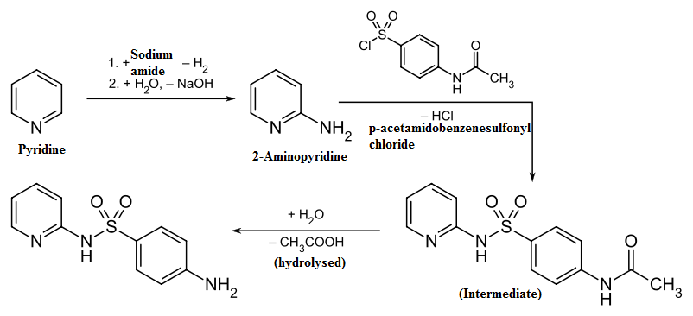
Sulfapyridine is a sulfonamide antibacterial medication. Sulfapyridine were also used as an antithyroid and antidiabetic drug. It is no longer prescribed for treatment of infections in humans but, may be used in veterinary medicine. It is a good antibacterial drug, but its water solubility is very pH dependent. Thus there is a risk of crystallization within the bladder or urethra, which could lead to pain or blockage.

Slide 42
Sulfa drug
Sulfa drug, also called sulfonamide, any member of a group of synthetic antibiotics containing the sulfanilamide molecular structure.
Sulfa drugs were the first chemical substances systematically used to treat and prevent bacterial infections in humans. Their use has diminished because of the availability of antibiotics that are more effective and safer and because of increased instances of drug resistance.
Sulfonamides are still used, but largely for treating urinary tract infections and preventing infection of burns. They are also used in the treatment of certain forms of malaria.

Slide 43
Mode of action of sulpha drugs
Sulfa drugs—the first class of antibiotics ever discovered—work at the molecular level. Sulfa antibiotics were first used in the 1930s, and they revolutionized medicine.
After a few years, bacteria started to develop resistance to the drugs, and eventually penicillin replaced them as a first-line treatment.
While antibiotic resistance remains a problem for this class of antibiotics, sulfa drugs are still commonly used to treat a variety of bacterial infections.
Sulfa drugs work by binding and inhibiting a specific enzyme called dihydropteroate synthase (DHPS). This enzyme is critical for the synthesis of folate, an essential nutrient.
Mammals get folate from their diet, but bacteria must synthesize this vitamin. Folate synthesis requires a chemical reaction between 2 molecules, DHPP and PABA, that is catalyzed by DHPS.

Slide 44
Mode of action of ampicillin:
Ampicillin is antibiotic contain the beta lactam structure, a 4-membered ring containing an amide group which reacts with the active site of enzyme transpeptidase involved in building the bacterial cell wall. So it cause the disintegration of the cell wall by preventing the cross-linking of peptidoglycan and ultimately leads to death of bacteria.
Ampicillin is in the penicillin group of beta-lactam antibiotics and is part of the aminopenicillin family. It is roughly equivalent toamoxicillin in terms of activity.
Ampicillin is able to penetrate Gram-positive and some Gram-negative bacteria. It differs from penicillin G, or benzylpenicillin, only by the presence of an amino group. That amino group helps the drug penetrate the outer membrane of Gram-negative bacteria.

Slide 45
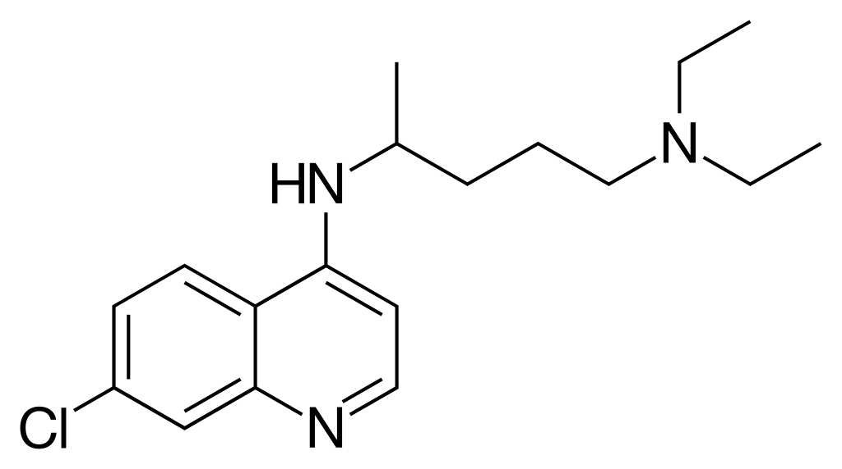
Other drugs,
Chloroquine is in a class of drugs called antimalarials and amebicides. It is used to prevent and treat malaria. It is also used to treat amebiasis.
Side effects include blurred vision, nausea, vomiting, abdominal cramps, headache, and diarrhea may occur.

Slide 46
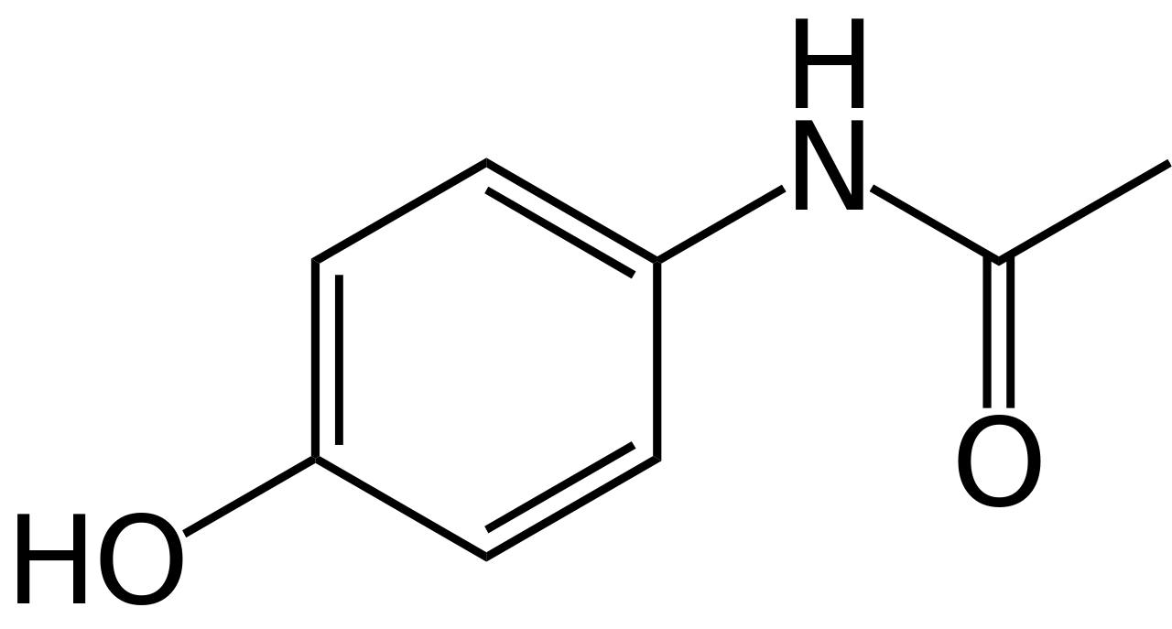
Paracetamol is a commonly used medicine that can help treat pain and reduce a high temperature (fever).
It's typically used to relieve mild or moderate pain, such as headaches, toothache or sprains, and reduce fevers caused by illnesses such as colds and flu.
Paracetamol is often recommended as one of the first treatments for pain, as it's safe for most people to take and side effects are rare.

Slide 47
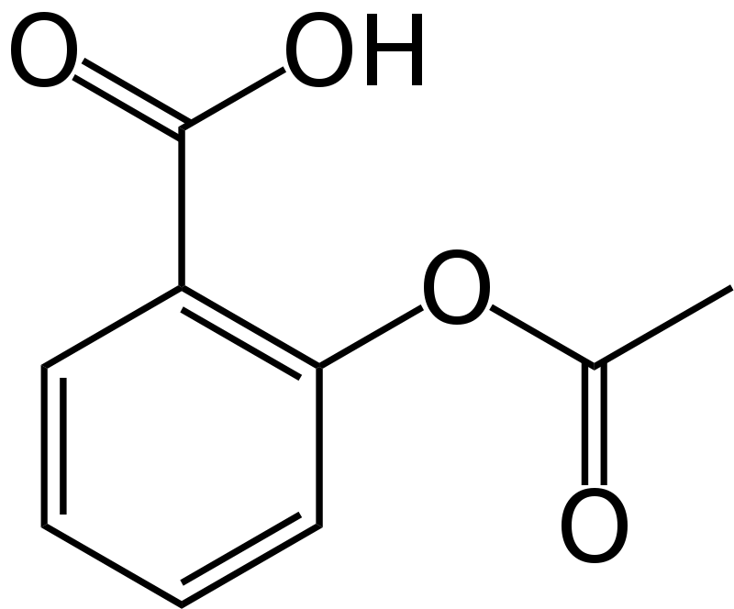
Aspirin, or acetylsalicylic acid (ASA), is commonly used as a pain reliever for minor aches and pains and to reduce fever. It is also an anti-inflammatory drug and can be used as a blood thinner. People with a high risk of blood clots, stroke, and heart attack can use aspirin long-term in low doses.
Aspirin contains salicylate, which derives from willow bark. Its use was first recorded around 400 BCE, in the time of Hippocrates, when people chewed willow bark to relieve inflammation and fever.
It is often given to patients immediately after a heart attack to prevent further clot formation and cardiac tissue death.

