Slide 1
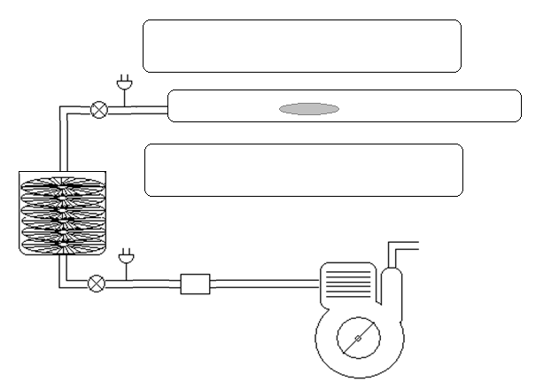
Thermal Decomposition Apparatus
Sample in Ta foil
Furnace
Evacuated
Quartz Tube
Turbo Molecular
Pump
Mechanical Pump

Slide 2
Pulsed Laser Methods
Pulsed Lasers have been employed in the synthesis silver nanoparticles from silver nitrate solutions.
A disc rotates in this solution while a laser beam is pulsed onto the disc creating hot spots.
Silver nitrate is reduced, forming silver nanoparticles.
The size of the particle is controlled by the energy in the laser and the speed of the rotating disc.
Poole, C., Owens, F. Introduction to Nanotechnology. Wiley, New Jersey. 2003

Slide 3
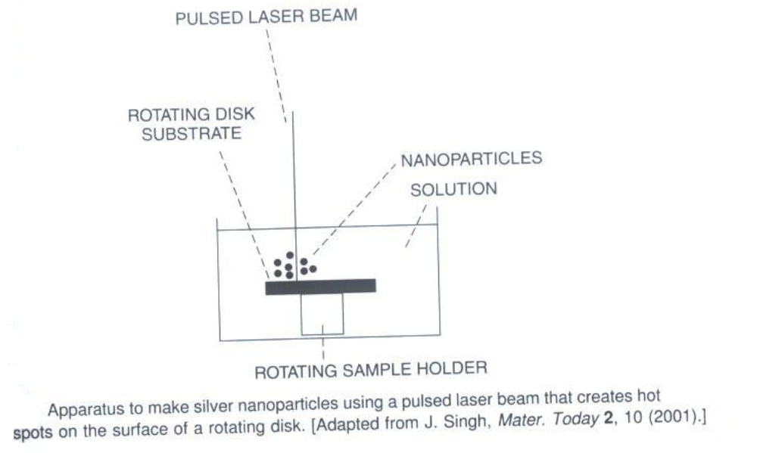
Pulsed Laser Apparatus for Ag Nanoparticles
Poole, C., Owens, F. Introduction to Nanotechnology. Wiley, New Jersey. 2003

Slide 4
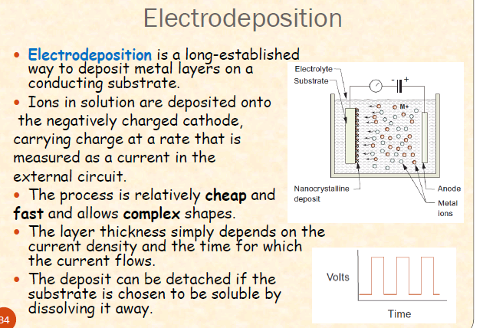

Slide 5
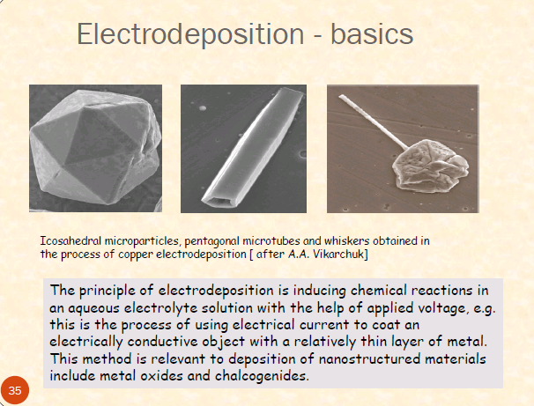

Slide 6
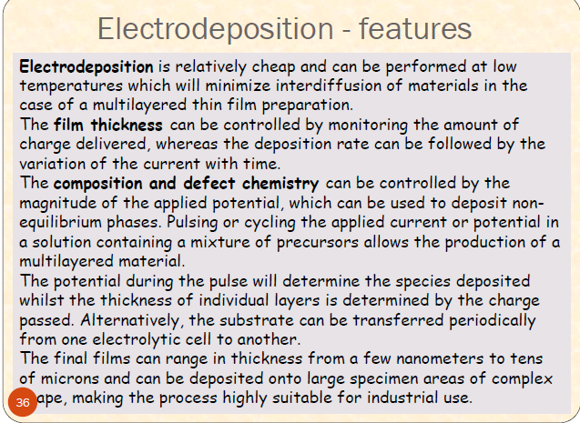

Slide 7
Attrition
Attrition is a mechanical method for creating certain types of nanoparticles.
Macro or micro scale particles are ground in a ball mill, a planetary ball mill, or other size reducing mechanism.
The resulting particles are separated by filters and recovered.
Particle sizes range from tens to hundreds of nm.
Broad size distribution and varied particle geometry.
May contain defects and impurities from the milling process.
Generally considered to be very energy intensive.
Cao, Guozhong. Nanostructures and Nanomaterials: Synthesis, Properties & Applications. Imperial College Press. 2004

Slide 8
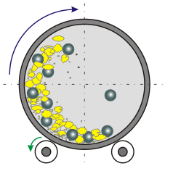
Attrition: Rotary Ball Mill
A hollow steel cylinder containing tungsten balls and a solid precursor rotates about its central axis.
Particle size is reduced by brittle fracturing resulting from ball-ball and ball-wall collisions.
Milling takes place in an inert gas atmosphere to reduce contamination.
http://www.ktf-split.hr/glossary/image/ball_mill.gif

Slide 9
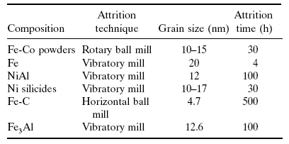
Attrition
Attrition Examples
Claudio L. De Castro, Brian S. Mitchell. Nanoparticles from Mechanical Attrition.
Department of Chemical Engineering, Tulane University, New Orleans, Louisiana, USA

Slide 10
Optical Properties: Surface Plasmon Resonance
Surface plasmon resonance is the coherent excitation of all the "free" electrons within the conduction band, leading to an in-phase oscillation.
When the size of a metal nanocrystal is smaller than the wavelength of incident radiation, a surface plasmon resonance is generated.
The figure shows schematically how a surface plasmon oscillation is created. The electric field of an incoming light induces a polarization of the free electrons relative to the cationic lattice.
The net charge difference occurs at the nanoparticle boundaries (the surface), which in turn acts as a restoring force. In this manner a dipolar oscillation of electrons is created with a certain frequency.

Slide 11
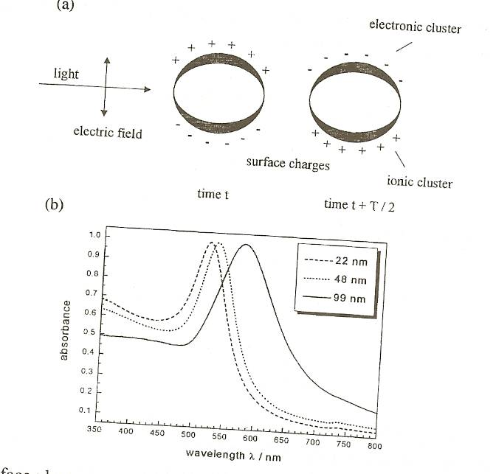
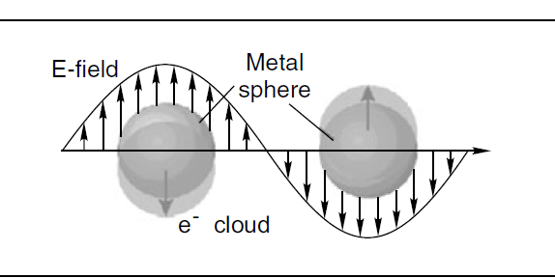

Slide 12
Surface plasmon resonance
In this manner a dipolar oscillation of electrons is created with a certain frequency. The energy of the surface plasmon resonance depends on both the free electron density and the dielectric medium surrounding the nanoparticle.
The resonance frequency increases with decreasing particle size if the size of the particles is smaller than the wavelength of the particles.
Noble metals have the reso­nance frequency in the visible light range.
Mie was the first to explain the red color of gold nanoparticle colloidal in 1908 by solving Maxwell's equation for an electromagnetic light wave interacting with small metallic spheres.

Slide 13
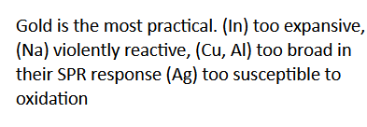

Slide 14
Surface plasmon resonance (SPR) is a powerful technique to retrieve information on optical properties of biomaterial and nanomaterials. Biosensor based on SPR is a versatiletechnique for biological analysis applications.
Essentially, SPR depends on the optical properties of metal layer [1] and enviromental changes so it is related to charge density oscillation at the interface between them [2]. Hence, biomolecular possess an extreme sensitivity to plasmon resonance and they remove the requirement for extrinsic biomolecular labeling [3].
One advantage of SPR is, the light beam never passes through the dielectric medium of interest and hence the effect of absorption of the light in the analyte can be ignored. Hence, the main potential of surface plasmon resonance is characterization of medium after the metal layer.

Slide 15
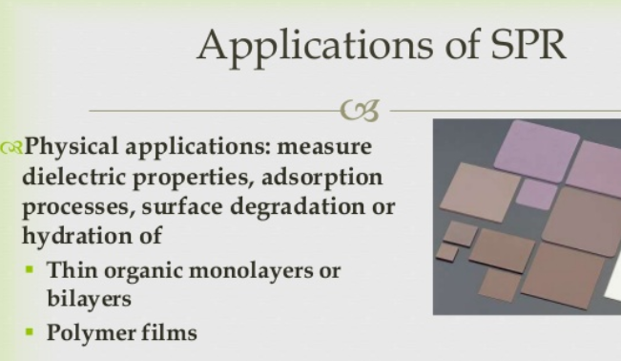

Slide 16
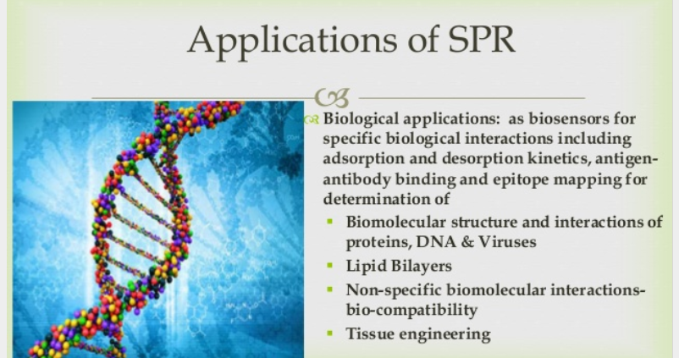

Slide 17
Applications of SPR
See Pradeep page 267

Slide 18
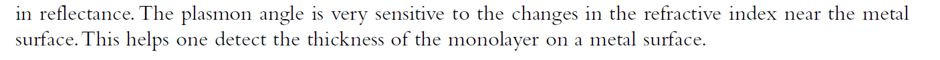
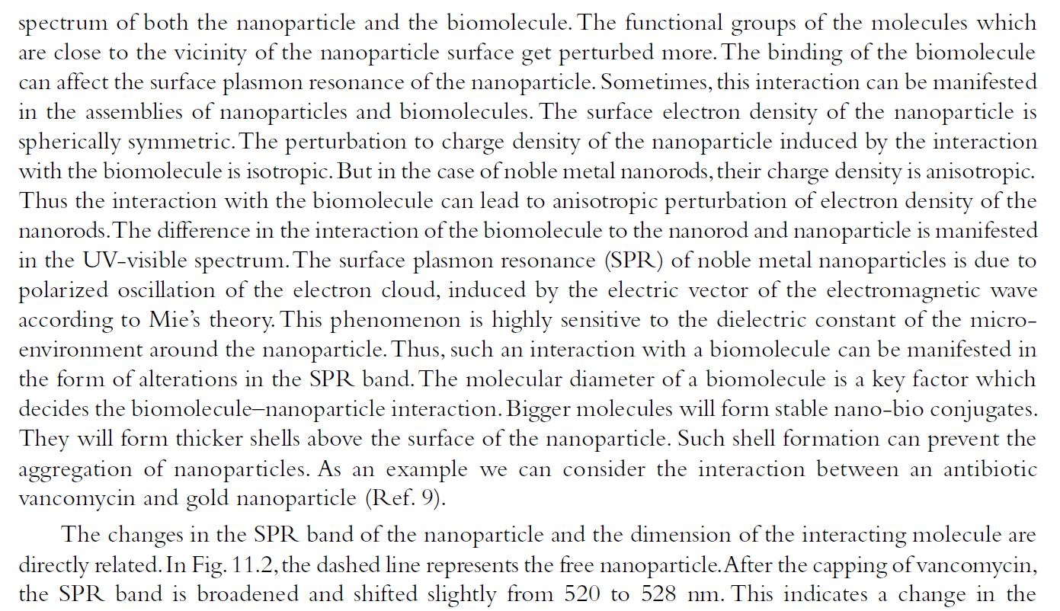
Biosensor

Slide 19
Catalysis
High surface area
High density of atoms on surface
Core-shell particles
NPs supported on oxides of high surface area/ dendrimers
Fuel cell, catalytic converters and photocatalysis
Exhaust catalyst-Pd
Chemical industry
Cu is a nanocatalyst in the production of H2 from HCHO

Slide 20
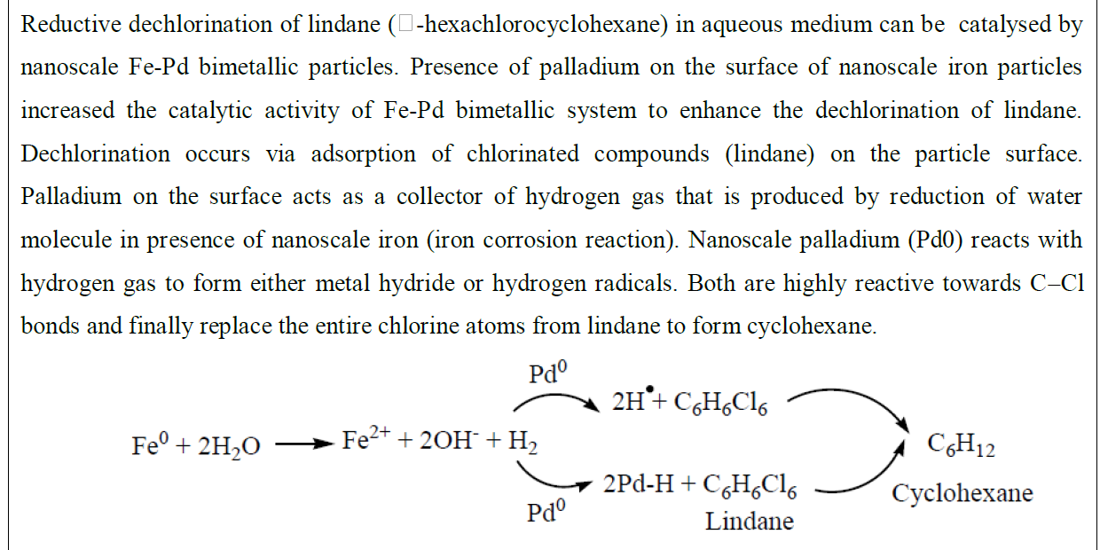

Slide 21
Nanoparticle Applications: Fe
50-100nm Iron nanoparticles are used in magnetic recording devices for both digital and analog data.
Decreasing the diameter to 30-40nm increases the magnetic recording capacity by 5-10 times per unit.

Slide 22
Nanoparticle Applications: Ag
Silver has excellent conductivity and has been used as an antimicrobial material for thousands of years.
Silver’s anti-microbial potential increase with increased surface area.
Applications include biocides, transparent conductive inks, and antimicrobial plastics, and bandages.

Slide 23
Nanoparticle Applications: Gold
Gold nanoparticles are relatively easy to produce compared to other types of nanoparticles due to its high chemical stability.
Uses for gold nanoparticles are typically catalytic and include DNA detection and the oxidation of carbon monoxide.
Gold has superior conductivity allowing gold nanoparticles to be used in various probes, sensors, and optical applications.

Slide 24
Nanoparticle Applications: Gold
The First Response® home pregnancy test uses 1µm polystyrene sphere and 50nm gold particles coated with an antibody to human chorionic gonadotropin (hCG), a hormone produced during pregnancy.
When urine containing hCG comes in contact with the polystyrene-gold-antibody complex, the nanoparticles coagulate into red clumps. Fluids pass through a filter where the clumps are caught yielding a pink filter.
Suspended (un-coagulated) nanoparticles pass through the filter and no color change occurs.
Bangs, L. B. New Developments in Particle-based Immunoassays. Pure & Appl. Chem. Vol. 68, No 10 p 1873-1879. 1996

Slide 25
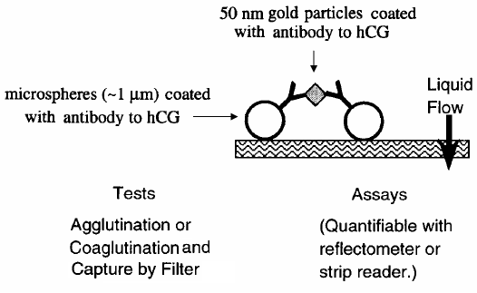
Nanoparticle Applications: Gold
Bangs, L. B. New Developments in Particle-based Immunoassays. Pure & Appl. Chem. Vol. 68, No 10 p 1873-1879. 1996

Slide 26
Thin Film Nanotechnology
A thin film is a layer of material ranging from fractions of a nanometer (monolayer) to several micrometers in thickness
Technique used is deposition
CVD
PVD

Slide 27
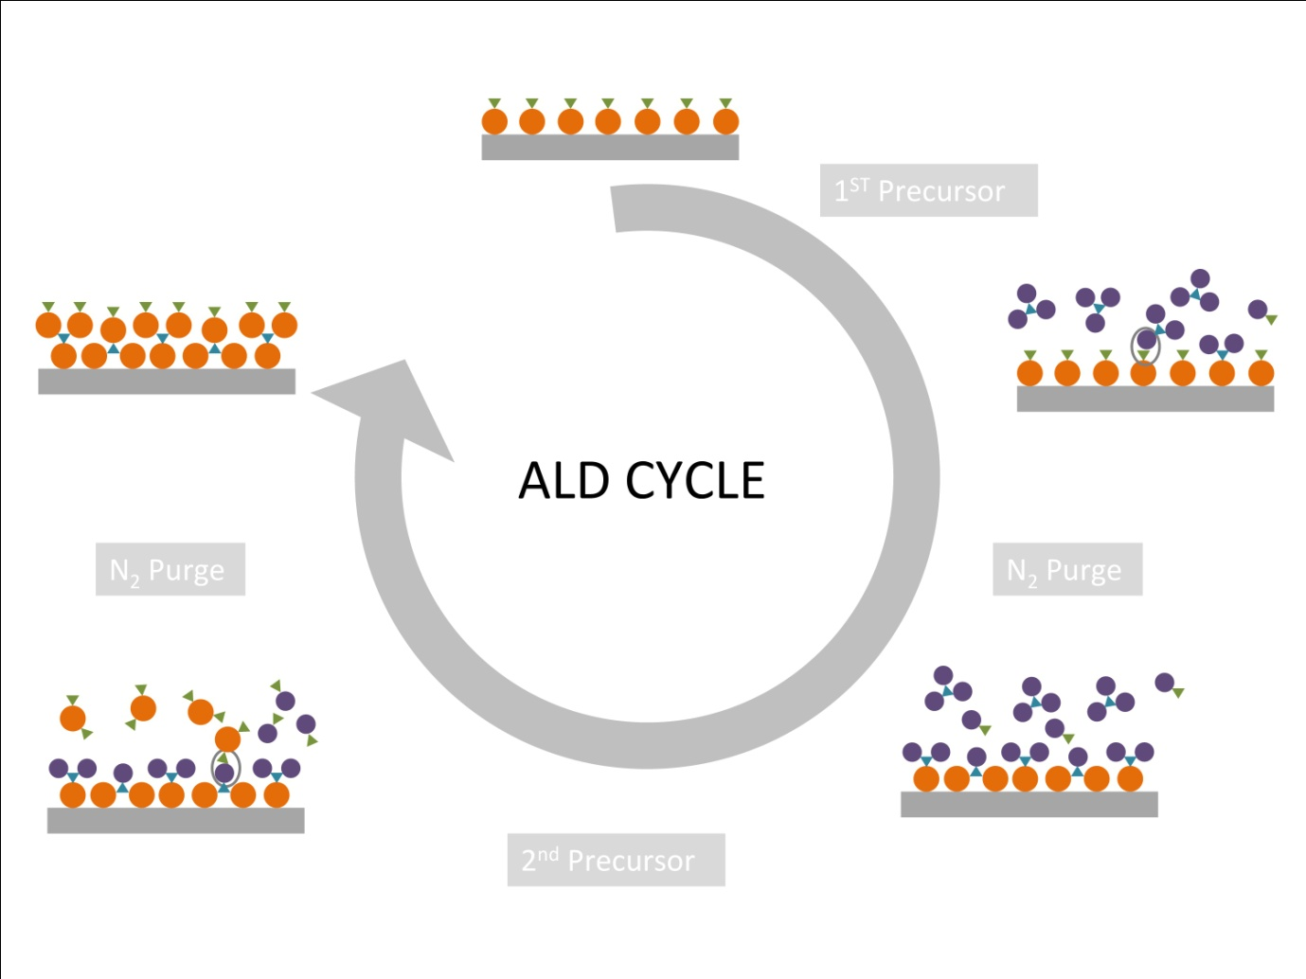

Slide 28
Atomic layer deposition (ALD) is poised to become one of the dominant technologies for the growth of nanometer-thick conformal films in microelectronics processing

Slide 29
Definition:
Chemical Vapor Deposition is the formation of a non-volatile solid film on a substrate by the reaction of vapor phase chemicals (reactants) that contain the required constituents.
The reactant gases are introduced into a reaction chamber and are decomposed and reacted at a heated surface to form the thin film.

Slide 30
Principle:
Fundamental principle is that a chemical reaction takes place between the source gases.
The product of that is a solid material that condenses on all surfaces inside the reactor
Precursor gases (often diluted in carrier gases) are delivered into the reaction chamber at approximately ambient temperatures.

Slide 31
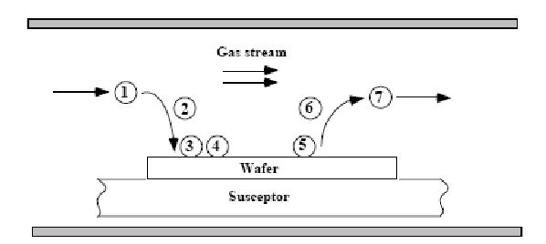
Sequential Steps:
Transport of reacting to the substrate surface
Absorption of species on the substrate surface
Heterogeneous surface reaction catalyzed by the substrate surface.
Desorption of gaseous reaction byproducts
Transportation of reaction by-products away from the substrate

Slide 32
Coating Characteristics
CVD coatings are typically:
    Fine grained
    Impervious
    High purity
CVD coatings are usually only a few microns thick and are generally deposited at fairly slow rates, usually of the order of a few hundred microns per hour.

Slide 33
CVD Apparatus
A CVD apparatus will consist of several basic components:
  Gas delivery system – For the supply of precursors to the reactor chamber
  Reactor chamber – Chamber within which deposition takes place
  Substrate loading mechanism – A system for introducing and removing substrates, mandrels etc
  Energy source – Provide the energy/heat that is required to get the precursors to react/decompose.
  Vacuum system – A system for removal of all other gaseous species other than those required for the reaction/deposition.
  Exhaust system – System for removal of volatile by-products from the reaction chamber.
  Exhaust treatment systems – In some instances, exhaust gases may not be suitable for release into the atmosphere and may require treatment or conversion to safe/harmless compounds.
  Process control equipment – Gauges, controls etc to monitor process parameters such as pressure, temperature and time. Alarms and safety devices would also be included in this category.

Slide 34
Precursors
Materials are deposited from the gaseous state during CVD. Thus precursors for CVD processes must be volatile, but at the same time stable enough to be able to be delivered to the reactor.
Typical Precursor Materials: Halides - TiCl₄, TaCl₅, WF₆, etc
  Hydrides - SiH₄, GeH₄, AlH₃(NMe₃)₂, NH₃, etc
  Metal Organic Compounds –
  Metal Alkyls - AlMe₃, Ti(CH₂tBu)₄, etc
  Metal Alkoxides - Ti(OiPr)₄, etc
  Metal Carbonyls - Ni(CO)₄, etc
  Advantages - CVD films are generally quite conformal, i.e., the ability of a film to uniformly coat a topographically complex substrate. ➢ Versatile –any element or compound can be deposited. ➢ High purity can be obtained. ➢ High density – nearly 100% of theoretical value. ➢ CVD films are harder than similar materials produced using conventional ceramic fabrication processes. ➢ Material formation well below the melting point. ➢ Economical in production, since many parts can be coated at the same time.

Slide 35
Applications
CVD has applications across a wide range of industries such as:
• Coatings – Coatings for a variety of applications such as wear resistance, corrosion resistance, high temperature protection, erosion protection and combinations thereof.
• Semiconductors and related devices – Integrated circuits, sensors and optoelectronic devices
• Dense structural parts – CVD can be used to produce components that are difficult or uneconomical to produce using conventional fabrication techniques. Dense parts produced via CVD are generally thin walled and maybe deposited onto a mandrel or former.
• Optical Fibres – For telecommunications.
• Powder production – Production of novel powders and fibres
• Catalysts
•

Slide 36
PHYSICAL VAPOR DEPOSITION
PVD is a process by which a thin film of material is deposited on a substrate acc to following steps:
The material to be deposited is converted into vapour by physical means
The vapor is transported across a region of low pressure from its source to the substrate
Vapor undergoes condensation on the substrate to form the thin film
Evaporation
Sputtering

Slide 37
PVD
CVD
Deposition occur by condensation.
The material that is introduced onto the substrate is introduced in solid form
Atoms are moving and depositing on the substrate
PVD coating is deposited at a relatively low temperature (around 250°C~450°C)
Deposition occur by chemical reaction.
Introduced in a gaseous form
The gaseous molecules will react with the substrate.
CVD uses high temperatures in the range of 450° C to 1050° C.

Slide 38
Cont….
PVD
CVD
5. PVD is suitable for coating tools that are used in applications that demand a tough cutting edge.
High capital cost
7. Coating thickness up to 20micrometer
5. CVD is mainly used for depositing compound protective coatings.
6. Low capital cost
7. Coating thickness 3-5 micrometer

Slide 39
SPUTTERING
Sputtering is a deposition tech consist of basic 4 steps;
Ions are generated & directed at the target material
The ion sputter atoms from the target material
The sputter atom get transported to the substrate through a region of reduced pressure
This sputter atom condense on the substrate forming a thin film

Slide 40
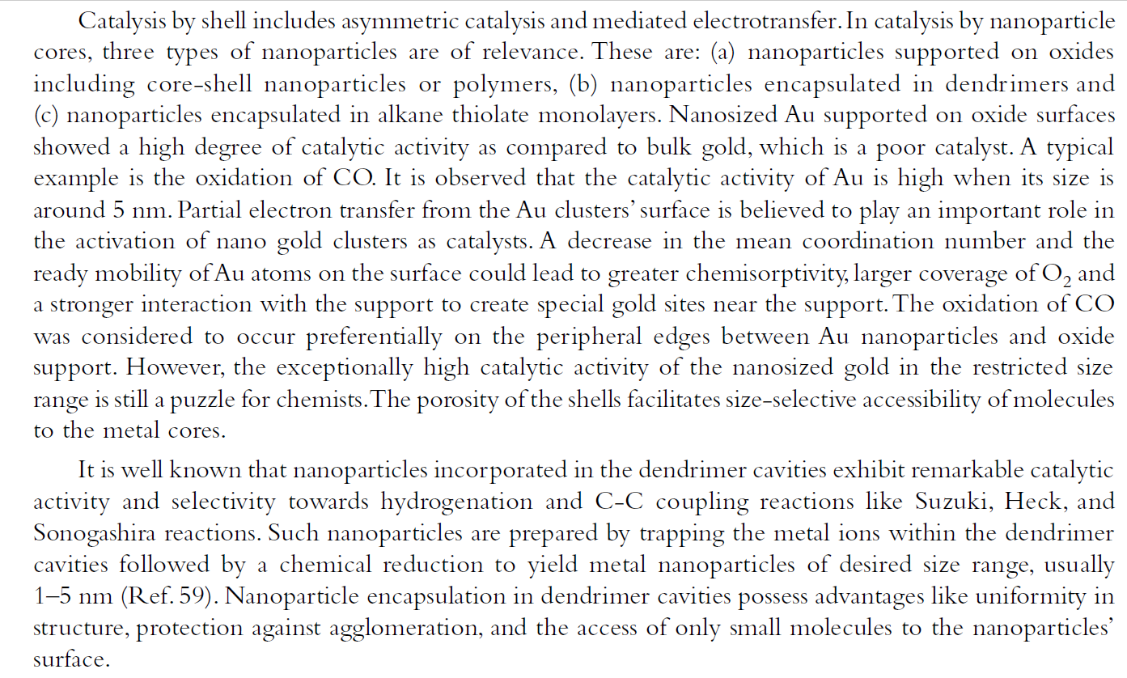
Catalysis

Slide 41
Summary
Nanotechnology is ubiquitous and pervasive. It is an emerging field in all areas of science, engineering and technology.
Welcome to NanoWorld!
Figure 1.26: Robot image.
22
Notes:
Summary:
Welcome to the NanoWorld, where nanotechnology is ubiquitous and pervasive. Nanotechnology is an emerging field in all areas of science, engineering and technology. Soon, much of the work in nanotechnology will transcend itself from research into the products and commodities we will use. Consider the fact that computers, cell phones, mp3’s and video game controllers have become exponentially smaller and more powerful over the last 10 years.
Before long, the materials developed through nanotechnology will lead to such things as better solar panels that are more efficient in transferring solar energy into electricity; stronger and lighter materials that can replace steel in construction of buildings and structures; and better tools for transporting medicine into patients and analyzing blood, cells, etc. The nanotechnology field will continue to expand and provide opportunities for all interested people regardless of their career specialty.
Fig. 1.26 - Microsoft Office Clip Art.

