Slide 1
Applications of QDs: Light Emitters
The discovery of quantum dots has led to the development of an entirely new gamut of materials for the active regions in LEDs and laser diodes.
Indirect gap semiconductors that don’t luminesce in their bulk form such as Si become efficient light emitters at the nanoscale due quantum confinement effects.
The study of QDs has advanced our understanding of the emission mechanisms in conventional LED materials such as InGaN, the active region of blue LEDs.
The high radiative-recombination efficiency of epitaxial InGaN is due to self-assembled, localized, In rich clusters that behave like QDs.

Slide 2
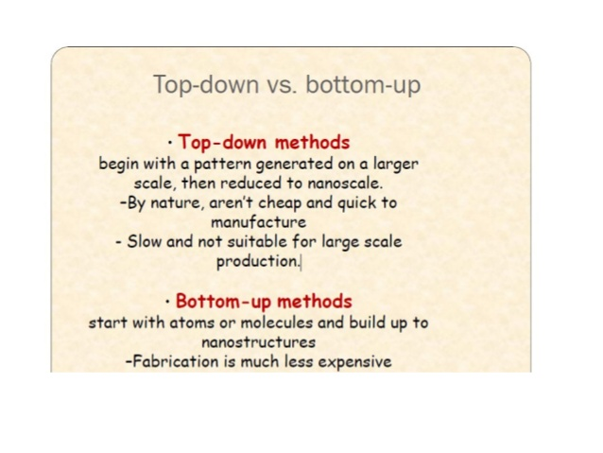

Slide 3
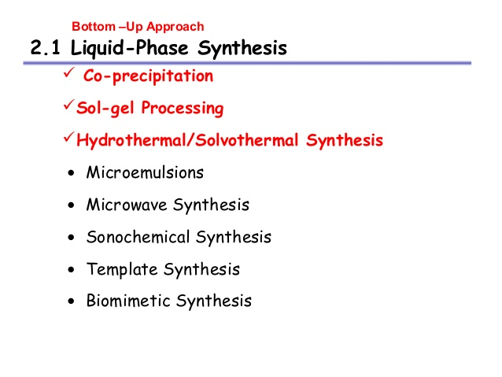

Slide 4
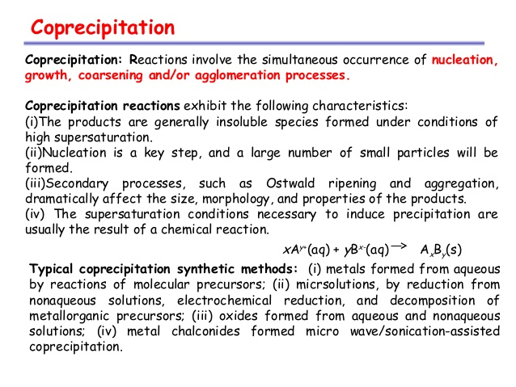

Slide 5
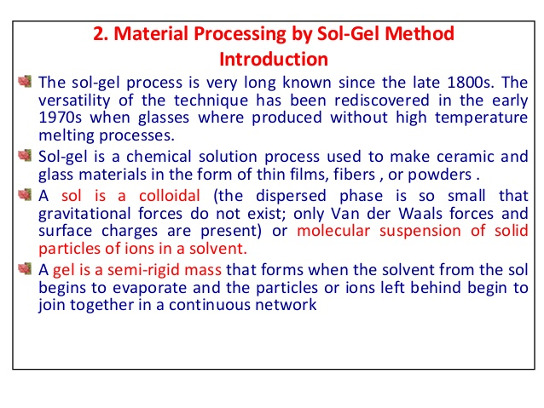

Slide 6
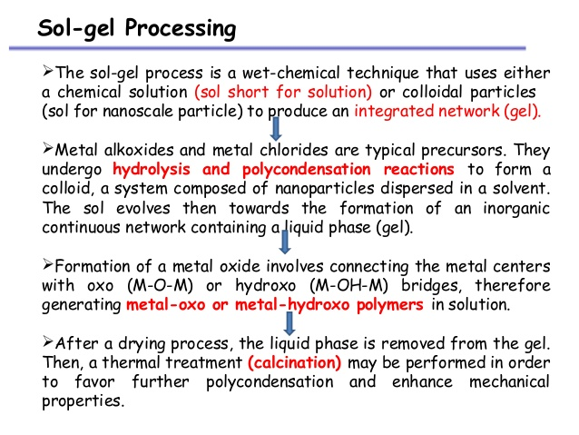

Slide 7
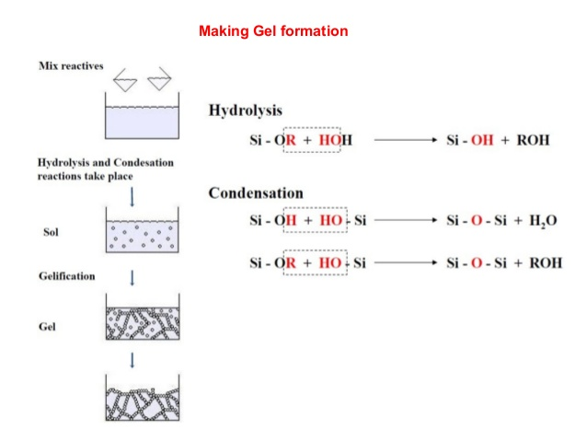

Slide 8
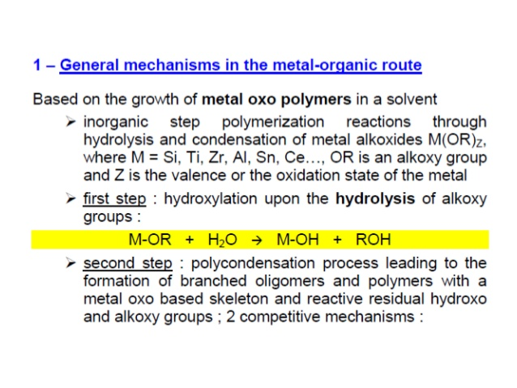

Slide 9
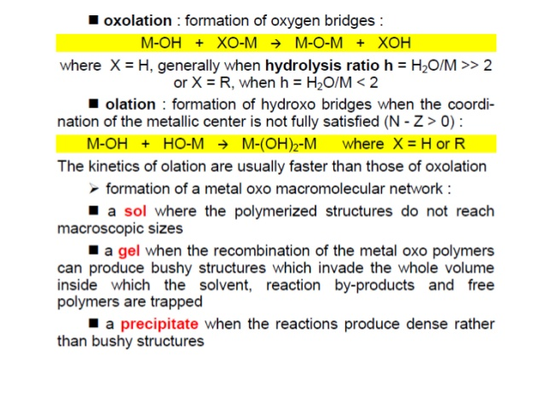

Slide 10
