Slide 1
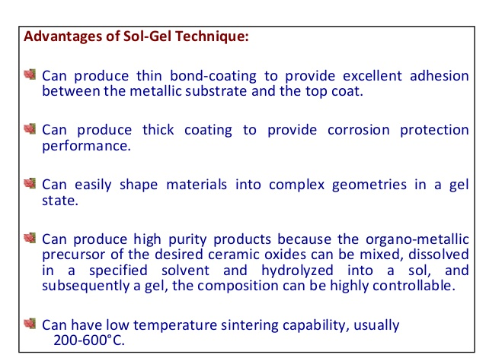

Slide 2
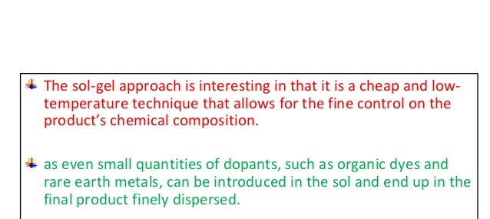

Slide 3
Colloidal Methods
Colloidal chemical methods are some of the most useful, easiest, and cheapest ways to create nanoparticles.
Colloidal methods may utilize both organic and inorganic reactants.
Typically, a metal salt is reduced leaving nanoparticles evenly dispersed in a liquid.
Aggregation is prevented by electrostatic repulsion or the introduction of a stabilizing reagent that coats the particle surfaces.
Particle sizes range from 1-200nm and are controlled by the initial concentrations of the reactants and the action of the stabilizing reagent.

Slide 4
Colloidal Methods
Examples: Gold
A common method for preparing colloidal gold nanoparticles involves combining hydrogen tetrachloroaurate (HAuCl₄) and sodium citrate (Na₃C₆H₅O₇) in a dilute solution.
Upon dissociation, the citrate ions (C₆H₅O₇³⁻) reduce Au³⁺ to yield 30-40 nm gold particles.
Half reaction equations:
Au³⁺⁽aq) + 3e⁻ → Au(s)
C₆H₅O₇³⁻(aq) +H₂O(l) → C₅H₄O₄²⁻(aq) + CO₂(g) + H₃O(aq) + 2e⁻

Slide 5
Example: Formation of Gold Nanoparticles
Sodium
Citrate
Red Color = Gold NP
HAuCl₄
HAuCl₄
Gold
NP
Heat
Heat a solution of chloroauric acid (HAuCl₄) up to reflux (boiling). HAuCl₄ is a water soluble gold salt.
Add trisodium citrate, which is a reducing agent.
Continue stirring and heating for about 10 minutes.
During this time, the sodium citrate reduces the gold salt (Au³⁺) to metallic gold (Au⁰).
The neutral gold atoms aggregate into seed crystals.
The seed crystals continue to grow and eventually form gold nanoparticles.
http://mrsec.wisc.edu/Edetc/nanolab/gold/index.html
J. Chem. Ed. 2004, 81, 544A.

Slide 6
Example: Formation of Gold Nanoparticles
Reduction of gold ions: Au(III) + 3e⁻ → Au(0)
Seed Crystal
10’s to 100’s of Atoms
Nucleation of Au(0) seed crystals:
Growth of nanoparticles:
Isotropic
Growth
Spherical
Nanoparticles
Surface capped
with citrate anions
Seed
Adding surfactant to growth solution
caps certain crystal faces and promotes
growth only in selected directions.
Anisotropic
Growth
Nanorods

Slide 7
Colloidial Methods
Examples: Molybdenum
1-5 nm molybdenum nanoparticles can be created at room temperature by reducing MoCl₃ in a toluene solution in the presence of sodium triethylborohydride (NaBEt₃H).
Reaction equation:
MoCl₃ + 3NaBEt₃H → Mo + 3NaCl + 3BEt₃ + (3/2)H₂

Slide 8
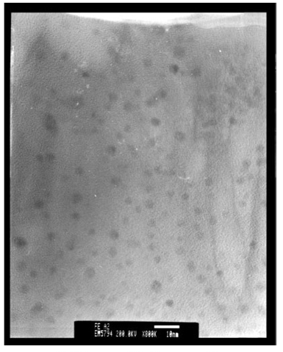
Colloidal Methods
Examples: Iron
The TEM image to the right shows 3nm Fe nanoparticles produced by reducing FeCl₂ with sodium borohydride (NaBH₄) in xylene.
Trioctylphosphine oxide (TOPO) was introduced as a capping agent to prevent oxidation and aggregation
TEM image of Fe nanoparticles
Phys. Chem. Chem. Phys., 2001, 3, 1661È1665

Slide 9
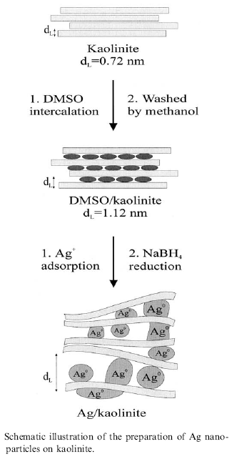
Colloidal Methods
Examples: Silver
The reduction of AgNO₃ by NaBH₄ in aqueous solution can produce small diameter (<5nm) silver nanoparticles
In one reported method, the reduction takes place between layers of kaolinite, a layered silicate clay material that functions to limit particle growth.
Dimethyl sulfoxide (DMSO) is used as a capping agent to prevent corrosion and aggregation of the Ag particles.
R. Patakfalvi et al. / Colloids and Surfaces A: Physicochem. Eng. Aspects 220 (2003) 45/54

Slide 10
Thermal Decomposition
Thermal decomposition is the chemical decomposition of a substance into ins constituents by heating.
A solid bulk material is heated beyond its decomposition temperature in an evacuated furnace tube.
The precursor material may contain metal cations and molecular anions, or metal organic solids.
Example: 2LiN₃(s)→ 2Li(s) +3N₂(g)
Lithium particles can be synthesized by heating LiN₃ in a quartz tube under vacuum.
When heated to 375ºC the nitrogen outgases from the bulk material and the Li atoms coalesce to form metal nanoparticles.
Poole, C., Owens, F. Introduction to Nanotechnology. Wiley, New Jersey. 2003

