Slide 1


Slide 2
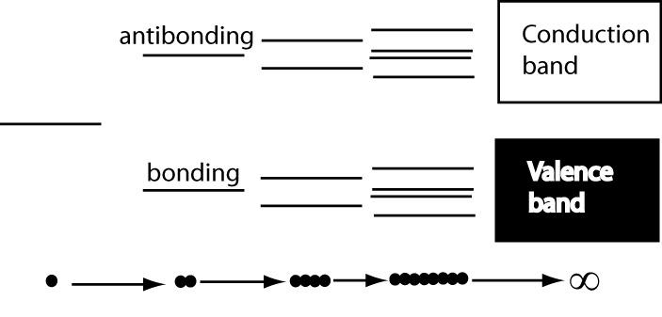
Development of electronic properties as a function of cluster size
Each band has a width that reflects the interaction between atoms, with a bandgap between the conduction and the valence bands that reflects the original separation of the bonding ad antibonding states.

Slide 3
Classification of nanoparticles
Density of states plot

Slide 4
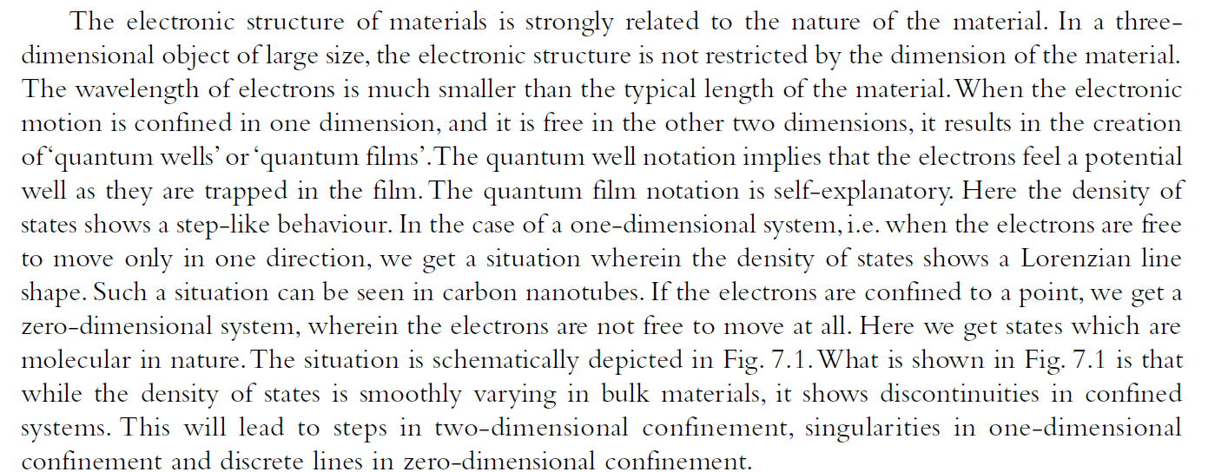
Quantum well, quantum wire
and quantum dot

Slide 5
Quantum Dot: Introduction
Quantum dots are usually regarded as semiconductors by definition.
Similar behavior is observed in some metals. Therefore, in some cases it may be acceptable to speak about metal quantum dots.
Typically, quantum dots are composed of groups II-VI, III-V, and IV-VI materials.
QDs are bandgap tunable by size which means their optical and electrical properties can be engineered to meet specific applications.

Slide 6
Quantum Confinement
Definition:
Quantum Confinement is the spatial confinement of electron-hole pairs (excitons) in one or more dimensions within a material.
1D confinement: Quantum Wells
2D confinement: Quantum Wire
3D confinement: Quantum Dot
Quantum confinement is more prominent in semiconductors because they have an energy gap in their electronic band structure.
Metals do not have a bandgap, so quantum size effects are less prevalent. Quantum confinement is only observed at dimensions below 2 nm.

Slide 7
Quantum Confinement
Recall that when atoms are brought together in a bulk material the number of energy states increases substantially to form nearly continuous bands of states.
Energy
Energy
N

Slide 8
Quantum Confinement
The reduction in the number of atoms in a material results in the confinement of normally delocalized energy states.
Electron-hole pairs become spatially confined when the diameter of a particle approaches the de Broglie wavelength of electrons in the conduction band.
As a result the energy difference between energy bands is increased with decreasing particle size.
Energy
Eg
Eg

Slide 9
Quantum Confinement
This is very similar to the famous particle-in-a-box scenario and can be understood by examining the Heisenberg Uncertainty Principle.
The Uncertainty Principle states that the more precisely one knows the position of a particle, the more uncertainty in its momentum (and vice versa).
Therefore, the more spatially confined and localized a particle becomes, the broader the range of its momentum/energy.
This is manifested as an increase in the average energy of electrons in the conduction band = increased energy level spacing = larger bandgap
The bandgap of a spherical quantum dot is increased from its bulk value by a factor of 1/R², where R is the particle radius.*
Based upon single particle solutions of the schrodinger wave equation
valid for R< the exciton bohr radius.

Slide 10
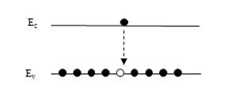
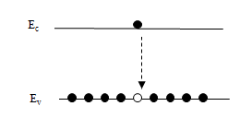
Quantum Confinement
What does this mean?
Quantum dots are bandgap tunable by size. We can engineer their optical and electrical properties.
Smaller QDs have a large bandgap.
Absorbance and luminescence spectrums are blue shifted with decreasing particle size.
Energy
555 nm
650 nm

