Slide 1
Elimination Reactions: E1cB (elimination, Pyrolytic elimination, and Chugave elimination)
By
Dr. Mahender Khatravath
Central University of South Bihar, Gaya
Reff: MODERN METHODS OF ORGANIC SYNTHESIS by William Carruthers

Slide 2
Outline of the Presentation:
E1cB Elimination
II. Pyrolytic Elimination Introduction
a) Chugave elimination of Xanthates and Thionocarbonates
b)The Cope Elimination of tert-amineoxides
c)Sulfoxides containing substrates
d) Selenoxides pyrolysis

Slide 3
E1cB Reaction
The E1cb mechanism, like the E1, involves two steps, but the order is reversed. Deprotonation, forming a carbanion intermediate, precedes expulsion of the leaving group.
E1cB stands for Elimination Unimolecular conjugate Base. The reaction is unimolecular from the conjugate base of the starting compound, which in turn is formed by deprotonation of the starting compound by a suitable base.
In this reaction base first abstracts the β hydrogen, giving rise to a carbanion or conjugate base of the substrate from which the leaving group departs subsequently to form the product.
An interesting comparison can be done with the E1 pathway. The timing of departure of the groups is reversed as compared to that in E1 reaction. In E1cB, the deprotonation occurs ahead of leaving group departure.
Reaction usually follows second order kinetics but is designated as E1cB to indicate that the departure of the leaving group is from the initially formed conjugate base (i.e., carbanion).

Slide 4
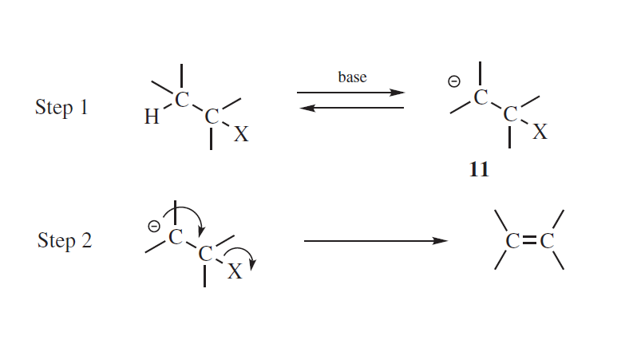
E1cB mechanism or carbanion mechanism

Slide 5
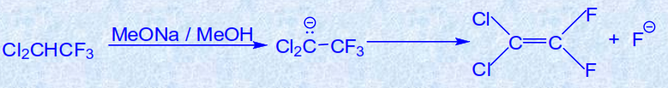
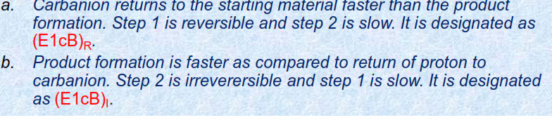
E1cb mechanisms can be subdivided into E1cb_{irr} and E1cb_{rev} , depending on whether the formation of the carbanion intermediate is or is not rate determining. If the anion is formed reversibly it may be possible to detect proton exchange with the solvent (E1cb)rev . This is not the case if formation of the carbanion is the rate-determining step E1cbirr.

Slide 6
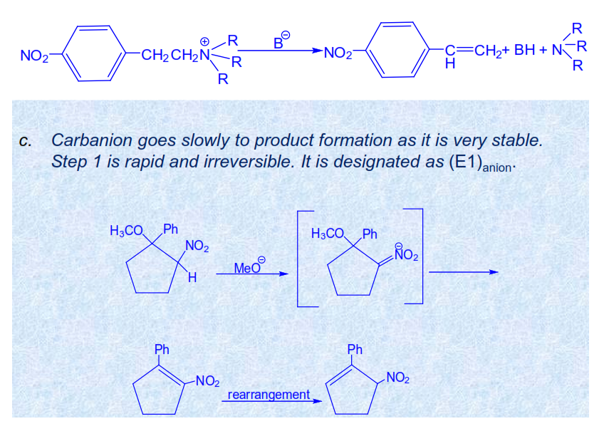

Slide 7
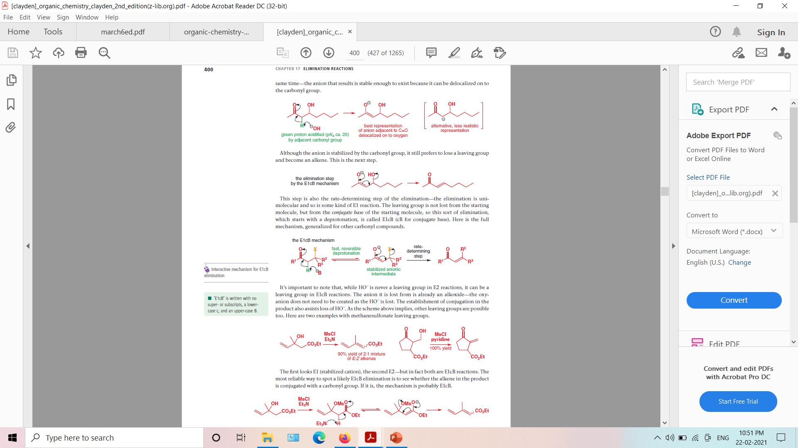

Slide 9
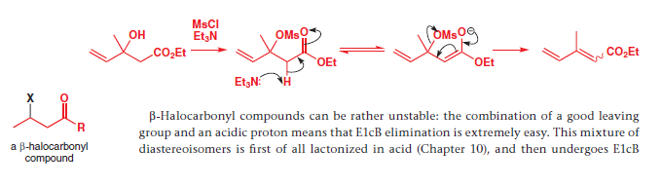

Slide 10
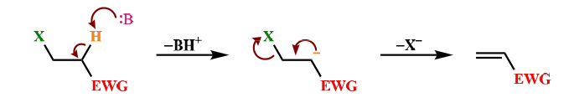
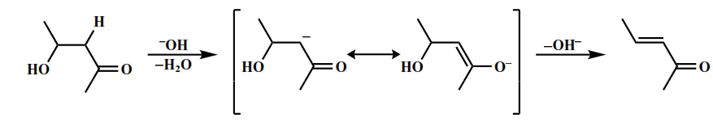
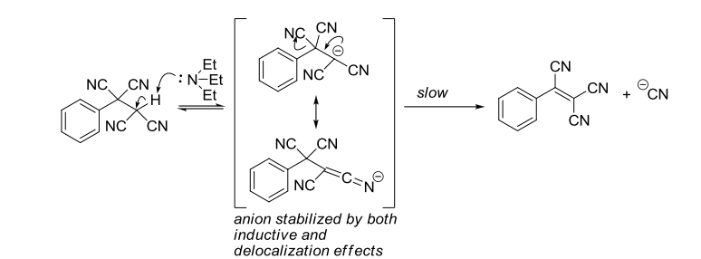
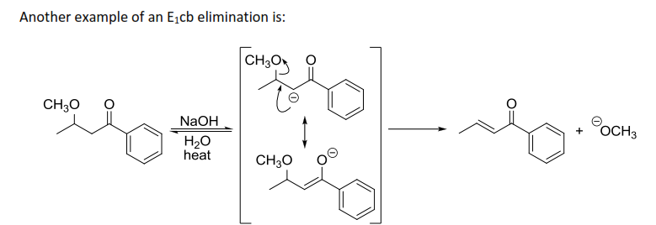
Example:2
The electron withdrawing group (EWG) can be a carbonyl group (keto, aldehyde, ester), a nitro group, an electron deficient aromatic group etc. Dehydration of aldol is the most common E1cB reaction
Example:3

Slide 11
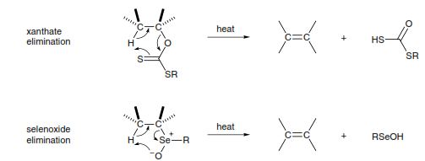
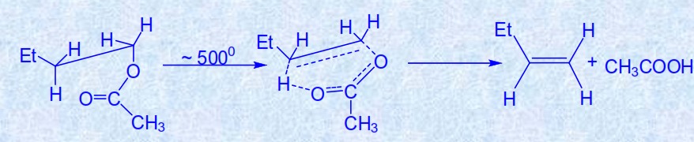
Pyrolytic elimination or syn eliminations
The term pyrolytic elimination literally means an elimination reaction occurring in the organic substrate due to the application of heat (Greek word pyr meaning fire). Pyrolytic eliminations do not require any additional reagent or solvent to occur, and mostly carried out in the gaseous phase though can be performed in inert solvents. Thus, these type of eliminations are different from other types of eliminations (E1,E2 or E1cB) as all other types of elimination reactions require an added base (external base or solvent) to proceed. These thermal elimination reactions of molecules can also be termed as pyrolytic Ei (Elimination internal) reactions.
Pyrolytic eliminations are an important group of alkene-forming reactions, by thermal decomposition.
The pyrolytic decomposition of carboxylic esters, xanthates, amine oxides, sulfoxides and selenoxides under high temperature to form carbon-carbon double are commonly known examples of pyrolytic elimination.
These reactions take place in a concerted manner, by way of a cyclic transition state (five or six membered TS) and therefore proceed with syn stereochemistry, such that the hydrogen atom and the leaving group depart from the same side of the incipient double bond.
Or Some substrates such as esters and amine oxides do not require any external agent for elimination. Simply heating such substrates provides elimination product. These reactions are known as pyrolytic Elimination.
Generalized mechanism

Slide 12
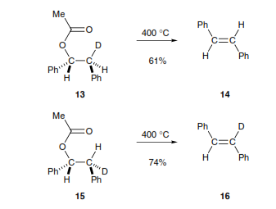
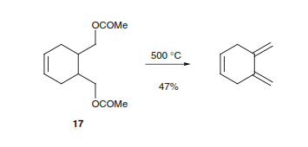
Exclusive syn elimination as demonstrated experimentally in various substrates with the use of radio-labelling techniques. For example, the pyrolysis of the erythro and threo isomers of 1-acetoxy-2-deutero-1,2-diphenylethane gave in each case trans-stilbene but, the stilbene from the erythro compound retained all the deuterium while the threo compound lost all of it. This must be due to syn elimination of hydrogen or the deuterium atom and the acetoxy group and preferred conformations (as shown) for syn elimination
Pyrolysis of esters to give an alkene and a carboxylic acid is usually effected at a temperature of about 300–500 ⁰C and may be carried out by heating the ester if its boiling point is high enough, or by passing the vapour through a heated tube

Slide 13
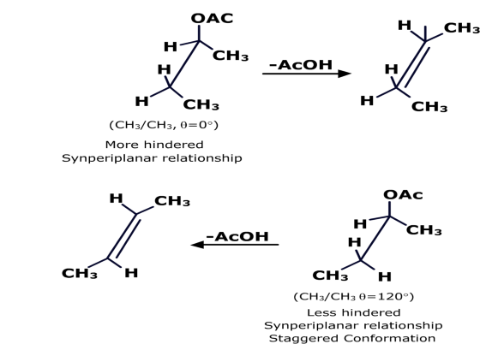
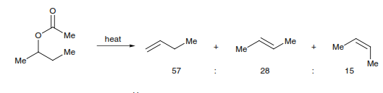
Aspects of pyrolytic eliminations in acyclic systems and cyclic systems
If two or more syn periplanar arrangements are available, the one with least crowding is preferred, as seen in the preceding discussion for 1-acetoxy-2-deutero-1,2-diphenylethane. Similarly, pyrolysis of 2-butyl acetate affords a mixture of 1-butene, cis-2-butene, and trans-2-butene, with the trans/cis ratio around 2 (since there is less steric interaction between the two methyl groups in the transition state leading to the trans-alkene).

Slide 14
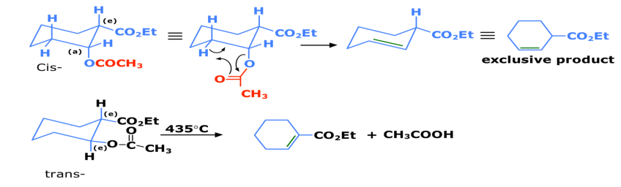
In cyclic compounds some restrictions are imposed by the conformation of the leaving groups and the necessity to form the cyclic transition state. Thus, the acetate (cis), in which the leaving group is axial, does not form a double bond in the direction of the ethoxycarbonyl group, even though it would be conjugated. In contrast, the trans-diastereomer can adopt the necessary cyclic transition state that leads to the conjugated alkene
Thus, we can generalize these observations as:
1.) When leaving group is axial, it cannot attain a cyclic transition state with a neighboring axial hydrogen.
2. When the leaving group is equatorial, it can form the cyclic transition state with either an equatorial (trans-relationship) or axial (cis-relationship) with a hydrogen atom at adjacent carbon as can be seen in the following example of methylcyclohexyl xanthate.

Slide 15
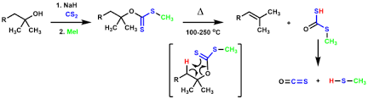
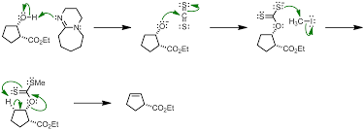
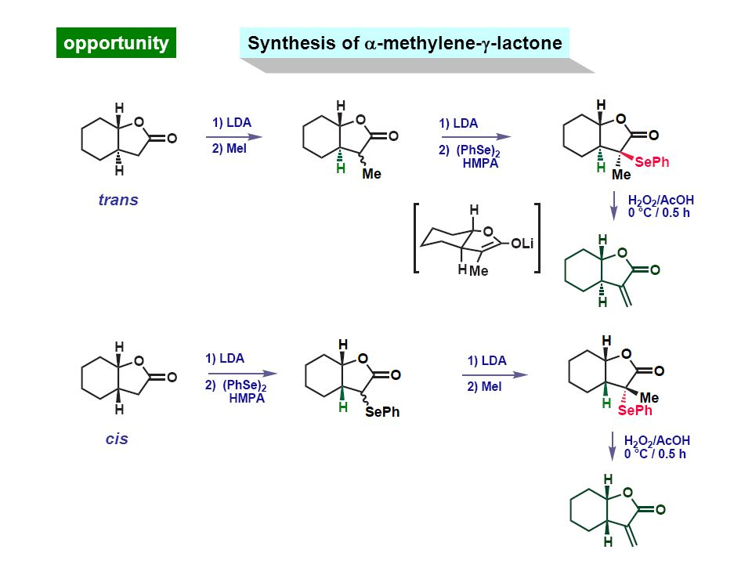
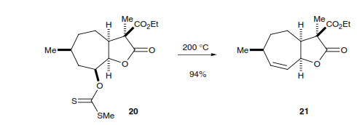
Chugave Elimination: The thermal/pyrolytic syn elimination of related thiocarbonates or xanthates to corresponding alkenes via cyclic transition state is known as Chugave elimination.
this reactions, eliminate at temperatures in the region of 150–250 ⁰C , with the result that further decomposition of the alkene product (Chugaev reaction). On the other hand, separation of the alkene from sulfur-containing by-products can sometimes be troublesome. In the same way as the corresponding acetates, the pyrolysis of xanthates promotes a syn elimination

Slide 16
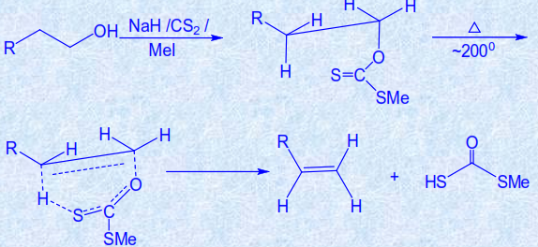
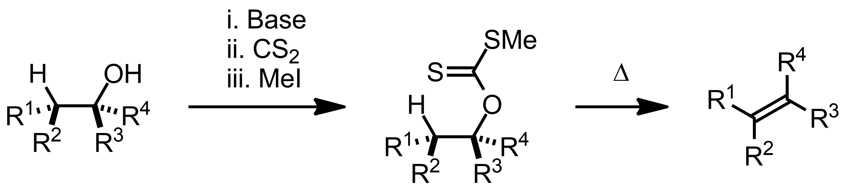
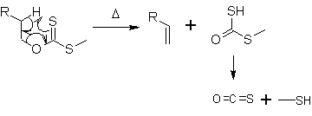
Eliminations using acyclic xanthates give predominantly the E-alkene product, although signiﬁcant amounts of the Z-isomer are also obtained and the regioselectivity is often poor.

Slide 17
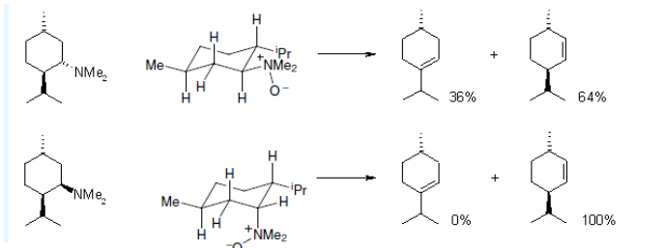
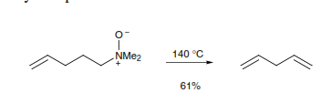
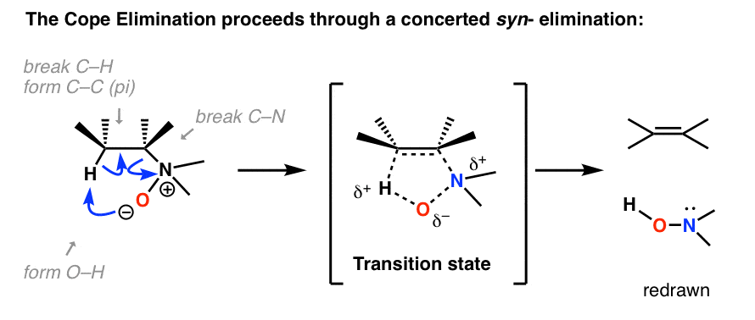
Pyrolysis of tertiary amine oxides (the Cope elimination reaction) also offers relatively mild reaction conditions (100–200 ⁰C)Oxidation of the tertiary amine to the N-oxide (e.g. with H2O2or mCPBA), followed by heating, provides an alternative to the Hofmann elimination of the quaternary ammonium salt. The mild conditions of the Cope elimination reaction allow the generation of a new carbon–carbon double bond without subsequent migration.
The stereochemistry of the product alkene for acyclic 1,2-disubstituted or trisubstituted alkenes is determined by the conﬁguration of the tertiary amine oxide. A stereospeciﬁc syn elimination pathway is followed. With cyclic substrates, the ring conformation is important, such that heating dimethylmenthylamine oxide 1 gave a mixture of 2- and 3-menthene, whereas the isomeric neomenthylamine oxide 2 gave only one product

Slide 18
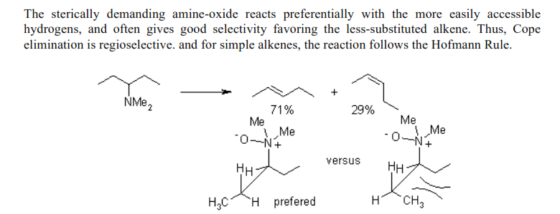

Slide 19
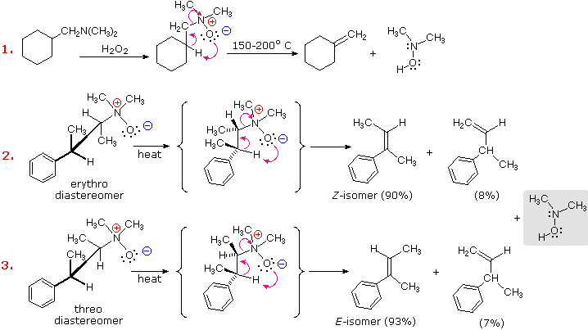

Slide 20
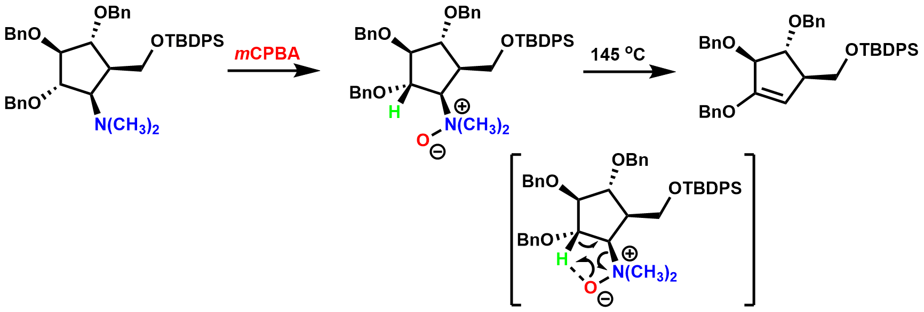

Slide 21
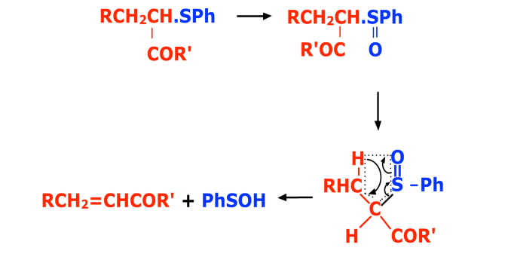
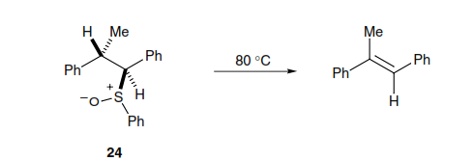
Pyrolytic elimination of sulphoxides
Sulfoxides with a -hydrogen atom readily undergo syn elimination on pyrolysis to form alkenes. These reactions take place by way of a concerted cyclic pathway and are therefore highly stereoselective. The sulfoxide anti-24, for example, gives predominantly trans-methylstilbene, whereas the corresponding syn-isomer gives mainly cis-methylstilbene. Because sulfoxides are readily obtained by oxidation of sulﬁdes, the reaction provides another useful method for making carbon–carbon double bonds.

Slide 22
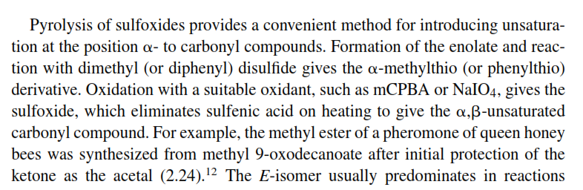
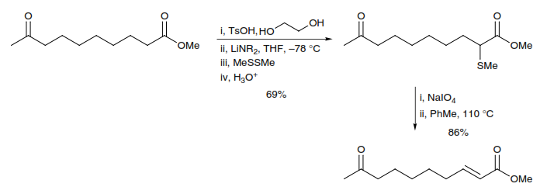

Slide 23

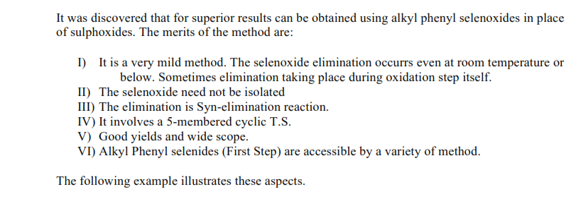
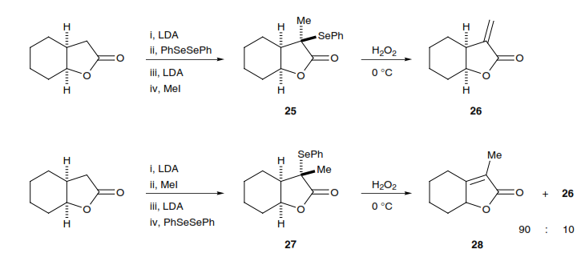
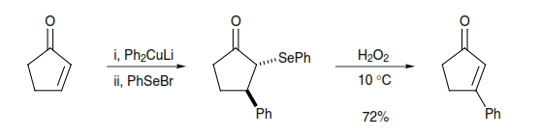

Slide 24
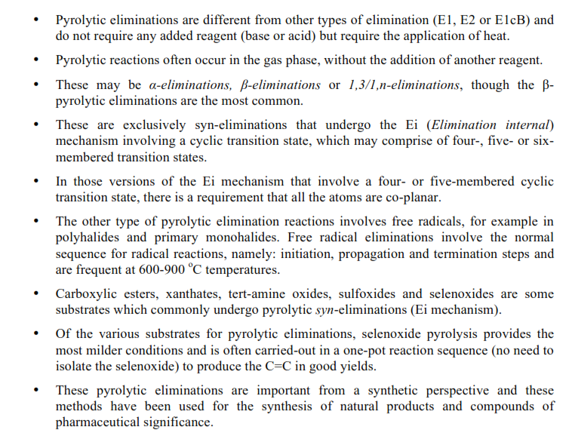
Summary

Slide 25
Thank You

