Slide 1
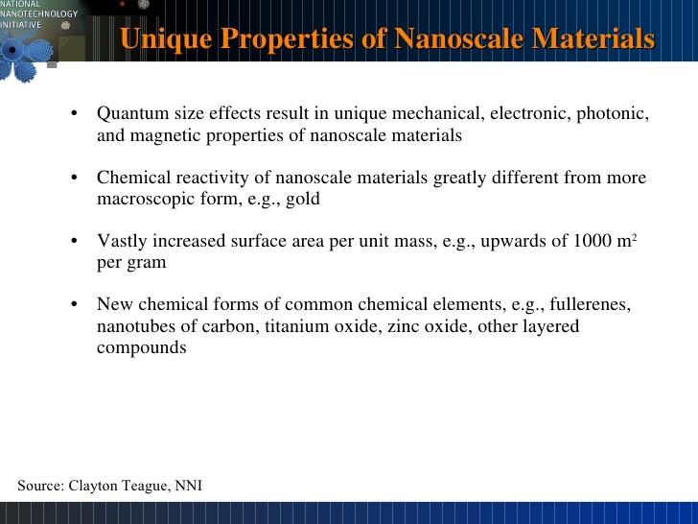

Slide 2
Classification of nanoparticles

Slide 3
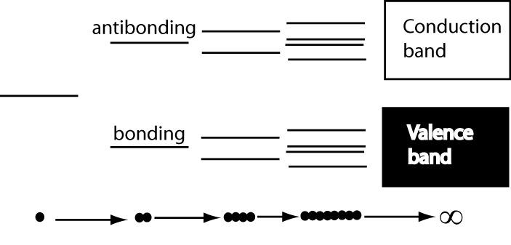
Development of electronic properties as a function of cluster size
Each band has a width that reflects the interaction between atoms, with a bandgap between the conduction and the valence bands that reflects the original separation of the bonding ad antibonding states.

Slide 4
Quantum Dot: Introduction
Quantum dots are usually regarded as semiconductors by definition.
Similar behavior is observed in some metals. Therefore, in some cases it may be acceptable to speak about metal quantum dots.
Typically, quantum dots are composed of groups II-VI, III-V, and IV-VI materials.
QDs are bandgap tunable by size which means their optical and electrical properties can be engineered to meet specific applications.

Slide 5
Quantum Confinement
Definition:
Quantum Confinement is the spatial confinement of electron-hole pairs (excitons) in one or more dimensions within a material.
1D confinement: Quantum Wells
2D confinement: Quantum Wire
3D confinement: Quantum Dot
Quantum confinement is more prominent in semiconductors because they have an energy gap in their electronic band structure.
Metals do not have a bandgap, so quantum size effects are less prevalent. Quantum confinement is only observed at dimensions below 2 nm.

Slide 6
Quantum Confinement
Recall that when atoms are brought together in a bulk material the number of energy states increases substantially to form nearly continuous bands of states.
Energy
Energy
N

Slide 7
Quantum Confinement
The reduction in the number of atoms in a material results in the confinement of normally delocalized energy states.
Electron-hole pairs become spatially confined when the diameter of a particle approaches the de Broglie wavelength of electrons in the conduction band.
As a result the energy difference between energy bands is increased with decreasing particle size.
Energy
Eg
Eg

Slide 8
Quantum Confinement
This is very similar to the famous particle-in-a-box scenario and can be understood by examining the Heisenberg Uncertainty Principle.
The Uncertainty Principle states that the more precisely one knows the position of a particle, the more uncertainty in its momentum (and vice versa).
Therefore, the more spatially confined and localized a particle becomes, the broader the range of its momentum/energy.
This is manifested as an increase in the average energy of electrons in the conduction band = increased energy level spacing = larger bandgap
The bandgap of a spherical quantum dot is increased from its bulk value by a factor of 1/R², where R is the particle radius.*
Based upon single particle solutions of the schrodinger wave equation
valid for R< the exciton bohr radius.

Slide 9
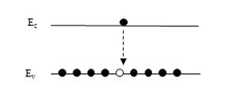
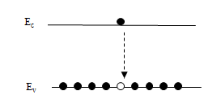
Quantum Confinement
What does this mean?
Quantum dots are bandgap tunable by size. We can engineer their optical and electrical properties.
Smaller QDs have a large bandgap.
Absorbance and luminescence spectrums are blue shifted with decreasing particle size.
Energy
555 nm
650 nm

Slide 10
Applications of QDs: Light Emitters
The discovery of quantum dots has led to the development of an entirely new gamut of materials for the active regions in LEDs and laser diodes.
Indirect gap semiconductors that don’t luminesce in their bulk form such as Si become efficient light emitters at the nanoscale due quantum confinement effects.
The study of QDs has advanced our understanding of the emission mechanisms in conventional LED materials such as InGaN, the active region of blue LEDs.
The high radiative-recombination efficiency of epitaxial InGaN is due to self-assembled, localized, In rich clusters that behave like QDs.

Slide 11
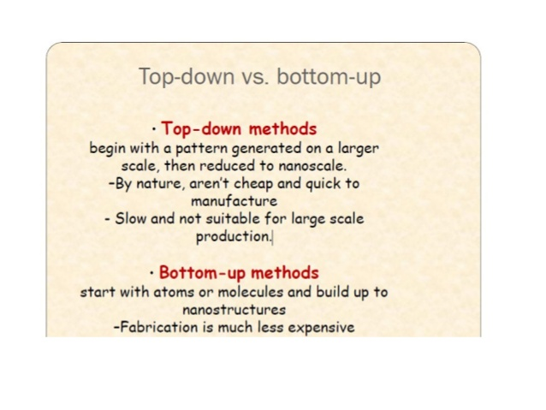

Slide 12
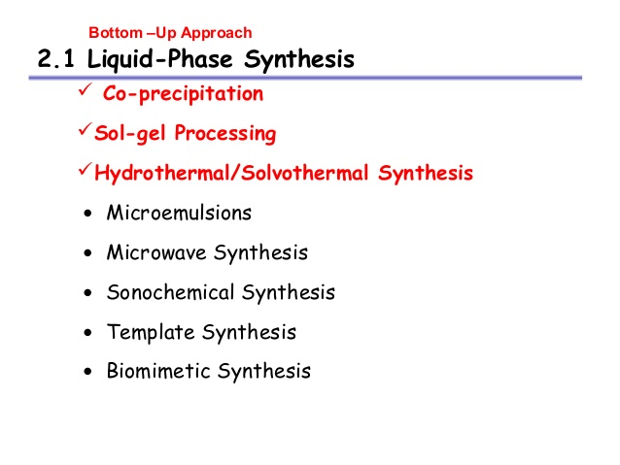

Slide 13
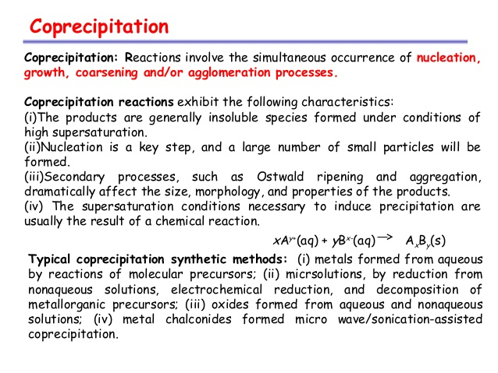

Slide 14
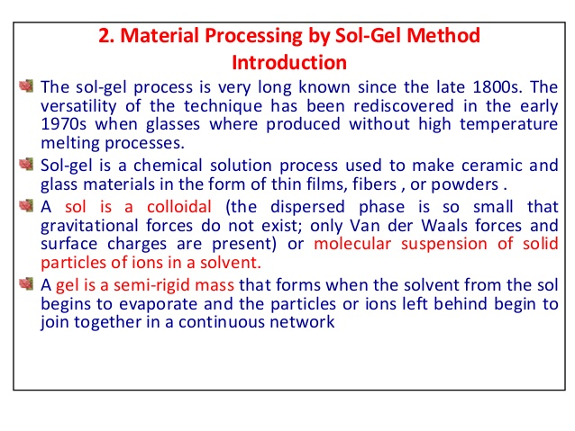

Slide 15
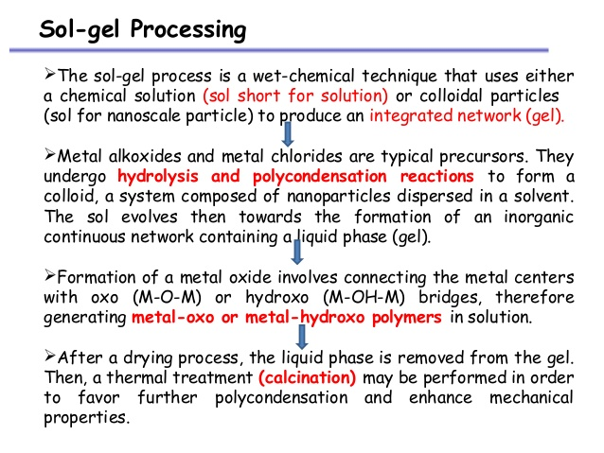

Slide 16
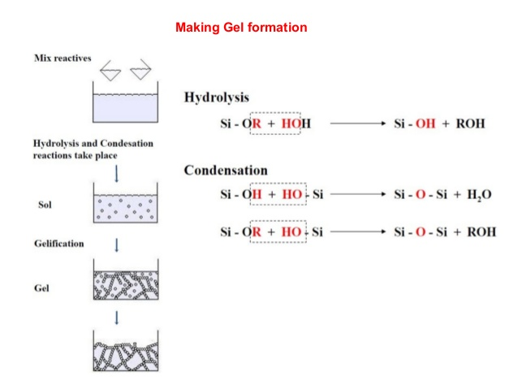

Slide 17
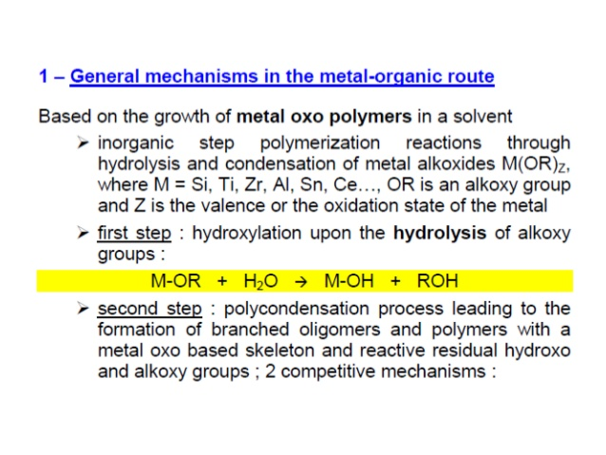

Slide 18
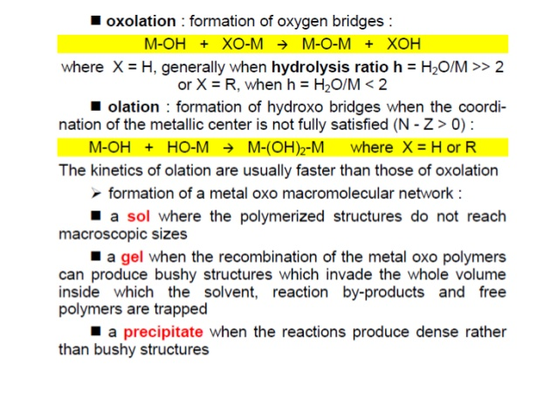

Slide 19
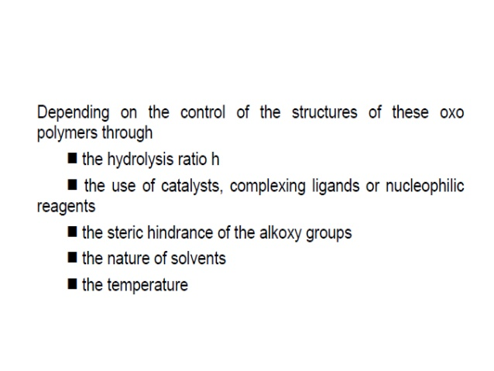

Slide 20
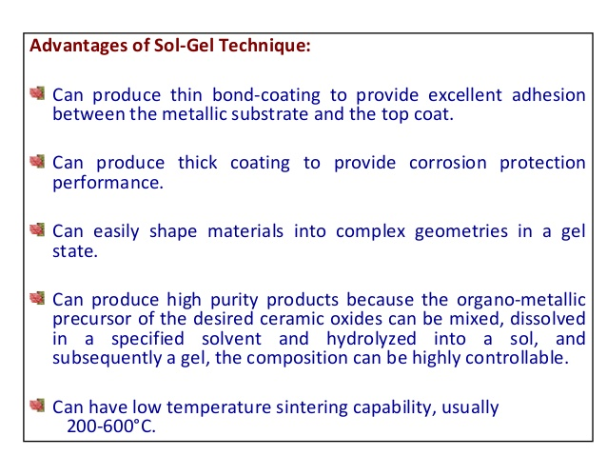

Slide 21
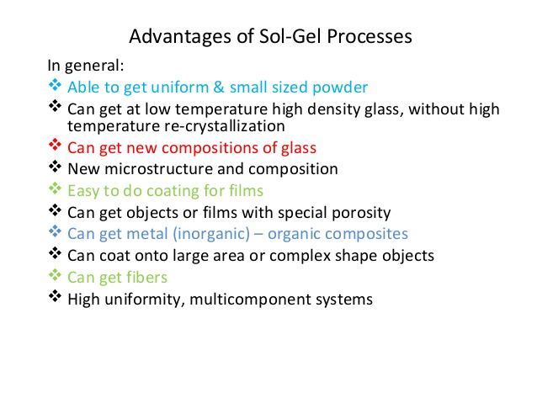

Slide 22
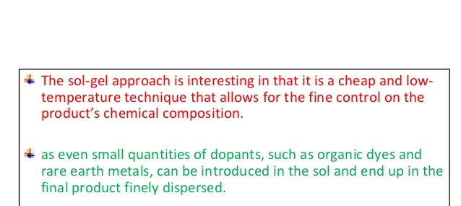

Slide 23
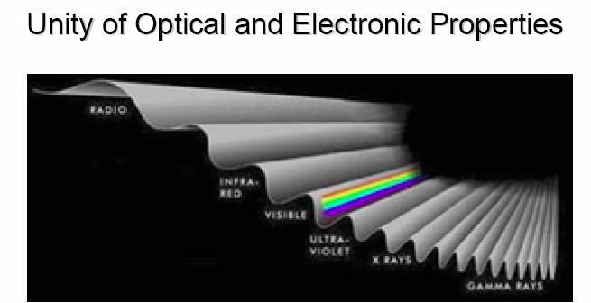
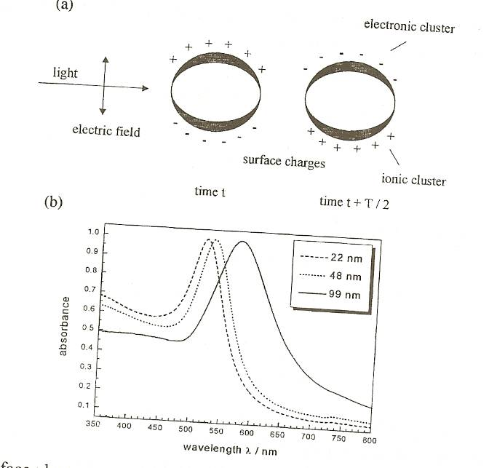
Optical Properties: Surface Plasmon Resonance
Surface plasmon resonance is the coherent excitation of all the "free" electrons within the conduction band, leading to an in-phase oscillation.
When the size of a metal nanocrystal is smaller than the wavelength of incident radiation, a surface plasmon resonance is generated.
The figure shows schematically how a surface plasmon oscillation is created. The electric field of an incoming light induces a polarization of the free electrons relative to the cationic lattice.
The net charge difference occurs at the nanoparticle boundaries (the surface), which in turn acts as a restoring force. In this manner a dipolar oscillation of electrons is created with a certain frequency.

Slide 24
Surface plasmon resonance
In this manner a dipolar oscillation of electrons is created with a certain frequency. The energy of the surface plasmon resonance depends on both the free electron density and the dielectric medium surrounding the nanoparticle.
The resonance frequency increases with decreasing particle size if the size of the particles is smaller than the wavelength of the particles.
The width of the resonance varies with the characteristic time before electron scattering. For larger nanoparticle, the resonance sharpens as the scattering length increases. Noble metals have the reso­nance frequency in the visible light range.
Mie was the first to explain the red color of gold nanoparticle colloidal in 1908 by solving Maxwell's equation for an electromagnetic light wave interacting with small metallic spheres.

Slide 25
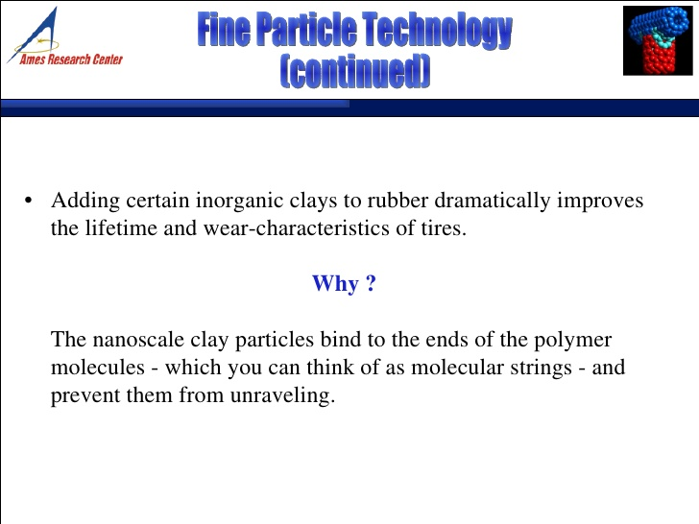

Slide 26
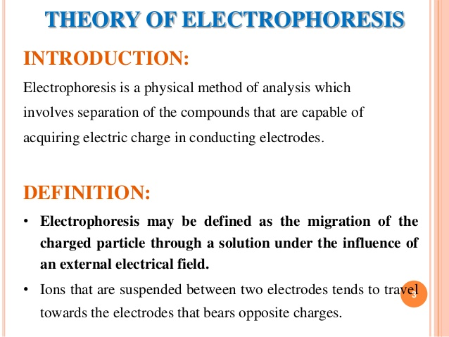

Slide 27
Electrophoresis
Those molecules with higher molecular weight move slower. While those with small weight move faster. Also the size of the molecule also influences the movement. The bigger size molecule experience more friction than smaller ones in motion. These molecules migrate at different speed and to different lengths based on their charge, mass and shape.

Slide 28
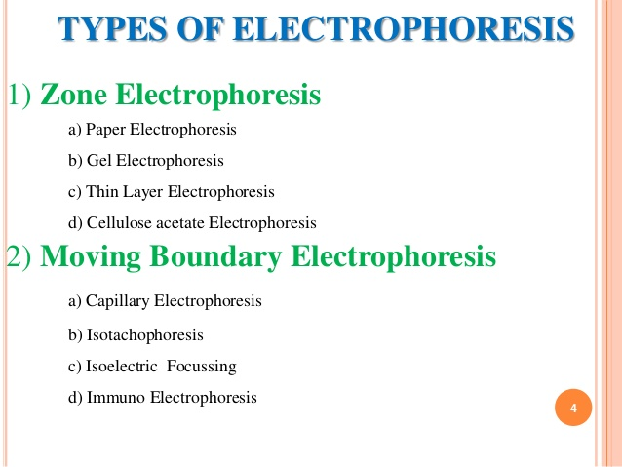

Slide 29
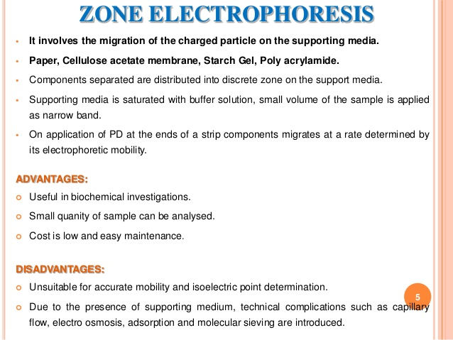

Slide 30


Slide 31
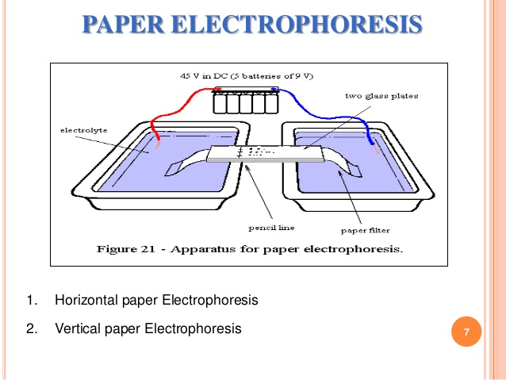
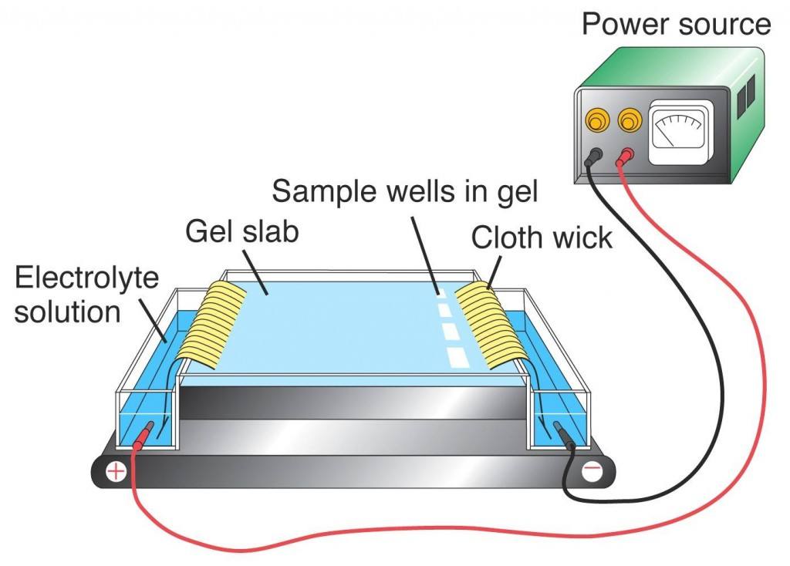

Slide 32
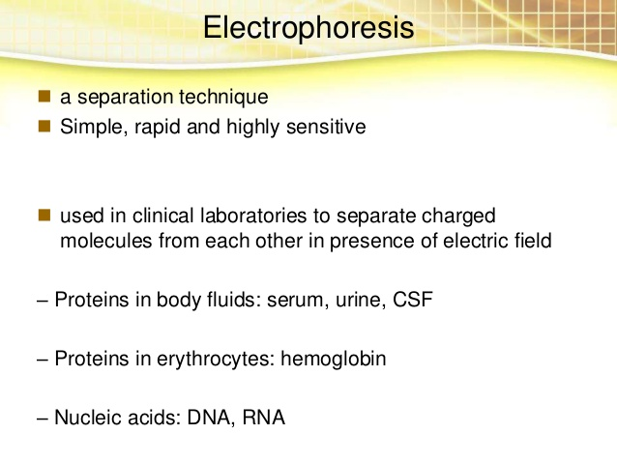

Slide 33
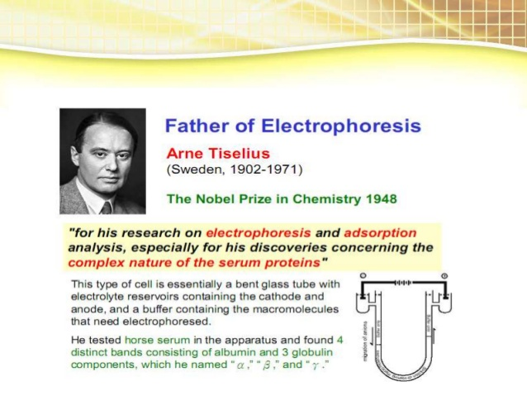

Slide 34
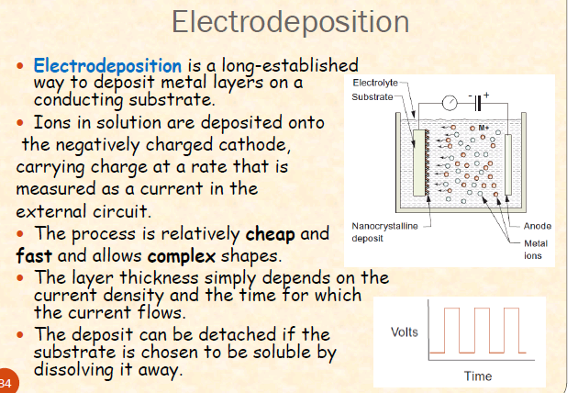

Slide 35
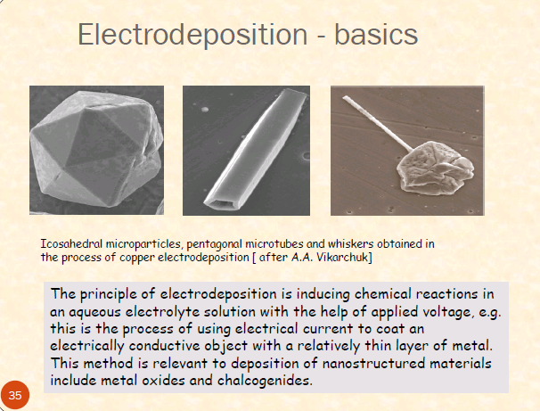

Slide 36
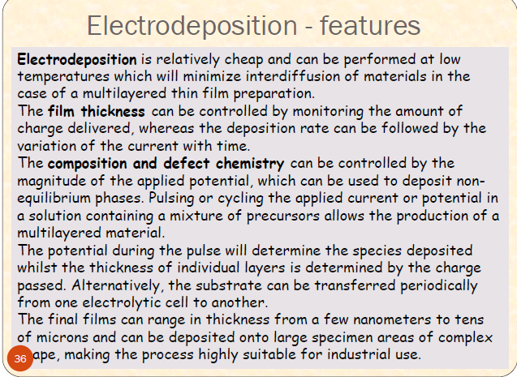

Slide 37
Synthesis of Pt, Pd, Au, Ag, ……..
Metal reduction method

Slide 38
Summary
Nanotechnology is ubiquitous and pervasive. It is an emerging field in all areas of science, engineering and technology.
Welcome to NanoWorld!
Figure 1.26: Robot image.
22
Notes:
Summary:
Welcome to the NanoWorld, where nanotechnology is ubiquitous and pervasive. Nanotechnology is an emerging field in all areas of science, engineering and technology. Soon, much of the work in nanotechnology will transcend itself from research into the products and commodities we will use. Consider the fact that computers, cell phones, mp3’s and video game controllers have become exponentially smaller and more powerful over the last 10 years.
Before long, the materials developed through nanotechnology will lead to such things as better solar panels that are more efficient in transferring solar energy into electricity; stronger and lighter materials that can replace steel in construction of buildings and structures; and better tools for transporting medicine into patients and analyzing blood, cells, etc. The nanotechnology field will continue to expand and provide opportunities for all interested people regardless of their career specialty.
Fig. 1.26 - Microsoft Office Clip Art.

