Slide 1
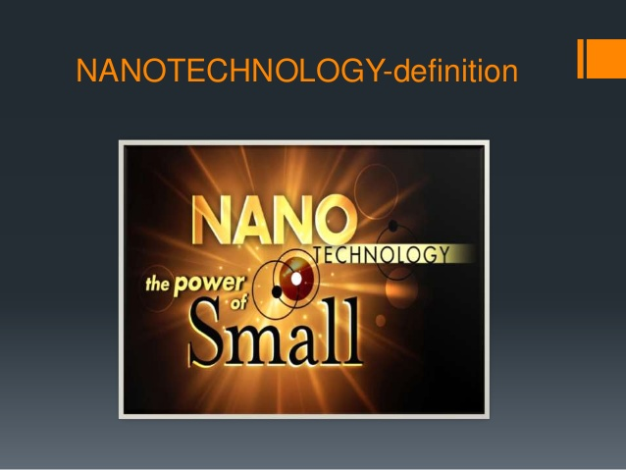

Slide 2
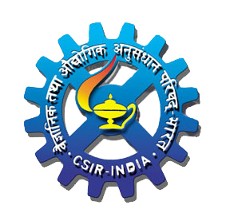
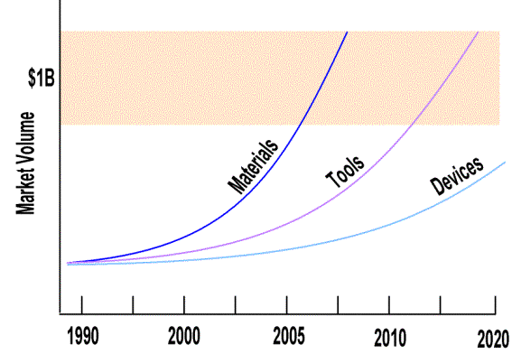
What are Nanomaterials?
Structures with dimensions in the 1-100 nanometer range
Interface between the molecular and bulk materials
Manifest extremely fascinating and useful properties
Emerging and promising field of research
Notes:
Nanomaterials as you know…… Manifest useful magnetic, optical and mechanical properties due to enhanced surface area to volume ratio, quantum confinement, changes in lattice parameter and symmetry. Projected Nanotechnology growth

Slide 3
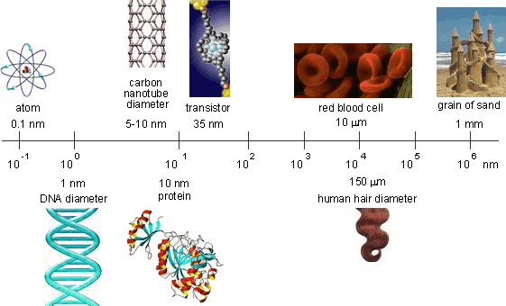
Why Nanoscale?

Slide 4
Definition
“Nanotechnology is the understanding and control of matter at dimensions of roughly 1 to 100 nanometers, where unique phenomena enable novel applications.”
“Encompassing nanoscale science, engineering and technology, nanotechnology involves imaging, measuring, modeling, and manipulating matter at this length scale.”
National Nanotechnology Initiative, 2007
7
Notes:
Definition:
Most research universities and centers as well as private and government entities working with nanotechnology provide their own similar but distinct definition of nanotechnology. Therefore, the first lesson about nanotechnology is to understand that it is a broad multidisciplinary field encompassing all branches of science, engineering and technology as well as medical, business, finance, economics, social sciences and many other disciplines.
A general definition of nanotechnology is provided in the National Nanotechnology Initiative (NNI) website which is a federal government website (http://www.nano.gov). The NNI agency was created to foster worldwide advancement and leadership in nanotechnology within the United States. The NNI definition for nanotechnology is:
“Nanotechnology is the understanding and control of matter at dimensions of roughly 1 to 100 nanometers, where unique phenomena enable novel applications.”
“Encompassing nanoscale science, engineering and technology, nanotechnology involves imaging, measuring, modeling, and manipulating matter at this length scale.”

Slide 5
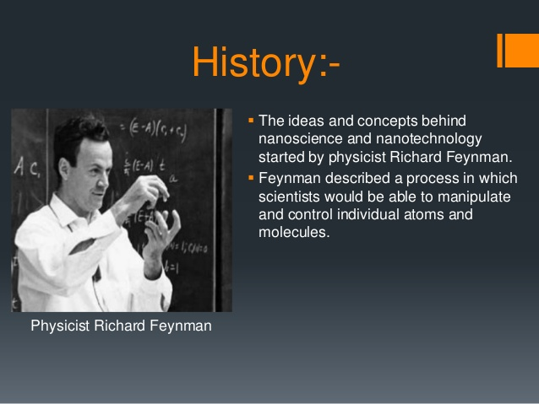

Slide 6

Brief History, Continued
Dr. Richard P. Feynman
“Why cannot we write the entire 24 volumes of the Encyclopedia Britannica on the head of a pin?”
Dr. Richard Feynman, one of America’s most notable physicists, 1918-1988.
Figure 1.11: Richard Feynman.
12
Notes:
Brief History, Continued:
Dr. Richard P. Feynman:
The first well documented talk on the possibilities of nanotechnology was made by one of America’s most notable physicists, Richard Feynman (Zyvex, 2007). Dr. Feynman’s talk was called There Is Plenty of Room at the Bottom, and he delivered it on December 12, 1959, before the American Physical Society meeting held at Caltech. In his talk, Feynman challenged the scientific community to think small in terms of solving future problems. Feynman stated:
“Why cannot we write the entire 24 volumes of the Encyclopedia Britannica on the head of a pin?” (Zyvex, 2007).
Fig. 1.11 - http://en.wikipedia.org/wiki/Image:Feynman_and_Oppenheimer_at_Los_Alamos.jpg.

Slide 7
Brief History Continued,
Dr. Feynman, Continued
“The problems of chemistry and biology can be greatly helped if our ability to see what we are doing, and to do things on an atomic level, is ultimately developed – a development which I think cannot be avoided.”
Surely You’re Joking Mr. Feynman!
Adventures of a Curious Character By Richard Feynman
Figure 1.12: Collection of reminiscences by Nobel Prize-winning physicist.
13
Notes:
Brief History, Continued:
Dr. Feynman, Continued:
Feynman’s vision previewed the collaboration between the sciences, the need for more powerful measurement tools such as the electron microscope that could allow atomic viewing and manipulation. He believed that engineers and scientists had to work together to develop tools that would have the ability to see and manipulate atoms and molecules in order to solve problems using nanotechnology. Feynman said:
“The problems of chemistry and biology can be greatly helped if our ability to see what we are doing, and to do things on an atomic level, is ultimately developed – a development which I think cannot be avoided.” (Zyvex, 2007)
Fig. 1.12 – ACC Instructional Development Services.

Slide 8

Brief History, Continued
Birth of Nanotechnology
Professor Taniguchi of Tokyo Science University used the word “nanotechnology” to describe the science and technology of processing or building parts with nanometric tolerances.
A nanometer is a unit of length in the metric system, equal to one billionth of a meter.
Figure 1.9: Tokyo Science University.
Figure 1.10: Equivalent Units
11
Notes:
Brief History, Continued:
Birth of Nanotechology:
In contemporary times, manufacturing tolerances of parts have approached nanometric dimensions, especially in the manufacturing of semiconductor devices. However, the term “nanotechnology” was not coined until 1974 by Professor Norio Taniguchi, whose work and research was in the area of high precision machining (Wikipedia, 2007).
Professor Taniguchi of Tokyo Science University used the word “nanotechnology” to describe the science and technology of processing or building parts with nanometric tolerances. Essentially, Professor Taniguchi’s theoretical concepts involved the use of electron, ion beam, and laser beam processes for machining tolerances at the nanoscale. (Booker & Boysen, 2005).
Fig. 1.9 - http://en.wikipedia.org/wiki/Image:Ridailogo.gif.
Fig. 1.10 – ACC Instructional Development Services.

Slide 9
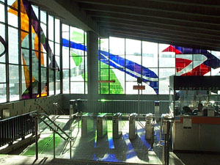
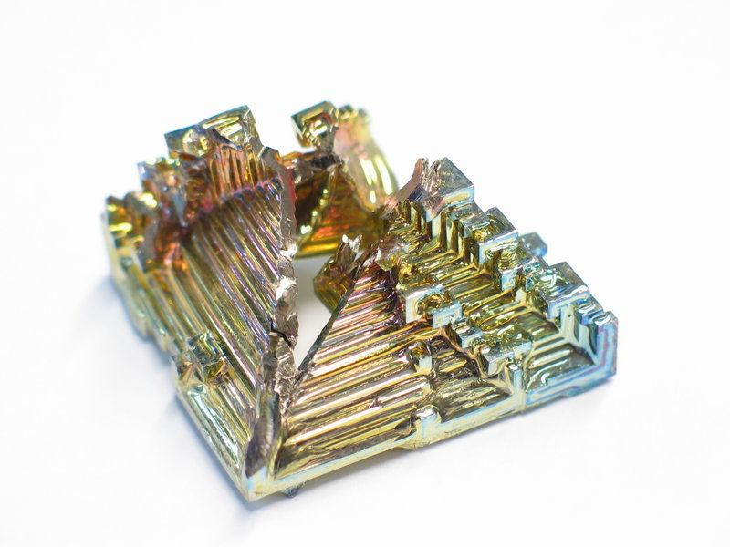
Brief History
The concepts of nanotechnology are not new to nature or to mankind. An early example of a manmade nanoprocess is stained glass.
Figure 1.7: Stained glass windows.
Figure 1.8: Picture of gold nano particles.
10
Notes:
Brief History:
The concepts of nanotechnology are not inherently new to nature or to the history of mankind. Science and nature have taught us that biological systems are built using small cells and proteins that follow an intrinsic plan dictated by infinitesimally small genetic coding (Roukes, et al., 2002). A well documented and early example of a manmade nanoprocess is the work of Medieval stained glass makers who used small nanosize gold particles of varying sizes to create the different color hues found in stained glass windows of Medieval churches and structures. Hence, gold particles display a different form of color depending on their size at the nanoscale (Ratner & Ratner, 2003). Gold at the larger scale, the macroscale, such as a gold brick reflects the well known yellowish color.
Fig. 1.7 - http://en.wikipedia.org/wiki/Image:Marcelle-ferron.jpg.
Fig. 1.8 - http://en.wikipedia.org/wiki/Image:Bismuth_crystal_macro.jpg.

Slide 10
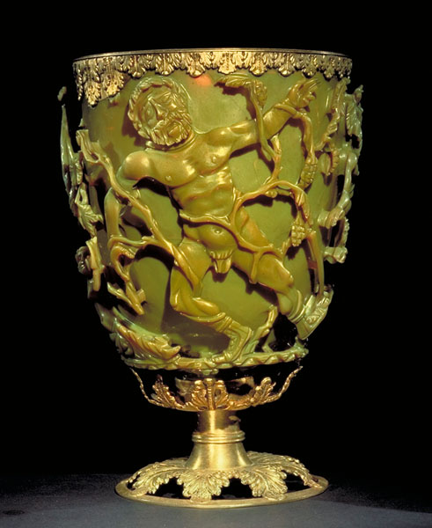
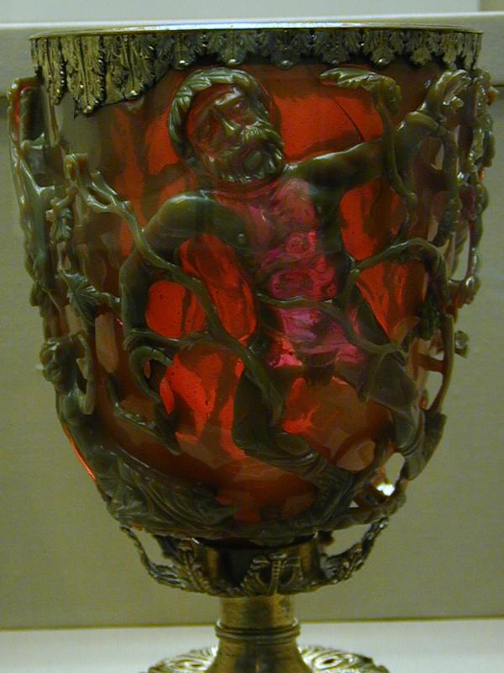
Nanotechnology in Roman Times: The Lycurgus Cup
Plasmons of gold nanoparticles in glass reflect green, transmit red.

Slide 11
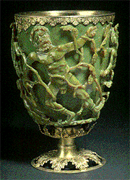
Appears green in
reflected light
Lycurgus Cup

Slide 12
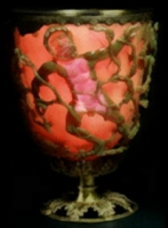
However, glows red
when light transmits
from within the cup
Notes:
It contains gold and silver particles of approximately 70 nm. The spectacular range of colors shown by colloidal gold is attributed to a phenomenon called Surface Plasmon Resonance.

Slide 13
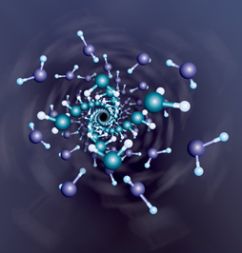
Brief History, Continued
Atomic Scale
A computer image of the nano ice double helix.
In the nano ice image, oxygen atoms are blue in the inner helix, purple in the outer helix. Hydrogen atoms are white.
Figure 1.13: A nanotechnology self-assembly process.
14
Notes:
Brief History, Continued:
Atomic Scale:
Feynman also discussed how matter at the atomic scale behaves differently than matter at the macroscopic scale since, he mentioned, at the atomic scale atomic size particles respond to forces governed by quantum mechanics as opposed to larger systems which are governed by classical Newtonian mechanics.
Also, the theoretical ability to build new compounds or materials one atom at a time opens up new possibilities beyond those developed using traditional chemical processes. A visual example of this concept is illustrated by a model of a Self Assembling Double Helix of Nano Ice which shows the atoms binding under high pressure with weak hydrogen links (UNL News Releases, 2006).
Fig. 1.13 - http://ucommxsrv1.unl.edu/unlnews2004/downloadables/photo/20061211helix.jpg.

Slide 14
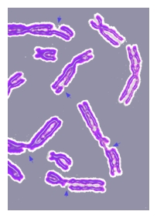
More History
Eric Drexler
Coined the term “Grey Goo”…the potential problem of self-replicating and autonomous artificial intelligence machines.
Engines of Creation
The Coming Era of Nanotechnology
By K. Eric Drexler
Figure 1.14: Drexler’s book.
Figure 1.15: DNA damage.
15
Notes:
More History:
Eric Drexler:
Eric Drexler’s book, Engines of Creation, first published in 1986, popularized the futuristic possibilities of nanotechnology. Engines of Creation covered everything from artificial intelligence to self-replicating machines to the use of nanotechnology to cure infectious diseases and repair damaged cells. Drexler also talked about how nanotechnology could be used to extend human lifespan, by placing people in suspended animation when they die so that they can later be brought back to life once a cure was found. Drexler also discussed how humans would be able to populate civilizations away from earth, on near planets or in space stations.
Drexler talked about the dangers of nanotechnology and specifically mentioned the “Grey Goo” phenomena (Drexler, 1986). Grey Goo is the term given to the potential problem of self-replicating and autonomous artificial intelligence machines that can take over the world and wipe out life as we know it today. This is a doomsday theory also called “Ecophagy,” where artificial intelligence machines multiply uncontrollably and spread much like bacteria until they consume all resources of Earth and turn the Earth itself into Grey Goo. Drexler wrote, “Dangerous replicators could easily be too tough, small, and rapidly spreading to stop – at least if we made no preparation” (Drexler, 1986).
Fig. 1.14 – ACC Instructional Development Services.
Fig. 1.15 – http://en.wikipedia.org/wiki/DNA_repair.

Slide 15

More History, Continued
Eric Drexler, Continued
Cell Repair Machines
“By working along molecule by molecule and structure by structure, repair machines will be able to repair whole cells. By working along cell by cell and tissue by tissue, they…will be able to repair whole organs…they will restore health.” - Drexler, 1986
X
Figure 1.16: Stylized example of targeted cell repair.
16
Notes:
More History, Continued:
Eric Drexler, Continued:
Cell Repair Machines:
Drexler also wrote about cell repair machines. These machines would be about the size of bacteria but would be more sophisticated since their internal parts would be more intricate and they would be controlled via a program inside a tiny microcomputer. This artist’s rendition shows a cell repair machine which was injected into the blood stream in order to repair a damaged cell or remove it from the blood stream. Cell repair machines will be able to identify damaged cells and repair them.
Drexler wrote: “By working along molecule by molecule and structure by structure, repair machines will be able to repair whole cells. By working along cell by cell and tissue by tissue, they…will be able to repair whole organs…they will restore health” (Drexler, 1986).
Fig. 1.16 - http://en.wikipedia.org/wiki/Image:Endomembrane_system_diagram_no_text_nucleus.png + Microsoft Clipart.

Slide 16

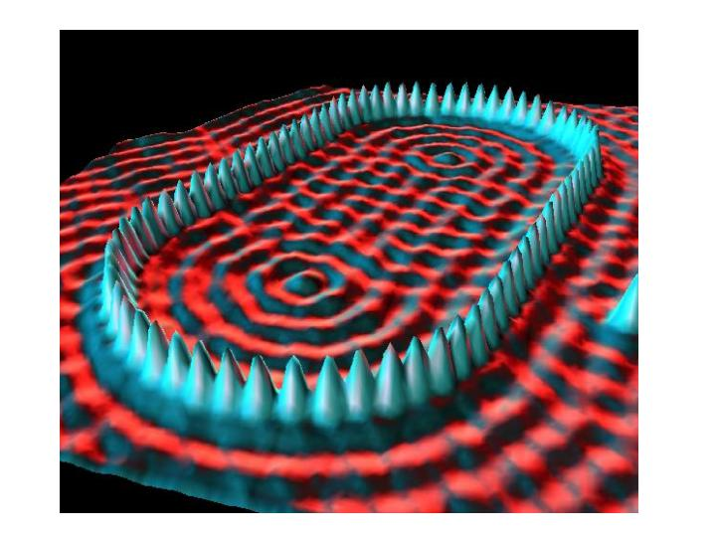
More History, Continued
Metrology
Measurement of equipment is the cornerstone of nanotechnology.
Figure 1.17: Scanning probe microscope systems from nanoscience instruments.
Figure 1.18: Scanning tunneling microscope image.
17
Notes:
More History, Continued:
Metrology:
Measurement equipment or metrology tools, as they are often called, have been the cornerstone of nanotechnology because they have allowed us to see what we are doing at the atomic scale. Tools such as the Atomic Force Microscope (AFM), Scanning Tunneling Microscope (STM) and the Scanning Electron Microscope (SEM) provide the bridge between the macro world and the nano world. The ability to see and characterize matter at the atomic scale began the work that Feynman envisioned.
In 1981, two gentlemen, Gerd Binnig and Heinrich Rohrer of IBM Zurich, invented the scanning tunneling microscope for which they later received the Nobel Prize in Physics in 1986. The scanning tunneling microscope works by sliding a very small tip, about the size of an atom, over a surface at an extremely close proximity – within a few atomic layers - and uses electronics to translate the surface topography into a visual image (Ratner and Ratner, 2002).
In this manner, the scanning tunneling microscope produces a visual representation of the material being scanned much like a key cutting machine traces and makes a copy of the original key.
Fig. 1.17 - http://www.nanoscience.com/products/index.html.
Fig. 1.18 - http://www.nano.gov/html/facts/home_facts.html.

Slide 17
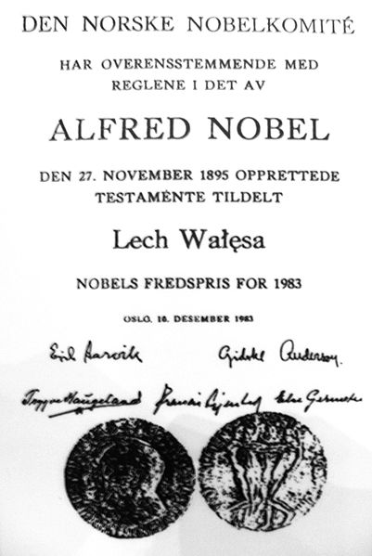
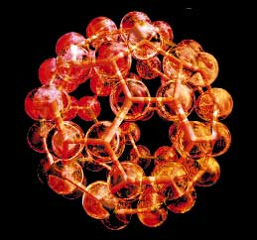
More History, Continued
Buckyballs
Three gentlemen—Harold Kroto from the University of Sussex, Robert Curl and Richard Smalley from Rice University—were awarded the Nobel Prize in Chemistry in 1996 for their discovery of a new composition of carbon, Carbon 60.
Figure 1.19: Carbon-60 buckyball is
shaped like a soccer ball.
Figure 1.20: Example of Nobel prize diploma.
18
Notes:
More History, Continued:
Buckyballs:
Three gentlemen—Harold Kroto from the University of Sussex, Robert Curl and Richard Smalley from Rice University—were awarded the Nobel Prize in Chemistry in 1996 for their discovery of a new composition of carbon, Carbon 60.
This new compound, which only measures about one nanometer in diameter, was called a Buckminsterfullerene or “Buckyball.” Carbon 60 (C 60) has 60 carbon atoms covalently bonded and forming geometric 12 pentagons and 20 hexagons—the same geometric configuration found in most soccer balls (Booker & Boysen, 2005).
Buckyballs are produced through a low pressure carbon vaporization process. The original technique only produced small quantities, but current processes produce Carbon60 or buckyballs at a much higher rate. Buckyballs are also used to form carbon nanotubes. These nanotubes can be used to form transistors and, depending on their configuration, they can be made to be conductors or insulators (Ratner & Ratner, 2002). Carbon is a very interesting element because it has four electrons in its outer shell, just like silicon, and is allotropic—which means it can take on different forms. Both diamond and graphite are made from carbon.
Fig. 1.19 - http://en.wikipedia.org/wiki/Image:C60a.png.
Fig. 1.20 - http://en.wikipedia.org/wiki/Nobel_Prize.

Slide 18
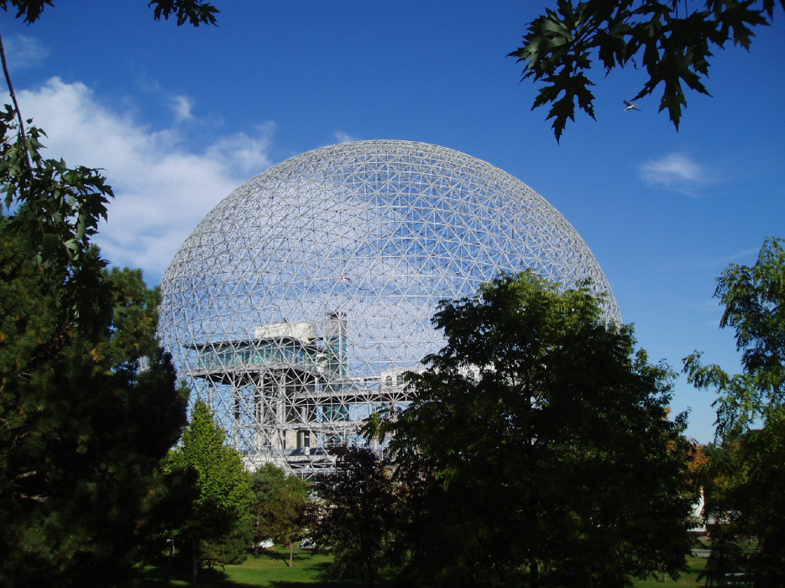
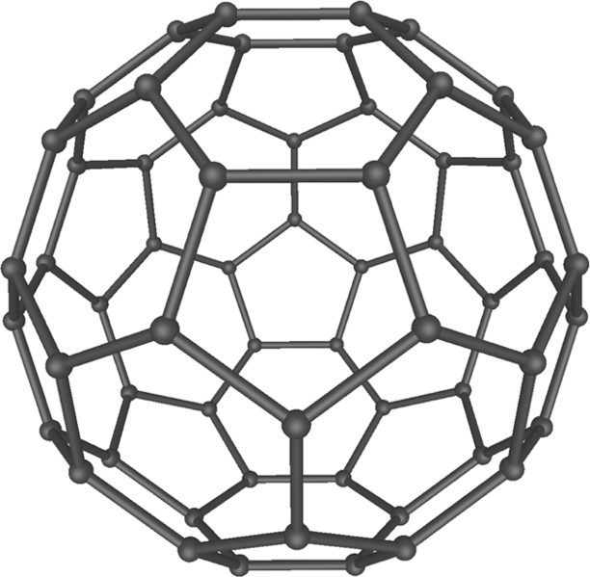
More History, Continued
Fullerenes
Carbon 60 was named after Richard Buckminster Fuller, who went by the nickname “Bucky.”
Figure 1.21: A “Buckyball.”
Figure 1.22: Dome over biosphere in Montreal.
19
Notes:
More History, Continued:
Fullerenes:
Carbon 60 (C60) was named after Richard Buckminster Fuller, who went by the nickname “Bucky.”
Fuller’s most noted architectural design was the geodesic dome. The geodesic dome is a sphere which is made up of geometric triangular shapes. It is a very rigid construction and very strong in terms of its weight to volume. The C60 Buckyball was named in Fuller’s honor (Wikipedia, 2007)
Fig. 1.21 - http://en.wikipedia.org/wiki/Image:C60a.png.
Fig. 1.22 - http://en.wikipedia.org/wiki/Image:Mtl._Biosphere_in_Sept._2004.jpg.

Slide 19
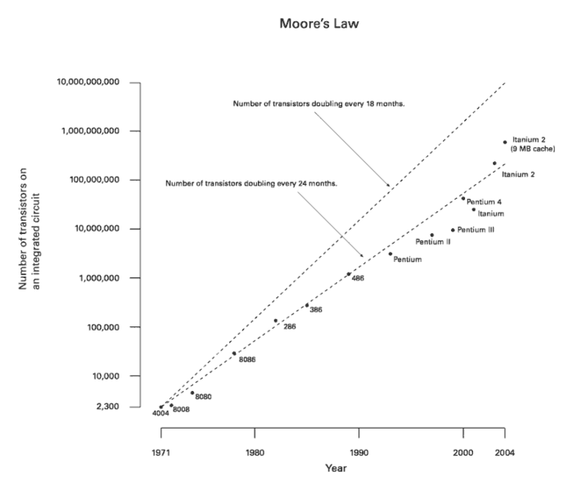
More History, Continued
Top-Down Approach- Moores law
Two approaches used in producing nanotechnology systems. Top-down method is used by computer chip manufacturers.
Figure 1.23: Moore’s Law.
20
Notes:
More History, Continued:
Top-down Approach:
Two approaches of producing nanotechnology systems are top-down and bottom-up. The top-down method is used by computer chip manufacturers (Booker & Boysen, 2005). The producers of chips begin the process with large bulk silicon wafers and then manufacture the devices on top of them through a series of printing, layering, doping and removal steps that ultimately lead to a functional device. The printing is done through a reduction process called photolithography. This process has evolved since the 1960s, into one that is now printing line width dimensions at the nanometer scale. The shrinking of line widths and the increased density of transistors has followed Moore’s Law. Moore’s Law states that transistor densities would double every 18–24 months (Wikipedia, 2007).
Fig. 1.23 - http://en.wikipedia.org/wiki/Image:Moore_Law_diagram_%282004%29.png.
Fig. 1.24 – Illustration created by Alberto Quiñonez.

Slide 20
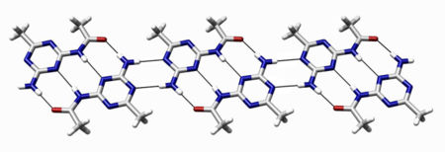
More History, Continued
Bottom-Up Approach
Bottom-up approach to manufacturing is analogous to the way biological systems are made.
Figure 1.25: An example of a molecular self assembly through hydrogen bonds.
21
Notes:
More History, Continued:
Bottom-Up Approach:
The bottom-up approach to nanomanufacturing is analogous to the way biological systems are made. In biology, cells grow tissue, organs, plants, hair, etc. through the process of self assembly. This approach is now being studied in nanotechnology. Drexler wrote about self assembling nanoparticles, and this type of research is already taking place, albeit at a rudimentary level as compared to Drexler’s vision.
The use of biological microorganisms to synthesize or form nanoparticles is being studied. This is an interesting concept since it purports to use organic material to grow inorganic metals. In several studies, certain types of bacteria are shown to produce gold or silver particles. Researchers also found that “…the exposure of lactic acid bacteria present in the whey of buttermilk to mixtures of gold and silver ions can be used to grow alloy nanoparticles of gold and silver” (Mandal, et al., 2005).
Fig. 1.25 - http://en.wikipedia.org/wiki/Molecular_self-assembly.

Slide 21
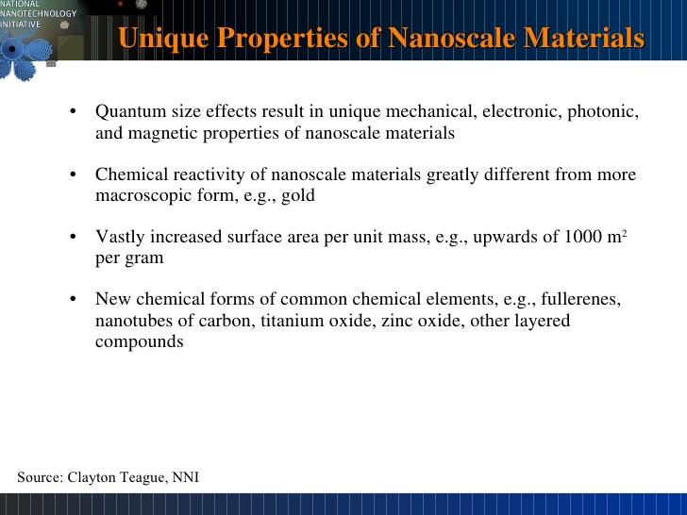

Slide 22
Classification of nanoparticles

Slide 23
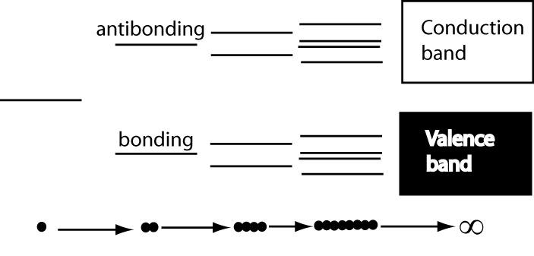
Development of electronic properties as a function of cluster size
Each band has a width that reflects the interaction between atoms, with a bandgap between the conduction and the valence bands that reflects the original separation of the bonding ad antibonding states.

Slide 24
Quantum Dot: Introduction
Quantum dots are usually regarded as semiconductors by definition.
Similar behavior is observed in some metals. Therefore, in some cases it may be acceptable to speak about metal quantum dots.
Typically, quantum dots are composed of groups II-VI, III-V, and IV-VI materials.
QDs are bandgap tunable by size which means their optical and electrical properties can be engineered to meet specific applications.

Slide 25
Quantum Confinement
Definition:
Quantum Confinement is the spatial confinement of electron-hole pairs (excitons) in one or more dimensions within a material.
1D confinement: Quantum Wells
2D confinement: Quantum Wire
3D confinement: Quantum Dot
Quantum confinement is more prominent in semiconductors because they have an energy gap in their electronic band structure.
Metals do not have a bandgap, so quantum size effects are less prevalent. Quantum confinement is only observed at dimensions below 2 nm.

Slide 26
Quantum Confinement
Recall that when atoms are brought together in a bulk material the number of energy states increases substantially to form nearly continuous bands of states.
Energy
Energy
N

Slide 27
Quantum Confinement
The reduction in the number of atoms in a material results in the confinement of normally delocalized energy states.
Electron-hole pairs become spatially confined when the diameter of a particle approaches the de Broglie wavelength of electrons in the conduction band.
As a result the energy difference between energy bands is increased with decreasing particle size.
Energy
Eg
Eg

Slide 28
Quantum Confinement
This is very similar to the famous particle-in-a-box scenario and can be understood by examining the Heisenberg Uncertainty Principle.
The Uncertainty Principle states that the more precisely one knows the position of a particle, the more uncertainty in its momentum (and vice versa).
Therefore, the more spatially confined and localized a particle becomes, the broader the range of its momentum/energy.
This is manifested as an increase in the average energy of electrons in the conduction band = increased energy level spacing = larger bandgap
The bandgap of a spherical quantum dot is increased from its bulk value by a factor of 1/R², where R is the particle radius.*
Based upon single particle solutions of the schrodinger wave equation
valid for R< the exciton bohr radius.

Slide 29
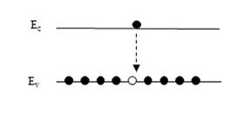
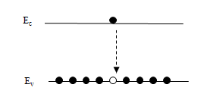
Quantum Confinement
What does this mean?
Quantum dots are bandgap tunable by size. We can engineer their optical and electrical properties.
Smaller QDs have a large bandgap.
Absorbance and luminescence spectrums are blue shifted with decreasing particle size.
Energy
555 nm
650 nm

Slide 30
Quantum Dots (QD)
Nanocrystals (2-10 nm) of semiconductor compounds
Small size leads to confinement of excitons (electron-hole pairs)
Quantized energy levels and altered relaxation dynamics
Examples: CdSe, PbSe, PbTe, InP
Eg

Slide 31
Quantum Dots: Optics
Absorption and emission occur at specific wavelengths, which are related to QD size
Eg

Slide 32
Applications of QDs: Light Emitters
The discovery of quantum dots has led to the development of an entirely new gamut of materials for the active regions in LEDs and laser diodes.
Indirect gap semiconductors that don’t luminesce in their bulk form such as Si become efficient light emitters at the nanoscale due quantum confinement effects.
The study of QDs has advanced our understanding of the emission mechanisms in conventional LED materials such as InGaN, the active region of blue LEDs.
The high radiative-recombination efficiency of epitaxial InGaN is due to self-assembled, localized, In rich clusters that behave like QDs.

Slide 33
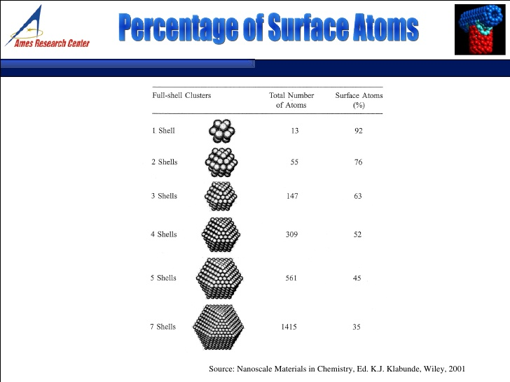

Slide 34
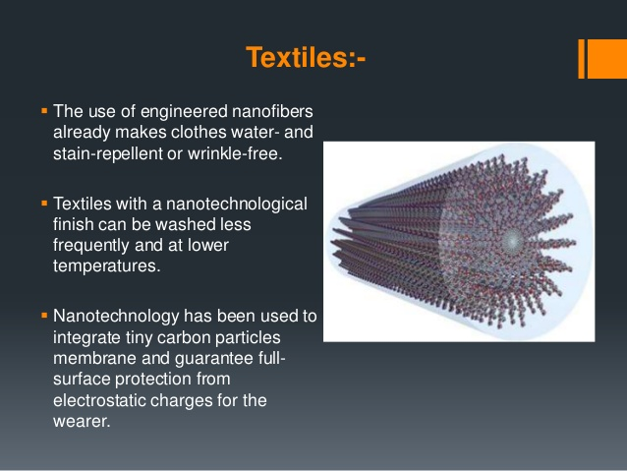
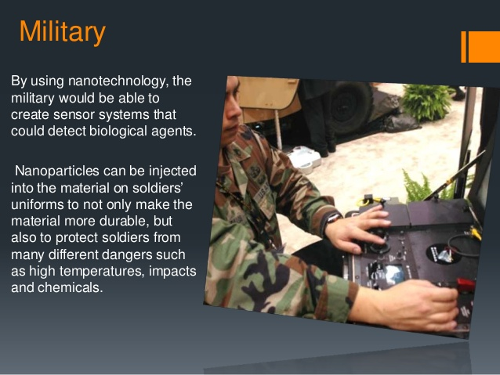
Few areas where nano is made use of

Slide 35
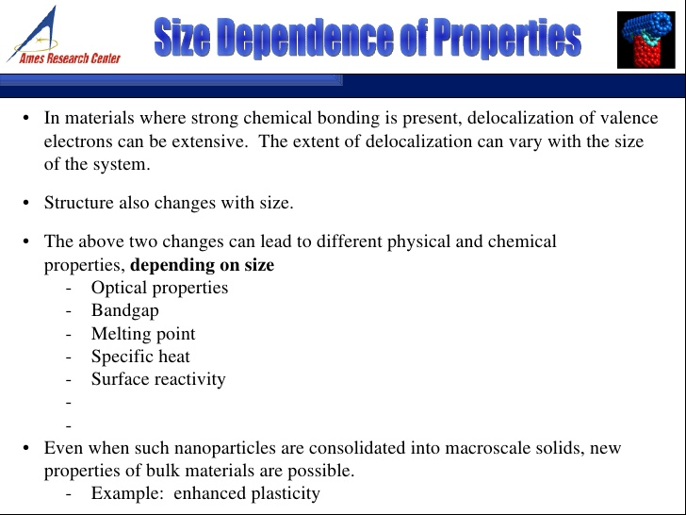

Slide 36
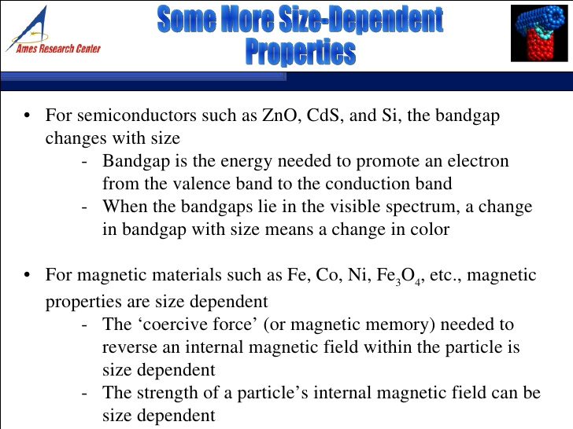

Slide 37
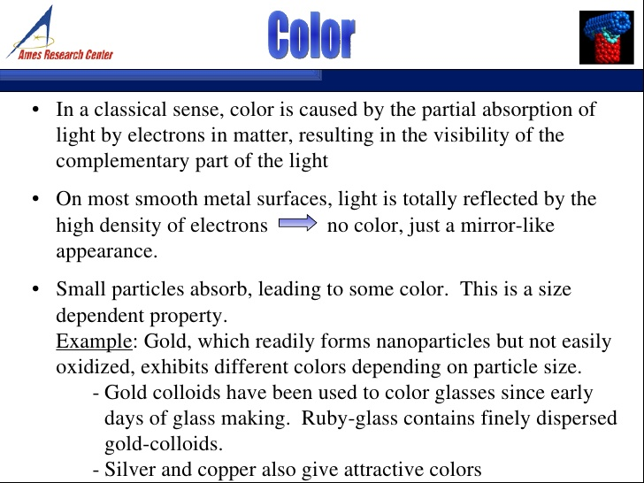

Slide 38
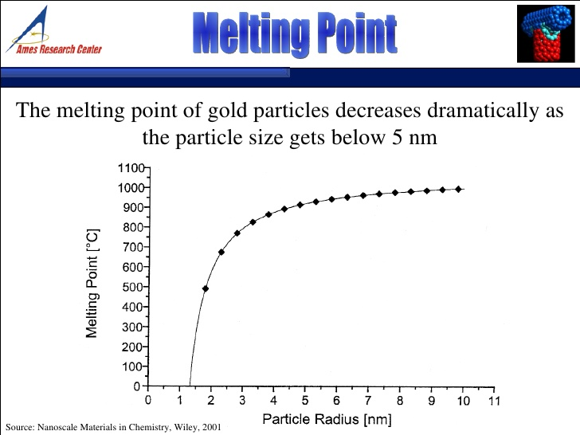

Slide 39
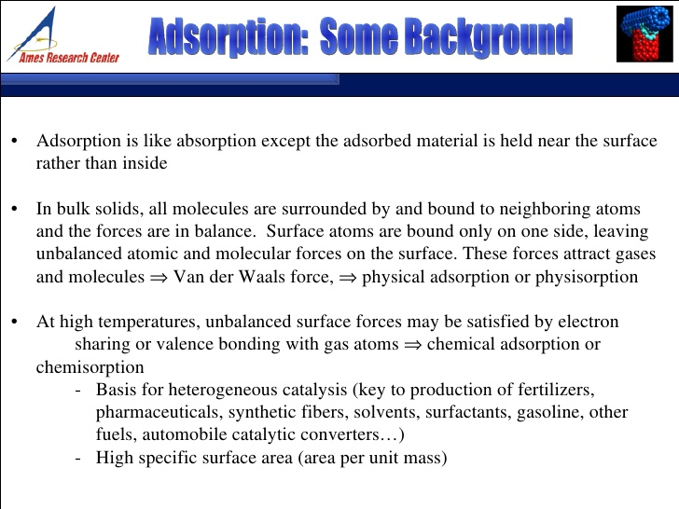

Slide 40
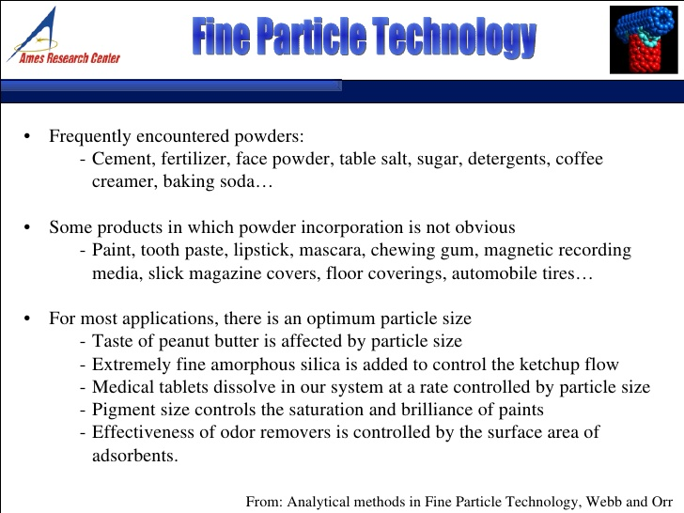

Slide 41
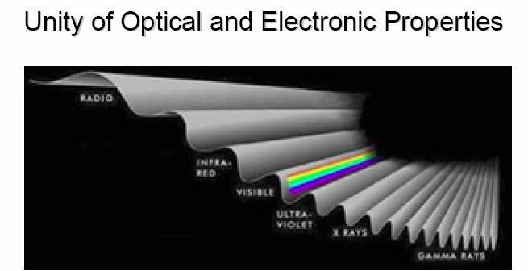
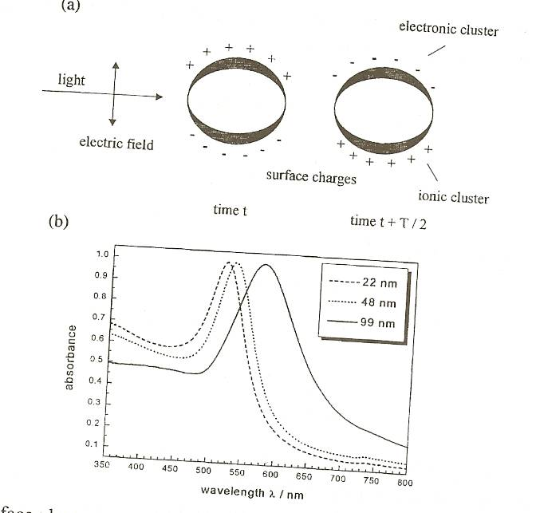
Optical Properties: Surface Plasmon Resonance
Surface plasmon resonance is the coherent excitation of all the "free" electrons within the conduction band, leading to an in-phase oscillation.
When the size of a metal nanocrystal is smaller than the wavelength of incident radiation, a surface plasmon resonance is generated.
The figure shows schematically how a surface plasmon oscillation is created. The electric field of an incoming light induces a polarization of the free electrons relative to the cationic lattice.
The net charge difference occurs at the nanoparticle boundaries (the surface), which in turn acts as a restoring force. In this manner a dipolar oscillation of electrons is created with a certain frequency.

Slide 42
Surface plasmon resonance
In this manner a dipolar oscillation of electrons is created with a certain frequency. The energy of the surface plasmon resonance depends on both the free electron density and the dielectric medium surrounding the nanoparticle.
The resonance frequency increases with decreasing particle size if the size of the particles is smaller than the wavelength of the particles.
The width of the resonance varies with the characteristic time before electron scattering. For larger nanoparticle, the resonance sharpens as the scattering length increases. Noble metals have the reso­nance frequency in the visible light range.
Mie was the first to explain the red color of gold nanoparticle colloidal in 1908 by solving Maxwell's equation for an electromagnetic light wave interacting with small metallic spheres.

Slide 43
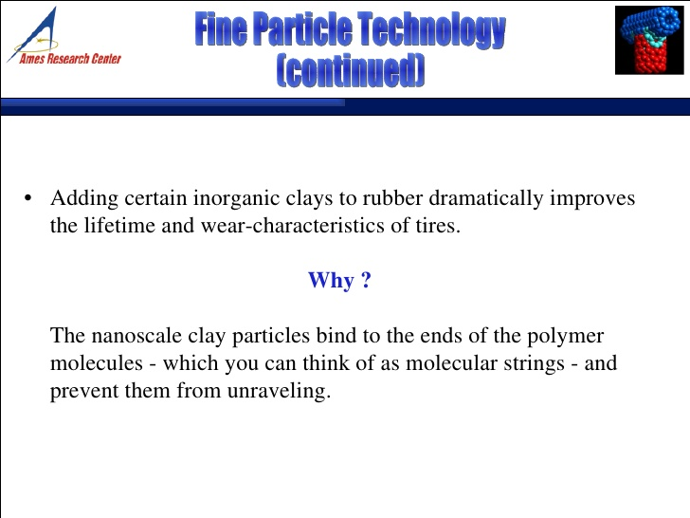

Slide 44
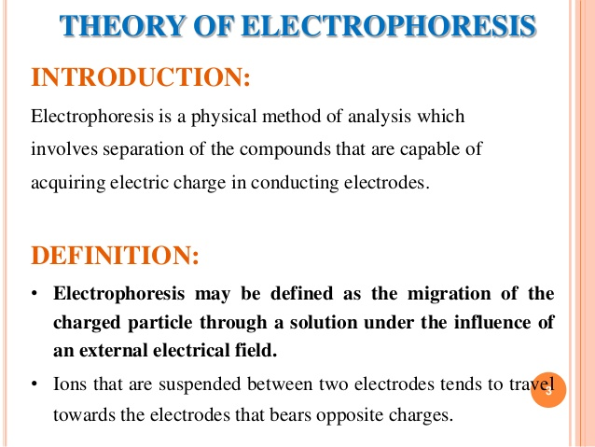

Slide 45
Electrophoresis
Those molecules with higher molecular weight move slower. While those with small weight move faster. Also the size of the molecule also influences the movement. The bigger size molecule experience more friction than smaller ones in motion. These molecules migrate at different speed and to different lengths based on their charge, mass and shape.

Slide 46
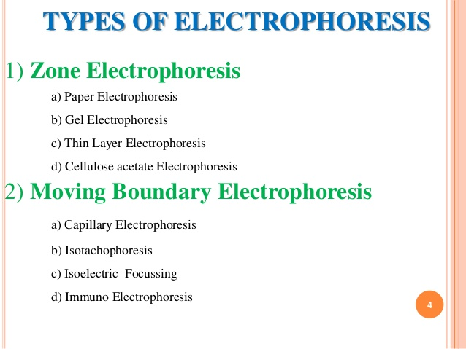

Slide 47
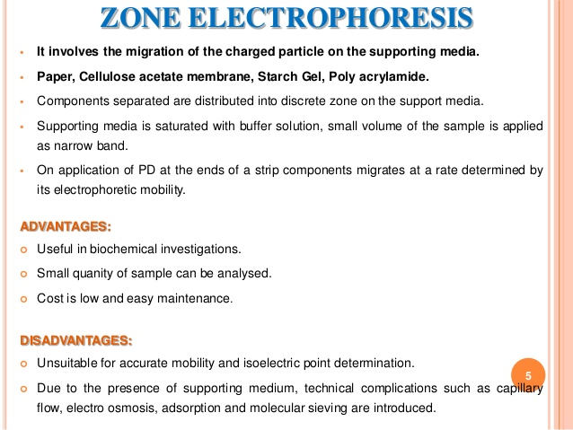

Slide 48
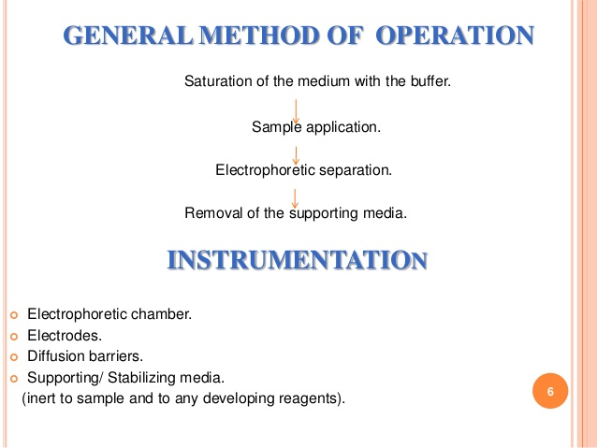

Slide 49
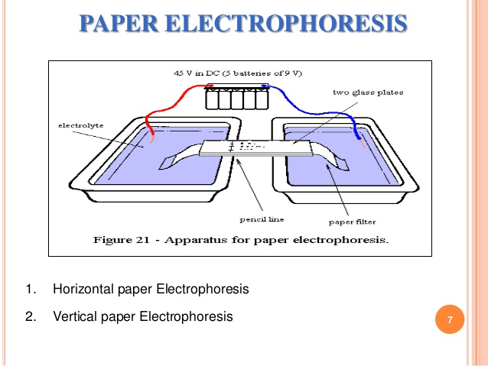
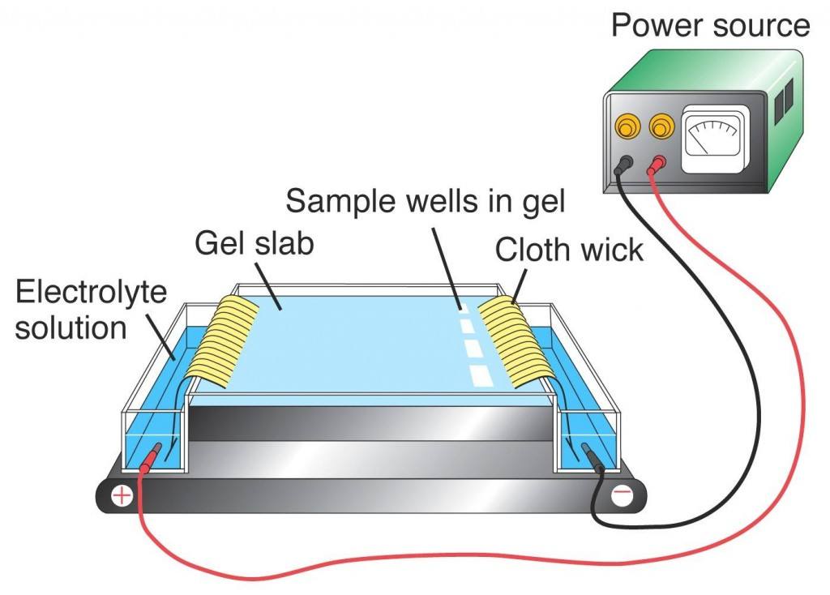

Slide 50
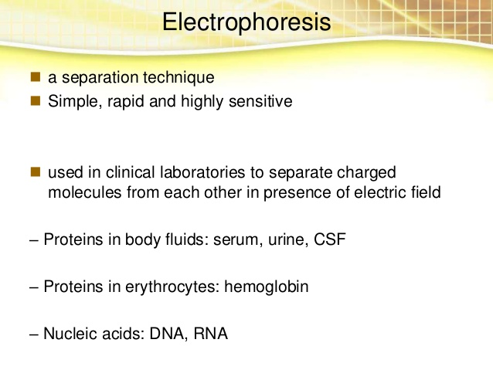

Slide 51
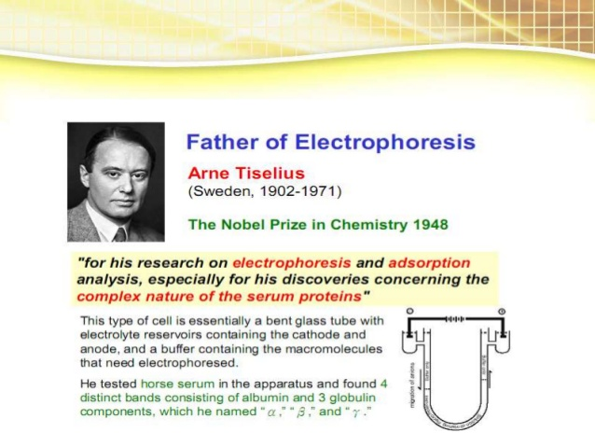

Slide 52
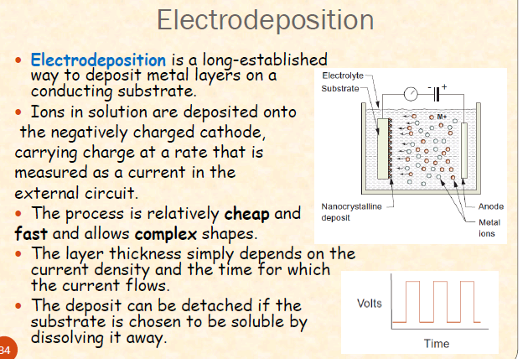

Slide 53
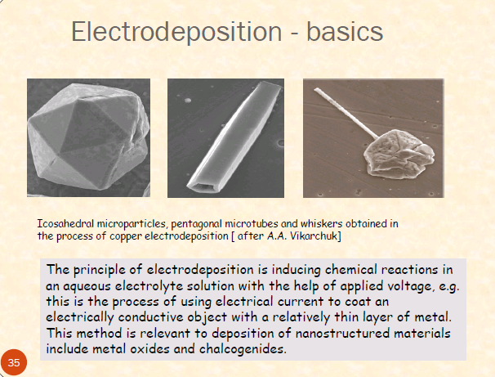

Slide 54
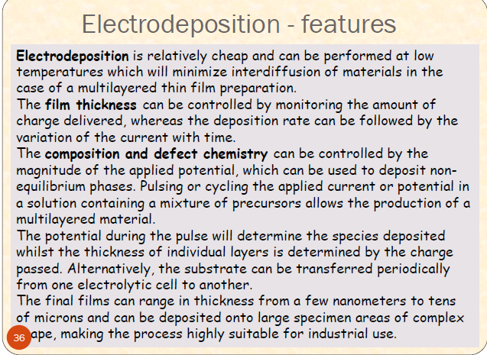

Slide 55
Synthesis of Pt, Pd, Au, Ag, ……..
Metal reduction method

Slide 56
Summary
Nanotechnology is ubiquitous and pervasive. It is an emerging field in all areas of science, engineering and technology.
Welcome to NanoWorld!
Figure 1.26: Robot image.
22
Notes:
Summary:
Welcome to the NanoWorld, where nanotechnology is ubiquitous and pervasive. Nanotechnology is an emerging field in all areas of science, engineering and technology. Soon, much of the work in nanotechnology will transcend itself from research into the products and commodities we will use. Consider the fact that computers, cell phones, mp3’s and video game controllers have become exponentially smaller and more powerful over the last 10 years.
Before long, the materials developed through nanotechnology will lead to such things as better solar panels that are more efficient in transferring solar energy into electricity; stronger and lighter materials that can replace steel in construction of buildings and structures; and better tools for transporting medicine into patients and analyzing blood, cells, etc. The nanotechnology field will continue to expand and provide opportunities for all interested people regardless of their career specialty.
Fig. 1.26 - Microsoft Office Clip Art.

