Slide 1
Optical Properties: Surface Plasmon Resonance
Surface plasmon resonance is the coherent excitation of all the "free" electrons within the conduction band, leading to an in-phase oscillation.
When the size of a metal nanocrystal is smaller than the wavelength of incident radiation, a surface plasmon resonance is generated.
The figure shows schematically how a surface plasmon oscillation is created. The electric field of an incoming light induces a polarization of the free electrons relative to the cationic lattice.
The net charge difference occurs at the nanoparticle boundaries (the surface), which in turn acts as a restoring force. In this manner a dipolar oscillation of electrons is created with a certain frequency.

Slide 2
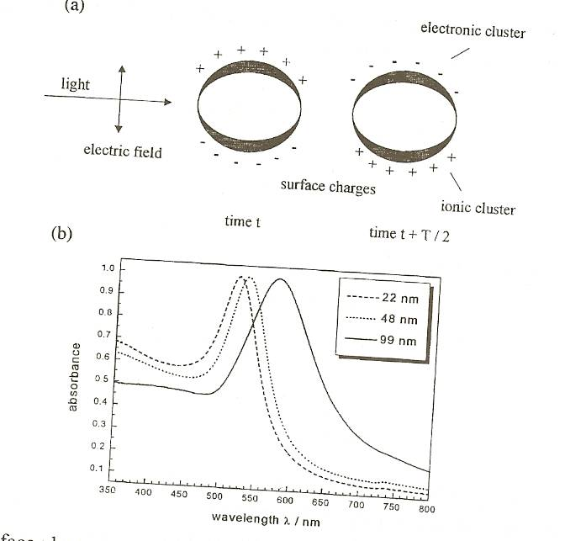

Slide 3
Surface plasmon resonance
In this manner a dipolar oscillation of electrons is created with a certain frequency. The energy of the surface plasmon resonance depends on both the free electron density and the dielectric medium surrounding the nanoparticle.
The resonance frequency increases with decreasing particle size if the size of the particles is smaller than the wavelength of the particles.
The width of the resonance varies with the characteristic time before electron scattering. For larger nanoparticle, the resonance sharpens as the scattering length increases. Noble metals have the reso­nance frequency in the visible light range.
Mie was the first to explain the red color of gold nanoparticle colloidal in 1908 by solving Maxwell's equation for an electromagnetic light wave interacting with small metallic spheres.

Slide 4
Colloidal Methods
Colloidal chemical methods are some of the most useful, easiest, and cheapest ways to create nanoparticles.
Colloidal methods may utilize both organic and inorganic reactants.
Typically, a metal salt is reduced leaving nanoparticles evenly dispersed in a liquid.
Aggregation is prevented by electrostatic repulsion or the introduction of a stabilizing reagent that coats the particle surfaces.
Particle sizes range from 1-200nm and are controlled by the initial concentrations of the reactants and the action of the stabilizing reagent.

Slide 5
Colloidal Methods
Examples: Gold
  A common method for preparing colloidal gold nanoparticles involves combining hydrogen tetrachloroaurate (HAuCl₄) and sodium citrate (Na₃C₆H₅O₇) in a dilute solution.
  Upon dissociation, the citrate ions (C₆H₅O₇³⁻) reduce Au³⁺ to yield 30-40 nm gold particles.
  Half reaction equations:
    Au³⁺⁽aq) + 3e⁻ → Au(s)
    C₆H₅O₇³⁻(aq) +H₂O(l) → C₅H₄O₄²⁻(aq) + CO₂(g) + H₃O(aq) + 2e⁻

Slide 6
Example: Formation of Gold Nanoparticles
Sodium
Citrate
Red Color = Gold NP
HAuCl₄
HAuCl₄
Gold
NP
Heat
Heat a solution of chloroauric acid (HAuCl₄) up to reflux (boiling). HAuCl₄ is a water soluble gold salt.
Add trisodium citrate, which is a reducing agent.
Continue stirring and heating for about 10 minutes.
  During this time, the sodium citrate reduces the gold salt (Au³⁺) to metallic gold (Au⁰).
  The neutral gold atoms aggregate into seed crystals.
  The seed crystals continue to grow and eventually form gold nanoparticles.
http://mrsec.wisc.edu/Edetc/nanolab/gold/index.html
J. Chem. Ed. 2004, 81, 544A.

Slide 7
Example: Formation of Gold Nanoparticles
Reduction of gold ions: Au(III) + 3e⁻ → Au(0)
Seed Crystal
10’s to 100’s of Atoms
Nucleation of Au(0) seed crystals:
Growth of nanoparticles:
Isotropic
Growth
Spherical
Nanoparticles
Surface capped
with citrate anions
Seed
Adding surfactant to growth solution
caps certain crystal faces and promotes
growth only in selected directions.
Anisotropic
Growth
Nanorods

Slide 8
Colloidial Methods
Examples: Molybdenum
  1-5 nm molybdenum nanoparticles can be created at room temperature by reducing MoCl₃ in a toluene solution in the presence of sodium triethylborohydride (NaBEt₃H).
  Reaction equation:
  MoCl₃ + 3NaBEt₃H → Mo + 3NaCl + 3BEt₃ + (3/2)H₂

Slide 9
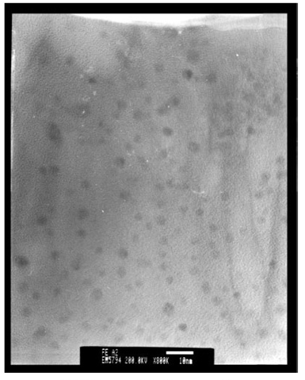
Colloidal Methods
Examples: Iron
  The TEM image to the right shows 3nm Fe nanoparticles produced by reducing FeCl₂ with sodium borohydride (NaBH₄) in xylene.
  Trioctylphosphine oxide (TOPO) was introduced as a capping agent to prevent oxidation and aggregation
TEM image of Fe nanoparticles
Phys. Chem. Chem. Phys., 2001, 3, 1661È1665

Slide 10
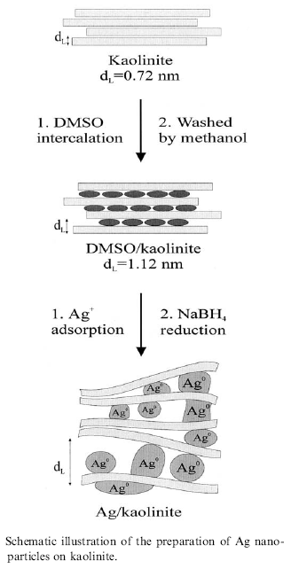
Colloidal Methods
Examples: Silver
  The reduction of AgNO₃ by NaBH₄ in aqueous solution can produce small diameter (<5nm) silver nanoparticles
  In one reported method, the reduction takes place between layers of kaolinite, a layered silicate clay material that functions to limit particle growth.
  Dimethyl sulfoxide (DMSO) is used as a capping agent to prevent corrosion and aggregation of the Ag particles.
R. Patakfalvi et al. / Colloids and Surfaces A: Physicochem. Eng. Aspects 220 (2003) 45/54

Slide 11
Attrition
Attrition is a mechanical method for creating certain types of nanoparticles.
Macro or micro scale particles are ground in a ball mill, a planetary ball mill, or other size reducing mechanism.
The resulting particles are separated by filters and recovered.
Particle sizes range from tens to hundreds of nm.
Broad size distribution and varied particle geometry.
May contain defects and impurities from the milling process.
Generally considered to be very energy intensive.
Cao, Guozhong. Nanostructures and Nanomaterials: Synthesis, Properties & Applications. Imperial College Press. 2004

Slide 12
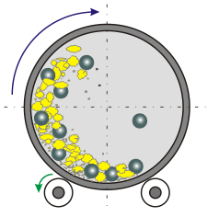
Attrition: Rotary Ball Mill
A hollow steel cylinder containing tungsten balls and a solid precursor rotates about its central axis.
Particle size is reduced by brittle fracturing resulting from ball-ball and ball-wall collisions.
Milling takes place in an inert gas atmosphere to reduce contamination.
http://www.ktf-split.hr/glossary/image/ball_mill.gif

Slide 13
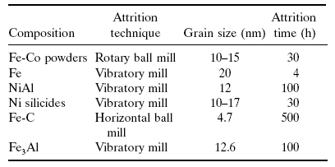
Attrition
Attrition Examples
Claudio L. De Castro, Brian S. Mitchell. Nanoparticles from Mechanical Attrition.
Department of Chemical Engineering, Tulane University, New Orleans, Louisiana, USA

Slide 14
Thermal Decomposition
  Thermal decomposition is the chemical decomposition of a substance into ins constituents by heating.
  A solid bulk material is heated beyond its decomposition temperature in an evacuated furnace tube.
  The precursor material may contain metal cations and molecular anions, or metal organic solids.
  Example: 2LiN₃(s)→ 2Li(s) +3N₂(g)
  Lithium particles can be synthesized by heating LiN₃ in a quartz tube under vacuum.
  When heated to 375ºC the nitrogen outgases from the bulk material and the Li atoms coalesce to form metal nanoparticles.
Poole, C., Owens, F. Introduction to Nanotechnology. Wiley, New Jersey. 2003

Slide 15
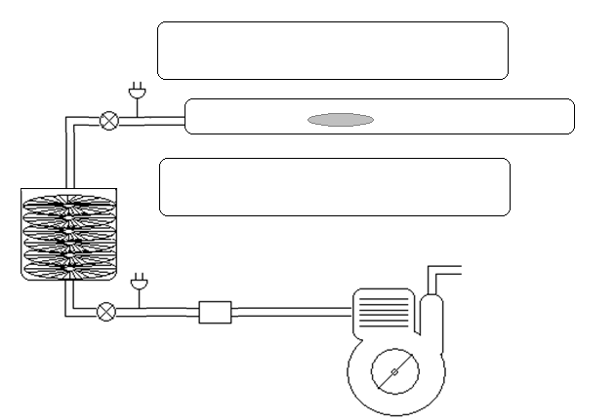
Thermal Decomposition Apparatus
Sample in Ta foil
Furnace
Evacuated
Quartz Tube
Turbo Molecular
Pump
Mechanical Pump

Slide 16
Pulsed Laser Methods
Pulsed Lasers have been employed in the synthesis silver nanoparticles from silver nitrate solutions.
A disc rotates in this solution while a laser beam is pulsed onto the disc creating hot spots.
Silver nitrate is reduced, forming silver nanoparticles.
The size of the particle is controlled by the energy in the laser and the speed of the rotating disc.
Poole, C., Owens, F. Introduction to Nanotechnology. Wiley, New Jersey. 2003

Slide 17
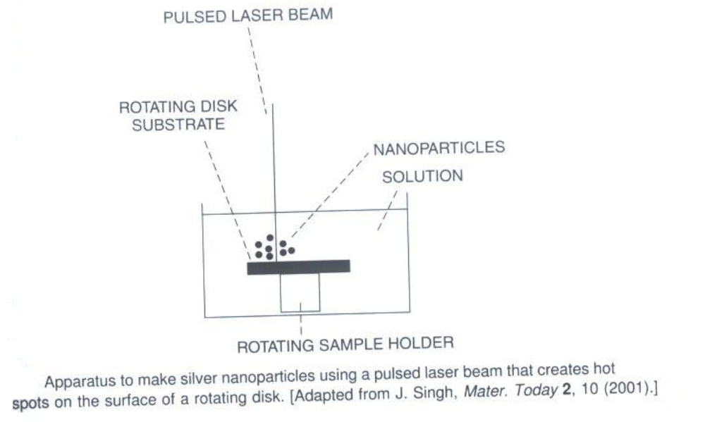
Pulsed Laser Apparatus for Ag Nanoparticles
Poole, C., Owens, F. Introduction to Nanotechnology. Wiley, New Jersey. 2003

Slide 18
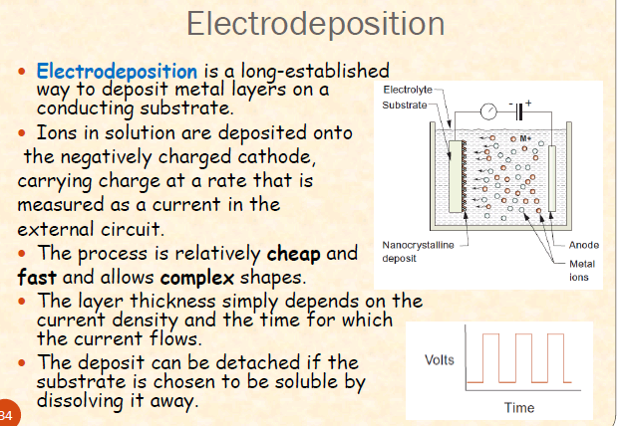

Slide 19
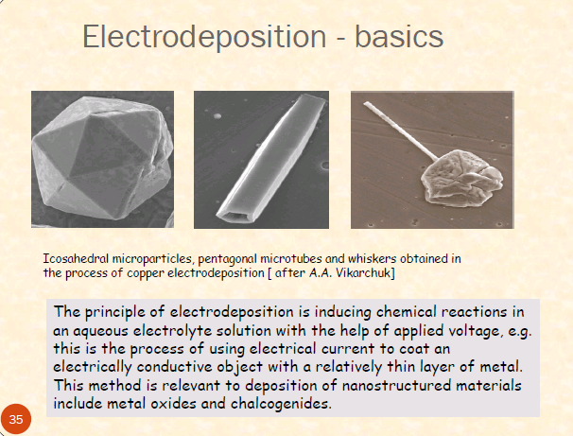

Slide 20
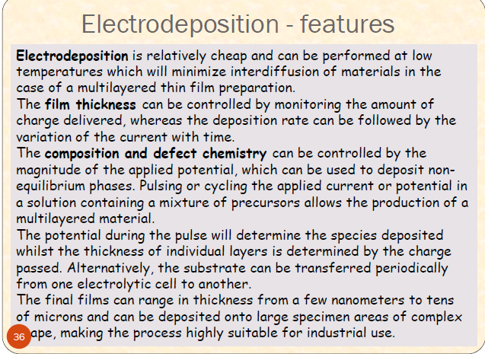

Slide 21
Characterisation techniques
See Pradeep page 225-227
XRD, TEM,SEM, DLS, Optical spectroscopy

Slide 22
Nanoparticle Applications: Fe
50-100nm Iron nanoparticles are used in magnetic recording devices for both digital and analog data.
Decreasing the diameter to 30-40nm increases the magnetic recording capacity by 5-10 times per unit.

Slide 23
Nanoparticle Applications: Ag
Silver has excellent conductivity and has been used as an antimicrobial material for thousands of years.
Silver’s anti-microbial potential increase with increased surface area.
Applications include biocides, transparent conductive inks, and antimicrobial plastics, and bandages.

Slide 24
Nanoparticle Applications: Gold
Gold nanoparticles are relatively easy to produce compared to other types of nanoparticles due to its high chemical stability.
Uses for gold nanoparticles are typically catalytic and include DNA detection and the oxidation of carbon monoxide.
Gold has superior conductivity allowing gold nanoparticles to be used in various probes, sensors, and optical applications.

Slide 25
Nanoparticle Applications: Gold
The First Response® home pregnancy test uses 1µm polystyrene sphere and 50nm gold particles coated with an antibody to human chorionic gonadotropin (hCG), a hormone produced during pregnancy.
When urine containing hCG comes in contact with the polystyrene-gold-antibody complex, the nanoparticles coagulate into red clumps. Fluids pass through a filter where the clumps are caught yielding a pink filter.
Suspended (un-coagulated) nanoparticles pass through the filter and no color change occurs.
Bangs, L. B. New Developments in Particle-based Immunoassays. Pure & Appl. Chem. Vol. 68, No 10 p 1873-1879. 1996

Slide 26
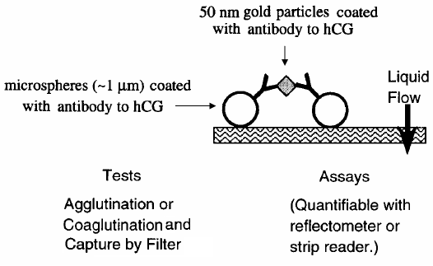
Nanoparticle Applications: Gold
Bangs, L. B. New Developments in Particle-based Immunoassays. Pure & Appl. Chem. Vol. 68, No 10 p 1873-1879. 1996

Slide 27
More applications of gold
See page 206 Pradeep

Slide 28
Metal NP’s in catalysis
See Pradeep page no 236

Slide 29
Thin Film Nanotechnology
A thin film is a layer of material ranging from fractions of a nanometer (monolayer) to several micrometers in thickness
Technique used is deposition
CVD
PVD

Slide 30
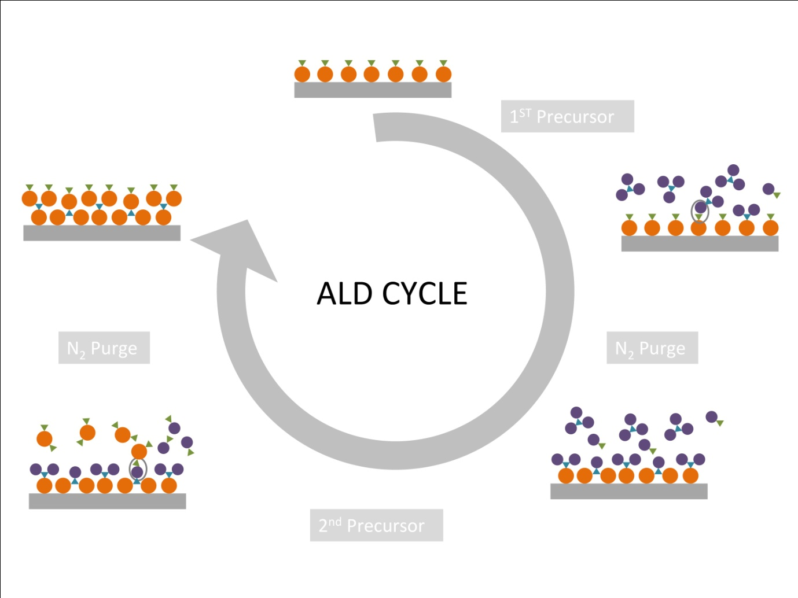

Slide 31
Atomic layer deposition (ALD) is poised to become one of the dominant technologies for the growth of nanometer-thick conformal films in microelectronics processing

Slide 32
Definition:
Chemical Vapor Deposition is the formation of a non-volatile solid film on a substrate by the reaction of vapor phase chemicals (reactants) that contain the required constituents.
The reactant gases are introduced into a reaction chamber and are decomposed and reacted at a heated surface to form the thin film.

Slide 33
Principle:
Fundamental principle is that a chemical reaction takes place between the source gases.
The product of that is a solid material that condenses on all surfaces inside the reactor
Precursor gases (often diluted in carrier gases) are delivered into the reaction chamber at approximately ambient temperatures.

Slide 34
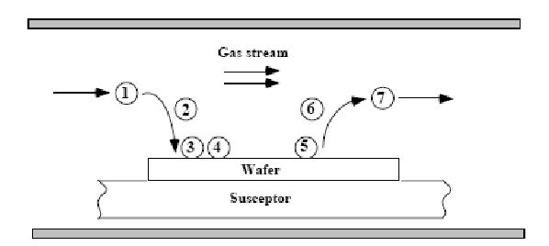
Sequential Steps:
Transport of reacting to the substrate surface
Absorption of species on the substrate surface
Heterogeneous surface reaction catalyzed by the substrate surface.
Desorption of gaseous reaction byproducts
Transportation of reaction by-products away from the substrate

Slide 35
Coating Characteristics
CVD coatings are typically:
    Fine grained
    Impervious
    High purity
CVD coatings are usually only a few microns thick and are generally deposited at fairly slow rates, usually of the order of a few hundred microns per hour.

Slide 36
CVD Apparatus
A CVD apparatus will consist of several basic components:
  Gas delivery system – For the supply of precursors to the reactor chamber
  Reactor chamber – Chamber within which deposition takes place
  Substrate loading mechanism – A system for introducing and removing substrates, mandrels etc
  Energy source – Provide the energy/heat that is required to get the precursors to react/decompose.
  Vacuum system – A system for removal of all other gaseous species other than those required for the reaction/deposition.
  Exhaust system – System for removal of volatile by-products from the reaction chamber.
  Exhaust treatment systems – In some instances, exhaust gases may not be suitable for release into the atmosphere and may require treatment or conversion to safe/harmless compounds.
  Process control equipment – Gauges, controls etc to monitor process parameters such as pressure, temperature and time. Alarms and safety devices would also be included in this category.

Slide 37
Precursors
Materials are deposited from the gaseous state during CVD. Thus precursors for CVD processes must be volatile, but at the same time stable enough to be able to be delivered to the reactor.
Typical Precursor Materials: Halides - TiCl₄, TaCl₅, WF₆, etc
  Hydrides - SiH₄, GeH₄, AlH₃(NMe₃)₂, NH₃, etc
  Metal Organic Compounds –
  Metal Alkyls - AlMe₃, Ti(CH₂tBu)₄, etc
  Metal Alkoxides - Ti(OiPr)₄, etc
  Metal Carbonyls - Ni(CO)₄, etc
  Advantages - CVD films are generally quite conformal, i.e., the ability of a film to uniformly coat a topographically complex substrate. ➢ Versatile –any element or compound can be deposited. ➢ High purity can be obtained. ➢ High density – nearly 100% of theoretical value. ➢ CVD films are harder than similar materials produced using conventional ceramic fabrication processes. ➢ Material formation well below the melting point. ➢ Economical in production, since many parts can be coated at the same time.

Slide 38
Applications
CVD has applications across a wide range of industries such as:
• Coatings – Coatings for a variety of applications such as wear resistance, corrosion resistance, high temperature protection, erosion protection and combinations thereof.
• Semiconductors and related devices – Integrated circuits, sensors and optoelectronic devices
• Dense structural parts – CVD can be used to produce components that are difficult or uneconomical to produce using conventional fabrication techniques. Dense parts produced via CVD are generally thin walled and maybe deposited onto a mandrel or former.
• Optical Fibres – For telecommunications.
• Composites – Preforms can be infiltrated using CVD techniques to produce ceramic matrix composites such as carbon-carbon, carbon-silicon carbide and silicon carbide-silicon carbide composites. This process is sometimes called chemical vapour infiltration or CVI.
• Powder production – Production of novel powders and fibres
• Catalysts
•

Slide 39
PHYSICAL VAPOR DEPOSITION
PVD is a process by which a thin film of material is deposited on a substrate acc to following steps:
The material to be deposited is converted into vapour by physical means
The vapor is transported across a region of low pressure from its source to the substrate
Vapor undergoes condensation on the substrate to form the thin film
Evaporation
Sputtering

Slide 40
PVD
CVD
Deposition occur by condensation.
The material that is introduced onto the substrate is introduced in solid form
Atoms are moving and depositing on the substrate
PVD coating is deposited at a relatively low temperature (around 250°C~450°C)
Deposition occur by chemical reaction.
Introduced in a gaseous form
The gaseous molecules will react with the substrate.
CVD uses high temperatures in the range of 450° C to 1050° C.

Slide 41
Cont….
PVD
CVD
5. PVD is suitable for coating tools that are used in applications that demand a tough cutting edge.
High capital cost
7. Coating thickness up to 20micrometer
5. CVD is mainly used for depositing compound protective coatings.
6. Low capital cost
7. Coating thickness 3-5 micrometer

Slide 42
SPUTTERING
Sputtering is a deposition tech consist of basic 4 steps;
Ions are generated & directed at the target material
The ion sputter atoms from the target material
The sputter atom get transported to the substrate through a region of reduced pressure
This sputter atom condense on the substrate forming a thin film

