Slide 1

LiAlH₄ ,Boranes (BH₃) and NaBH₄

Slide 2


Slide 4
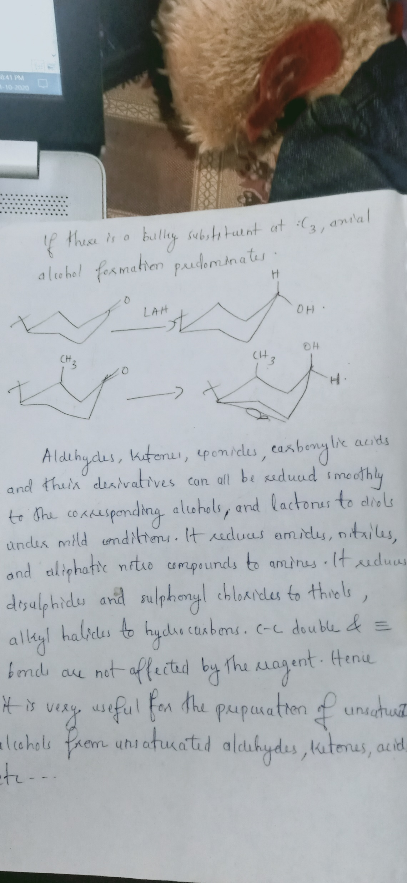
LiAlH₄

Slide 5
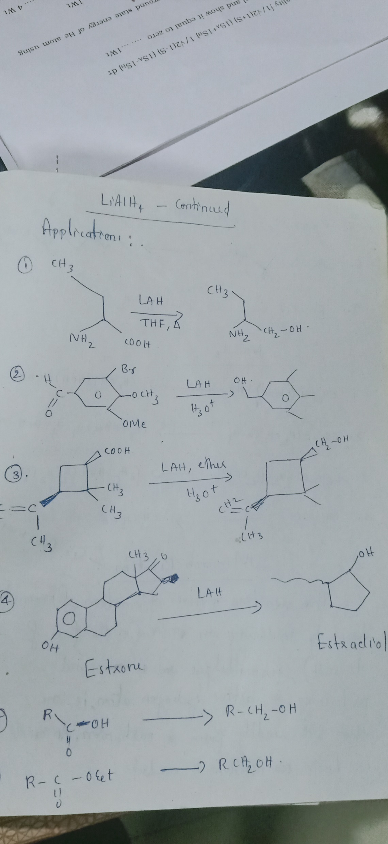

Slide 6
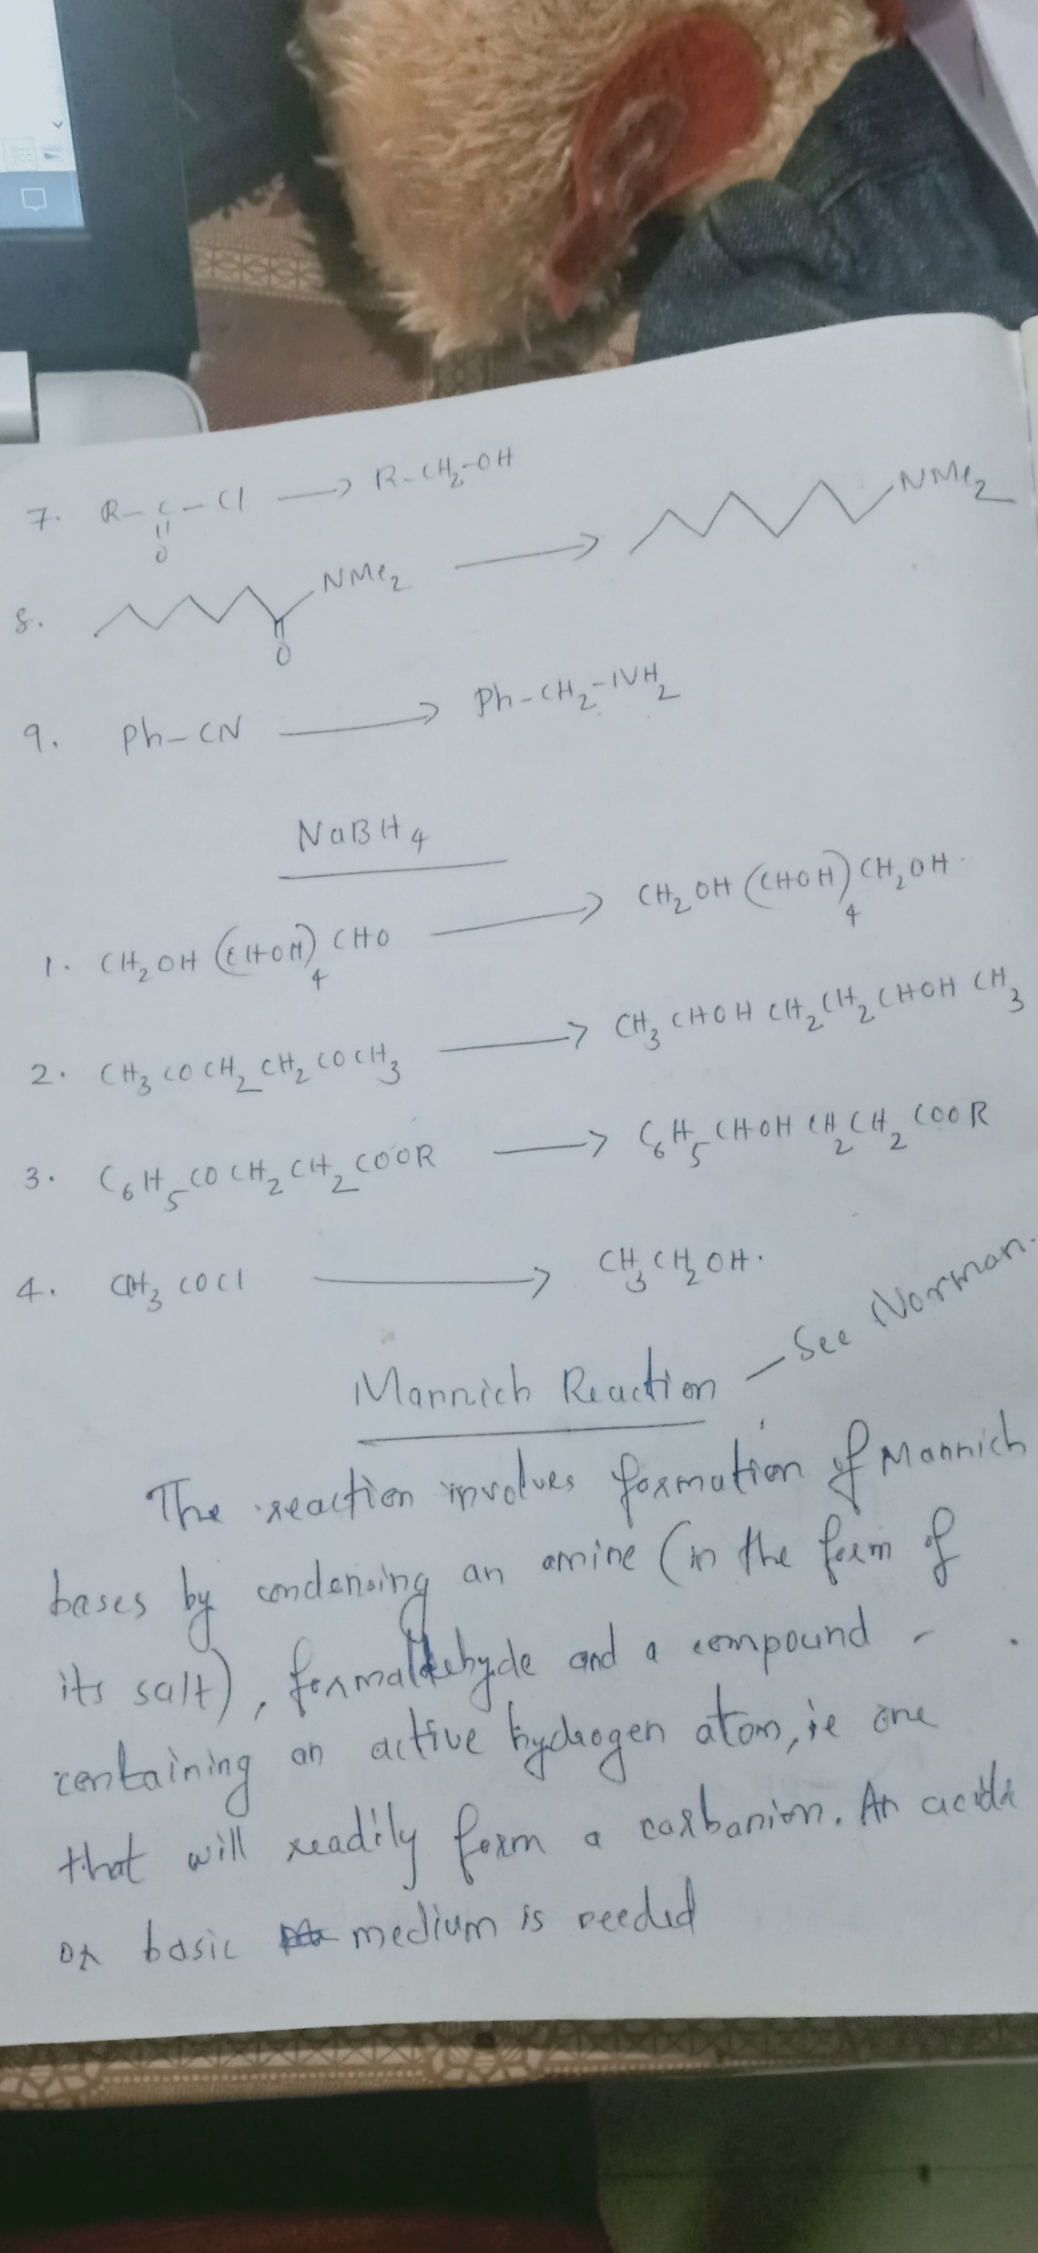

Slide 7
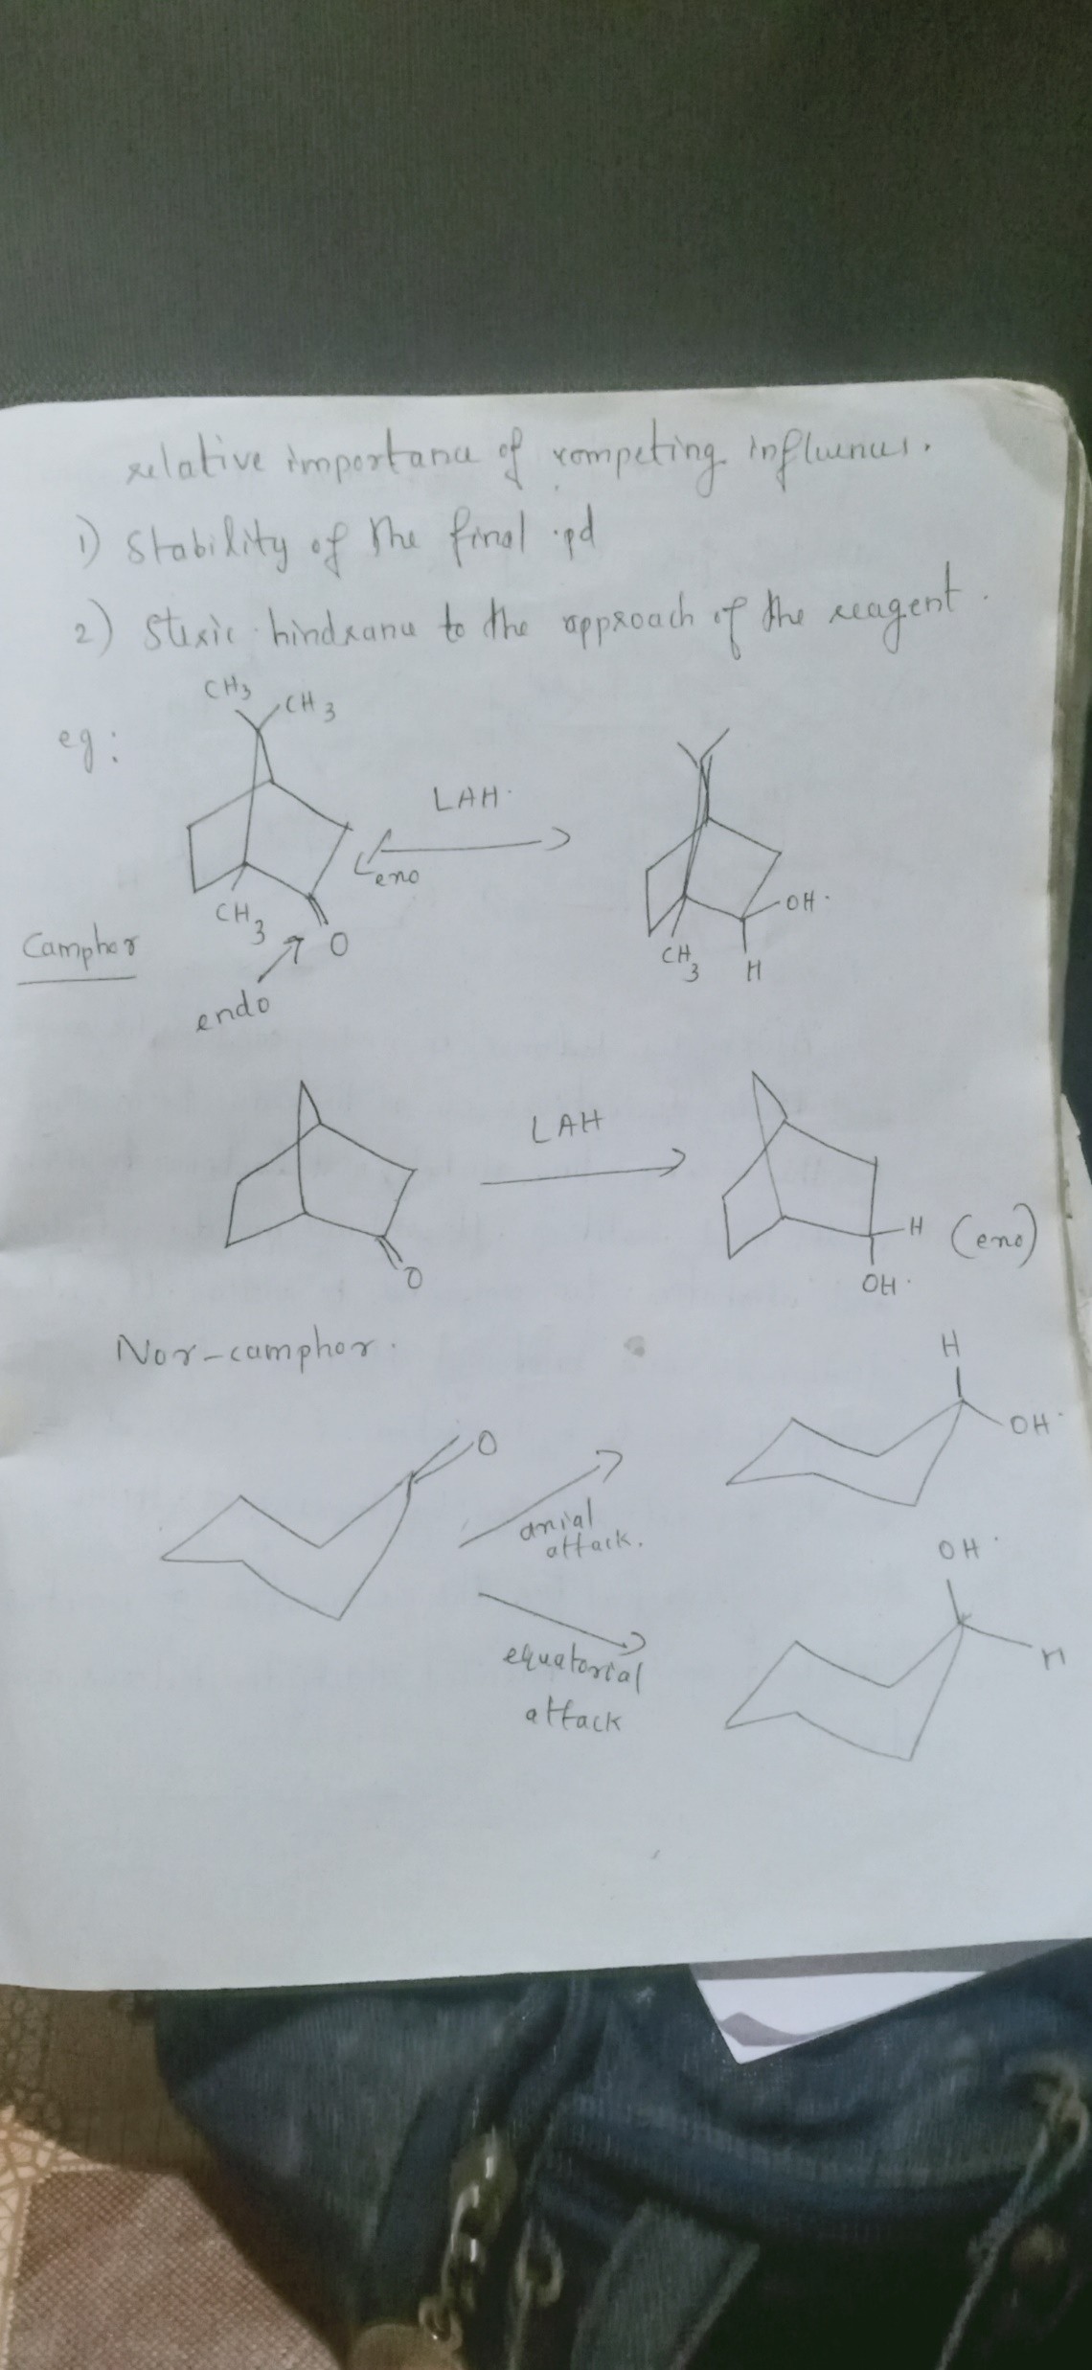
In rigid cyclic ring ketones, the stereochemistry of
reduction is determined by the relative importance of
competing influences which are

Slide 9


Slide 10
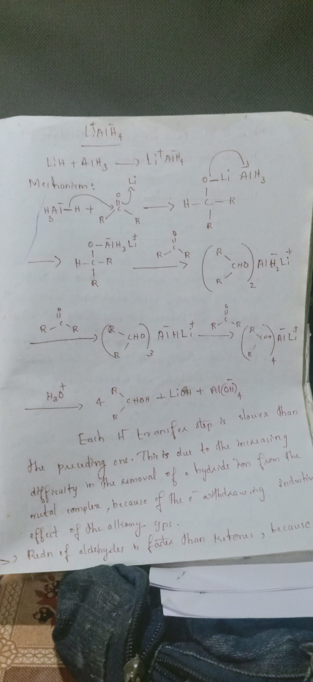

Slide 13


Slide 14
NaBH4

Slide 15
How to reduce carboxylic acids to alcohols---------------BH₃
The best reagent for this is borane, BH₃. Borane is, in fact, a gas with the structure B2H6, but it can be ‘tamed’ as a liquid by complexing it with ether (Et2O), THF, or dimethyl sulfide (DMS, Me₂S). Although borane appears superficially similar to borohydride, it is not charged, and that makes all the difference to its reactivity. Whereas borohydride reacts best with the most electro philic carbonyl groups, borane’s reactivity is dominated by its desire to accept an electron pair into the boron’s empty p orbital. In the context of carbonyl group reductions, this means that borane reduces electron-rich carbonyl groups fastest. The carbonyl groups of acyl chlorides and esters are relatively electron-poor (Cl and OR are very electronegative);
borane will not touch acyl chlorides and reduces esters only slowly. But it will reduce very effectively both carboxylic acids and amides.

Slide 16
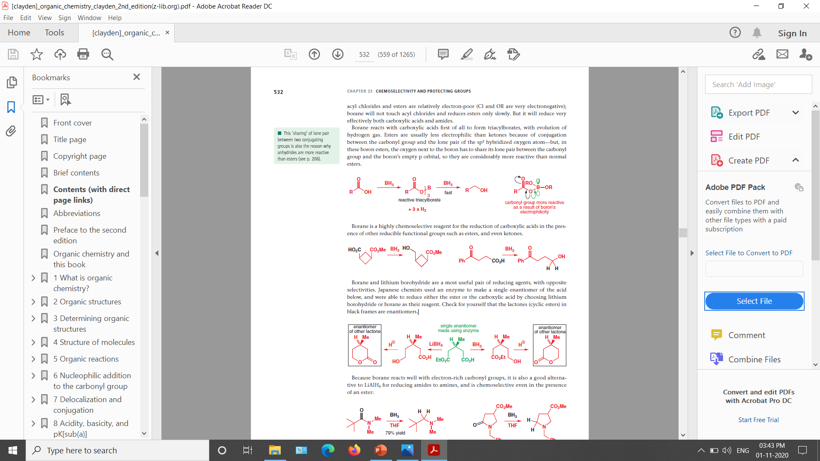
Borane is a highly chemoselective reagent for the reduction of carboxylic acids in the presence of other reducible functional groups such as esters, and even ketones.

Slide 17
Borane and lithium borohydride are a most useful pair of reducing agents, with opposite
selectivities

Slide 18
How to reduce aldehydes and ketones to alcohols? Best option is NaBH4
How to reduce esters to alcohols? Best option is LiAlH4 or LiBH4 in alcoholic soln
How to reduce amides to amines? LiAlH4 or BH3
How to reduce carboxylic acids to alcohols? Best is BH3

Slide 19
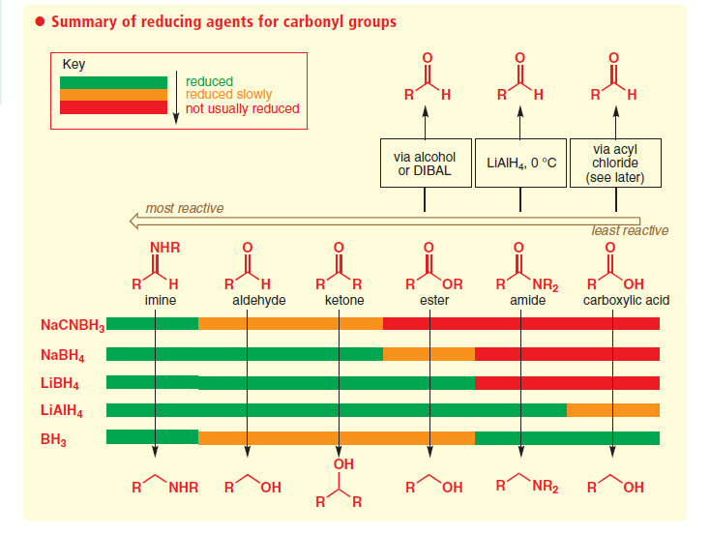

Slide 20
