Slide 1
MODIFICATION OF POLYMERIC MEMBRANES USING POLYELECTROLYTE ASSISTED LbL METHOD
Reg.No: 63617132009

Slide 2
INTRODUCTION
Conventional filters are limited to the separation of particulate suspensions larger than 1-10 µm
The most fundamental breakthrough in separation came in late 1960s, by the introduction of polymeric membranes
They are more effective than any other separation processes due to its small pore size of about 1000-0.0001µm and offers better performance at 99.9999%
It extends its applications towards the separation of dissolved solutes in liquids and for the separation of gaseous mixtures
It also has drawbacks due to membrane fouling, additional costs for membrane cleaning, high hydrophobicity, low fluxes and low mechanical strength with relatively low surface energy
This was overcome by the surface modification of membranes with polyelectrolyte multilayer coating through layer-by-layer (LbL) deposition technique which has improved its efficiency and performance
In the present work a PEMM was prepared by coating CHI/PSS layers on an Ultipor Membrane and investigated its properties

Slide 3
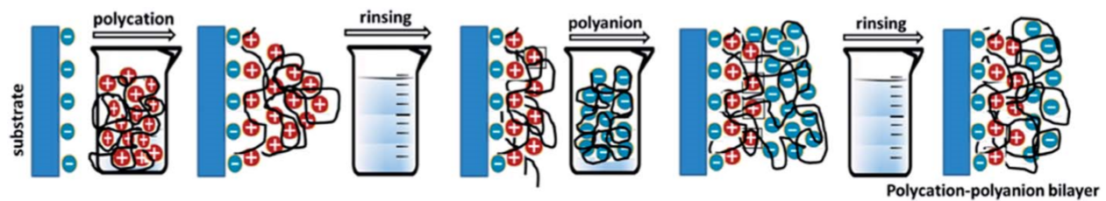
Layer by Layer (LbL) Method
A simple and versatile method for the fabrication of modified membranes making it suitable as separation membranes
The incorporation of polyelectrolytes (PE) into support membrane by LbL method offers nanometer thickness and high selectivity by governing the number of sequential adsorption , ease of fabrication, the ability to control charge density and porosity
It involves the alternative sequential adsorption of polyanions and polycations on any charged surface by immersing in PE solutions that leading to a polyelectrolyte multilayer (PEM) formation
There is a rinsing step after each deposition to remove weakly adsorbed polyelectrolyte
LbL technique is done by charge overcompensation between oppositely charged polyelectrolytes. This leads to improved thickness control and increased stability.
The process is repeated so as to get PEMM with desired thickness
Fig.1 Layer by Layer assembly of polyelectrolytes

Slide 4
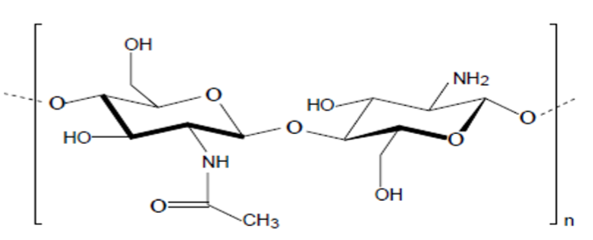
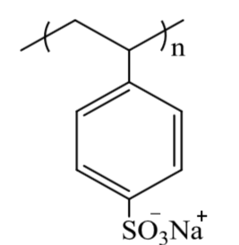
MATERIALS AND METHODS
Materials
Supporting membrane :Ultipor Nylon N6, 6 Membrane as (pore size :0.45 ,thickness 140-170µm,Pall Life Sciences),
Polycation : Chitosan (CHI, medium MW, 75–85% deacetylated chitin, Sigma-Aldrich)
Polyanion : Poly(styrene sulfonic acid) sodium salt (PSS, M​W= 200,000, 30wt % in water, Sigma-Aldrich)
NaCl (Emsure) , Hydrochloric acid (HCl) 10​-1​mol L​-1​ of AR grade
MilliQ water,resistivity18.2 M Ω cm) was used for all purposes
Fig.2 Chitosan
Fig.3 PSS
Sample preparation
1. First of all, Ultipor membrane was kept in water for 24h before use
2. The clean membrane was then dipped in 0.1M chitosan (0.4025g of Chitosan in 250ml water) in water at pH 1.7

Slide 5
3. After 15 minutes dipping, the membrane was rinsed with ultrapure water for 1min and then t dipped in 0.1M PSS in 0.1M NaCl (1.7163g of PSS along with 1.4655g of solid NaCl in 250ml water) at pH range 1.7
4. The membrane was then again washed with distilled water
5. The above mentioned steps were repeated several times to build successive CHI/PSS layers on the membrane. Thus a 2,4,6 and 8 bilayers of CHI/PSS PEMMS were prepared
Membrane Characterization
Characterization was done to determine whether the surface modification had actually taken place and are follows :
Attenuated Total Reflectance Fourier Transform Infrared (ATR-FTIR) spectroscopy (Shimadzu IR prestige 21 spectrophotometer)
UV/Vis Spectroscopy (Jasco V-650 UV/Vis Spectrophotometer)
Thermo-Gravimetric Analysis (TGA) (Universal analysis 2000,version4.5A, TA instrument)
Atomic force microscope (AFM) (Witec alpha 300 RA AFM instrument)

Slide 6
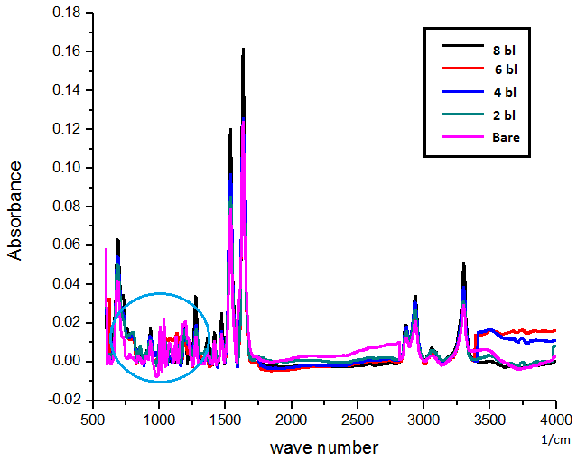
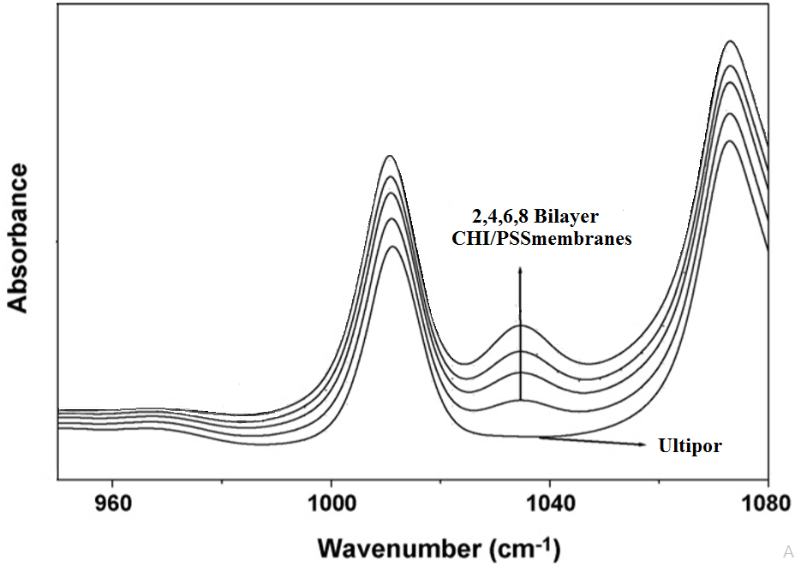
RESULT AND DISCUSSION
ATR-FTIR analysis of Modified membrane
1035cm​̄ ˡ:Sulfonate group of PSS
1178, 1035.77, 935.48 and 842.89cm​​̄ ˡ: asymmetric and symmetric O=S=O stretching and S-O-S stretching
1006.84 and 1128cm​​̄ ˡ: in-plane bending; in-plane skeletal vibration of aromatic ring
3300.2cm​​̄ ˡ:O-H stretching , characteristic of C=O in CHI
2935.66- 2864.29cm​̄ ˡ​: C-H symmetric and asymmetric stretching
1400–1700cm​​̄ˡ: symmetric and antisymmetric –NH​3​+ stretching
1633.71cm​̄ ˡ : C=O stretching of amide1537.27cm​̄ ˡ: N-H bending

Slide 7
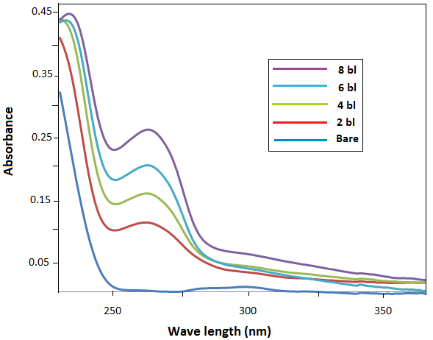
All theses peaks are characteristic of the functional groups in CHI and PSS.
The increase in area under the peak with the number of bilayers is a strong evidence that the PE physisorption was successful
The membrane thickness increases with the number of layers deposited
II UV/Vis Spectroscopic Characterization of modified membrane
A maximum absorption wavelength at 225nm phenyl groups in PSS) at each deposited layer
It is not observed in bare membrane
The intensity of absorption band increases linearly with the no. of bilayers on membrane due to π →π​∗ transition of the benzene ring in PSS which is the reason for the formation of self-assembled system of PEMs.

Slide 8
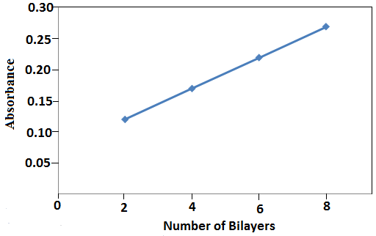
The linear increase of PEMM absorption with the no. of deposited bilayers suggest :
Same amount of PEs adsorbed at each deposition step.
Multilayer formation occurs first with monolayer deposition , then with bilayer and so on
PEMMS have an organized self assembly
PEMMS possess a certain degree of uniformity
III Thermal analysis of Modified membrane
Bare as well as modified membranes were thermally stable up to 220​​ºC
A slight weight loss above 220​°C where degradation starts
Two degradation stages were observed for modified membrane
A weight loss of 4.1980% is observed for 8bl membrane at 325º​​C due to the loss of adsorbed solvent, loss of moisture content and small amount of loosely bounded PEs.
A significant weight loss at 350-450º​​C is due to decomposition of phenyl groups; polyethylene chain of PSS and acetylated and deacetylated units of CHI

Slide 9
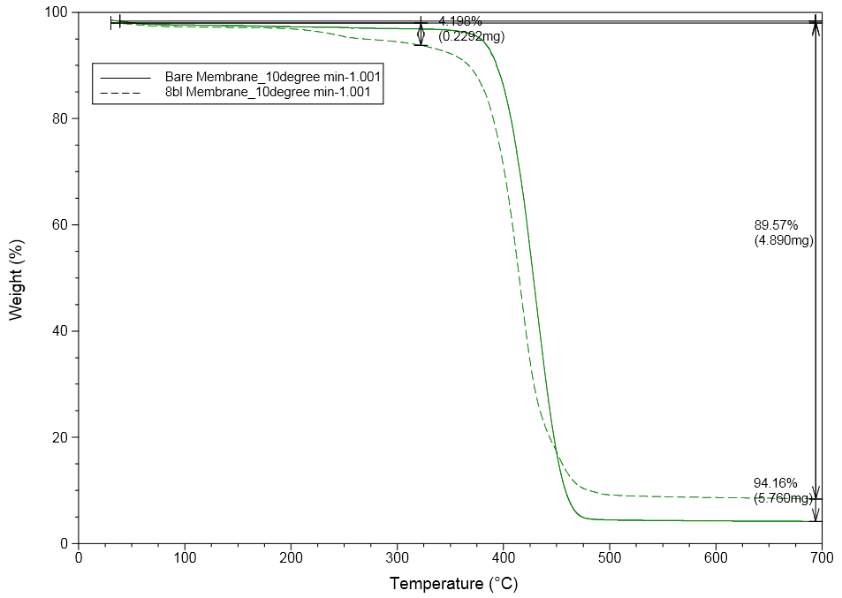
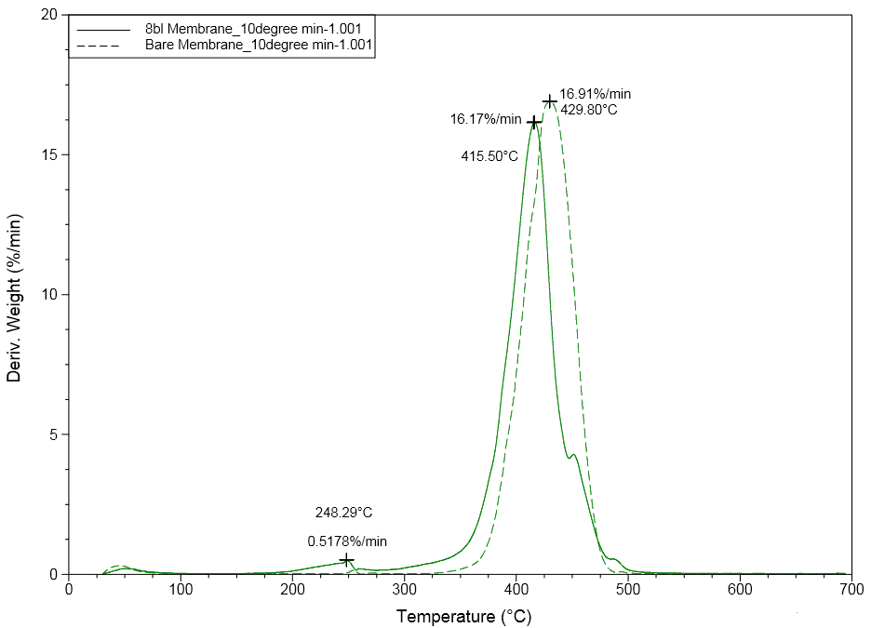
At 695ºC modified membrane shows another weight loss (89.57%) lower than bare membrane (94.16%). This difference is due to the extent of modification and cross linking
At around 490ºC decomposition of the membranes were almost completed
8 bl membrane has its Tg at 415.50°C (16.17%/min). While the bare membrane has a high Tg at 429.80°C (16.19%/min)
Decomposition temperature increases with PE coating shows that PEs were dispersed uniformly in the membrane and are strongly bonded
Thermal stability of modified membrane is greater than that of the modified membrane which increases with the number of deposited bilayers

Slide 10
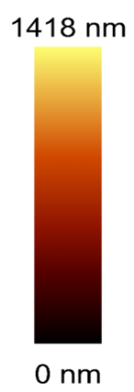
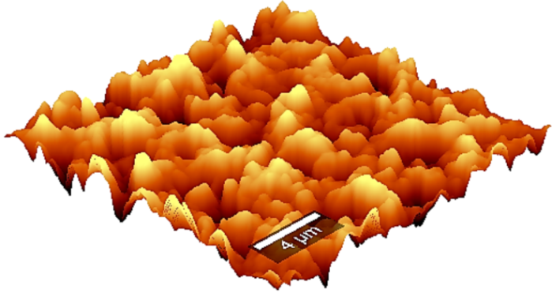
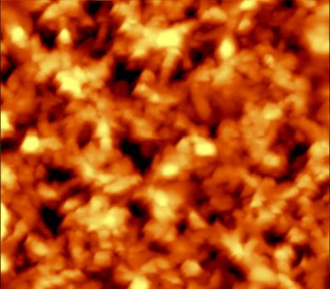
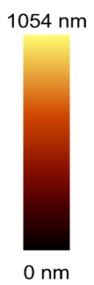
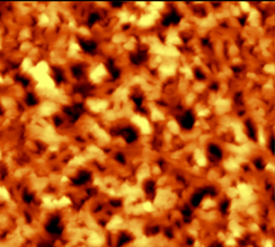
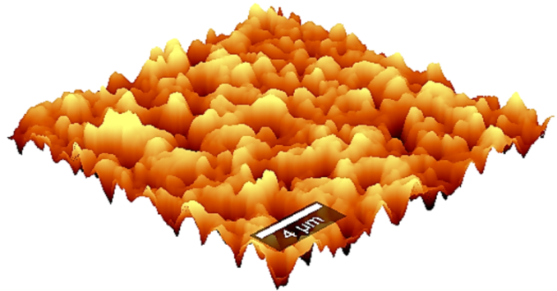
IV Atomic Force Microscopic (AFM) analysis of Modified membrane
Fig.4 2D and 3D AFM images of 2 bl membrane
Fig.5 2D and 3D AFM images of 8 bl membrane
The pore size of 2 bl membrane is higher than that of 8 bl membrane shows the decrease of pore size as well as porosity with the number of deposited layers
Modification causes a decrease in surface roughness due to the reduction of pore size by the migration of PEs towards the membrane surface. Thus mean roughness of 2 bl is higher than that of 8 bl membrane

Slide 11
Table.AFM results of modified membrane
Parameters | 2 bilayer membrane | 8 bilayer membrane
Average Roughness (Sa) nm | 235.862 | 180.23
RMS Roughness (Sq) nm | 298.187 | 229.021
Surface area ratio (Sdr) % | 48.6242 | 44.0408
Average pore size | 1.249 ± 0.43 | 0.759 ± 0.26
Pore density(µmˉ²) | 32 0.08 | 60 0.15
Porosity(%) | 9.8 | 6.8
Membrane thickness also increased linearly with the number of bilayers due to swelling of the membranes after the incorporation of PEs
In 2 bl membrane, surface charge is not so balanced. So the amount of assembled PEs on each layer was relatively less, resulting in incomplete compactness of the cross-linked thin ﬁlm on the surface of the modified membrane
In 8 bl, the surface charge reached a balance and the adsorption capacity of each PE double layer was the same, which resulting in comparatively denser and smoother surface
Smoother membranes were obtained as the number of adsorption step increases which leads to a reduction in fouling as surface area decreases

Slide 12
SCOPE AND OBJECTIVE OF THE STUDY
The aim of this work is to develop a modified membrane with better physical, chemical and thermal properties, good permeability ,high selectivity with low operation costs
Currently researches are focusing on polymeric membranes due to :
Easy forming properties, selective transfer of chemical species,
Relatively small foot print,
Better control of pore forming mechanism
High flexibility
Smaller spaces required for installations compared to inorganic membranes
The major advantages of membrane technology compared to other separation processes are low energy consumption, simplicity and environmental friendliness, easy to use, inexpensiveness
It is said to be a ‘clean technology’ as membrane separation does not require any additives which may be potential pollutants
Membrane technologies are attaining more attention due to their reliable contaminant removal without the production of harmful products
Membrane based processes enjoy numerous applications and the most important among them is that of efficient water purification

Slide 13
CONCLUSION
For low-cost filtration applications, polymeric materials are the ideal choice for membrane fabrication
This study investigated on the surface functionalization of membranes using PEs and focuses mainly on the properties of PEMMs. A PEM of CHI/PSS that designed on an Ultipor membrane with 2, 4, 6 and 8 bilayers by LbL treatment is demonstrated
The increase of membrane thickness with the number of adsorption steps was monitored through ATR-FTIR and UV analysis. UV/Vis spectroscopy suggests that PE adsorption is a step-wise, regular process .Thermal analysis shows the increase of thermal stability with addition of PEs. AFM results indicates a change in surface morphology with the addition of PEs
The successful PE adsorption occurs as a result of charge over compensation of oppositely charged PEs on the substrate surface
Major problems of membranes such as fouling and befouling can be reduced through this fabrication of PEs incorporated membranes. The film thickness can also easily controlled to the nanometer scale by simply varying the number of bilayers

Slide 14
THANK YOU

