Slide 1
Inorganic Chemistry III
Unit IV: Spectroscopic Methods in Inorganic Chemistry
18 h

Slide 2
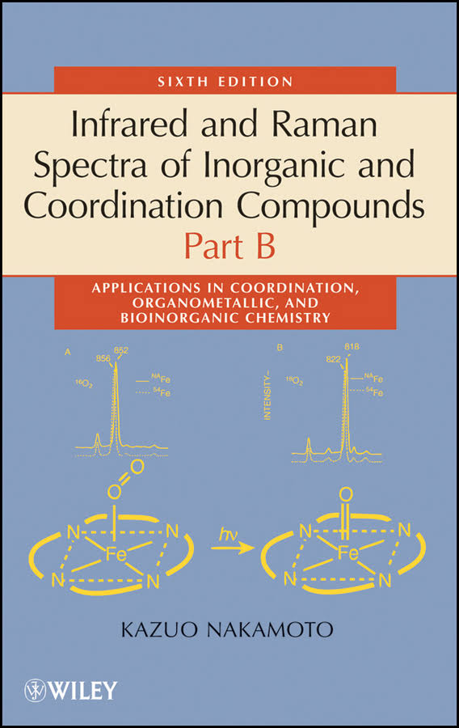
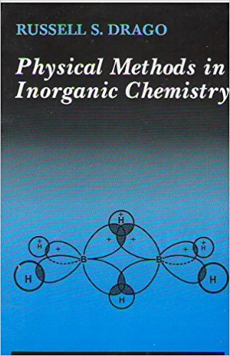
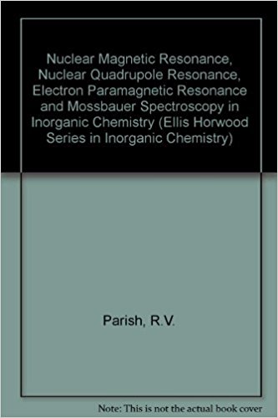
Books to read….

Slide 3
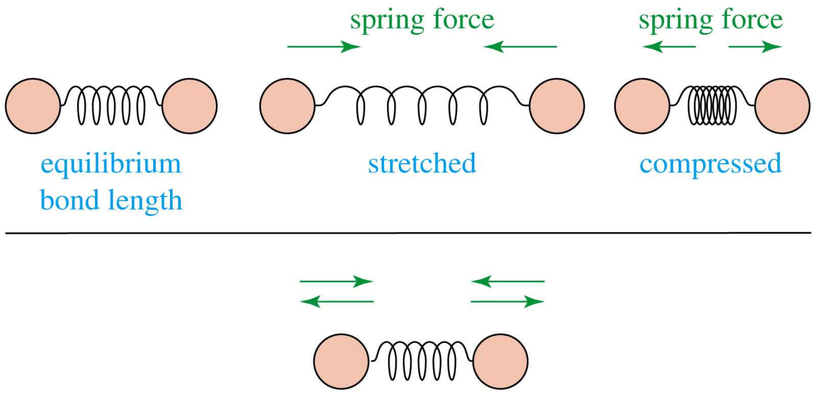
Infrared spectra
Infrared radiation is largely thermal energy.
It induces stronger molecular vibrations in covalent bonds, which can be viewed as springs holding together two masses, or atoms.
Specific bonds respond to (absorb) specific frequencies
Graphics source: Wade, Jr., L.G. Organic Chemistry, 5th ed. Pearson Education Inc., 2003

Slide 4
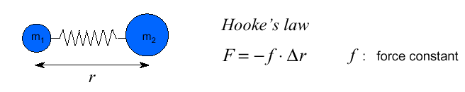
Vibrational spectra (I): Harmonic oscillator model
• Infrared radiation in the range from 10,000 – 100 cm ^{–1} is absorbed and converted by an organic molecule into energy of molecular vibration
–> this absorption is quantized:
A simple harmonic oscillator is a mechanical system consisting of a point mass connected to a massless spring. The mass is under action of a restoring force proportional to the displacement of particle from its equilibrium position and the force constant f (also k in followings) of the spring.

Slide 5

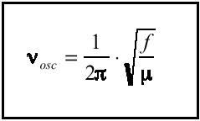
• The vibrational energy V(r) can be calculated using the (classical) model of the harmonic oscillator:
• Using this potential energy function in the Schrödinger equation, the vibrational frequency can be calculated:
The vibrational frequency is increasing with:
• increasing force constant f = increasing bond strength
• decreasing atomic mass
• Example: f _{c≡c} > f _{c=c} > f _{c-c}

Slide 6
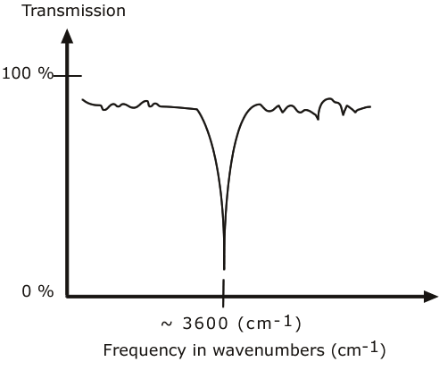
AN IR SPECTRUM IN TRANSMISSION MODE
The graph above shows a spectrum in transmission mode.
This is the most commonly used representation and the one found in most chemistry and spectroscopy books. Therefore we will use this representation.

Slide 7
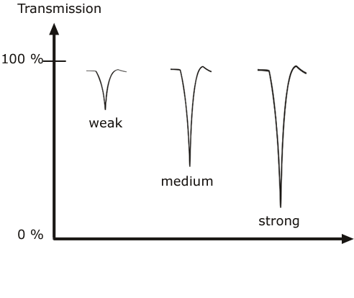
CLASSIFICATION OF IR BANDS
IR bands can be classified as strong (s), medium (m), or weak (w), depending on their relative intensities in the infrared spectrum. A strong band covers most of the y-axis. A medium band falls to about half of the y-axis, and a weak band falls to about one third or less of the y-axis.

Slide 8
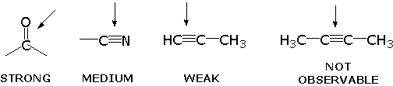
INFRARED ACTIVE BONDS
Not all covalent bonds display bands in the IR spectrum. Only polar bonds do so. These are referred to as IR active.
The intensity of the bands depends on the magnitude of the dipole moment associated with the bond in question:
Strongly polar bonds such as carbonyl groups (C=O) produce strong bands.
Medium polarity bonds and asymmetric bonds produce medium bands.
Weakly polar bond and symmetric bonds produce weak or non observable bands.

Slide 9
INFORMATION OBTAINED FROM IR SPECTRA
IR is most useful in providing information about the presence or absence of specific functional groups.
IR can provide a molecular fingerprint that can be used when comparing samples. If two pure samples display the same IR spectrum it can be argued that they are the same compound.
IR does not provide detailed information or proof of molecular formula or structure. It provides information on molecular fragments, specifically functional groups.
Therefore it is somewhat limited in scope, and must be used in conjunction with other techniques to provide a more complete picture of the molecular structure.

Slide 10
IR spectroscopy of coordination complexes

Slide 11
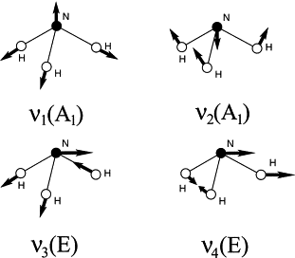
NH₃
Assymmetric and symmetric NH₃ stretching, NH₃ degenerate deformation, NH₃ symmetric deformation, and NH₃ rocking vibrations appear in the regions of 3400–3000, 1650–1550, 1370–1000, and 950–590 cm⁻¹, respectively.

Slide 12
The NH₃ stretching frequencies of the complexes are lower than those of the free NH₃ molecule for two reasons.
One is the effect of coordination. On coordination,
the NH bond is weakened and the NH₃ stretching frequencies are lowered. The stronger the M-N bond, the weaker is the NH bond and the lower are the NH₃ stretching frequencies if other conditions are equal. Thus the NH₃ stretching frequencies may be used as a rough measure of the M-N bond strength.
The other reason is the effect of the counter ion. The NH₃ stretching frequencies of the chloride are much lower than those of the perchlorate, for example. This is attributed to the weakening of the NH bond, due to the formation of the NH Cl-type hydrogen bond in the former.
The effects of coordination and hydrogen bonding mentioned above shift the NH₃ deformation and rocking modes to higher frequencies.

Slide 13
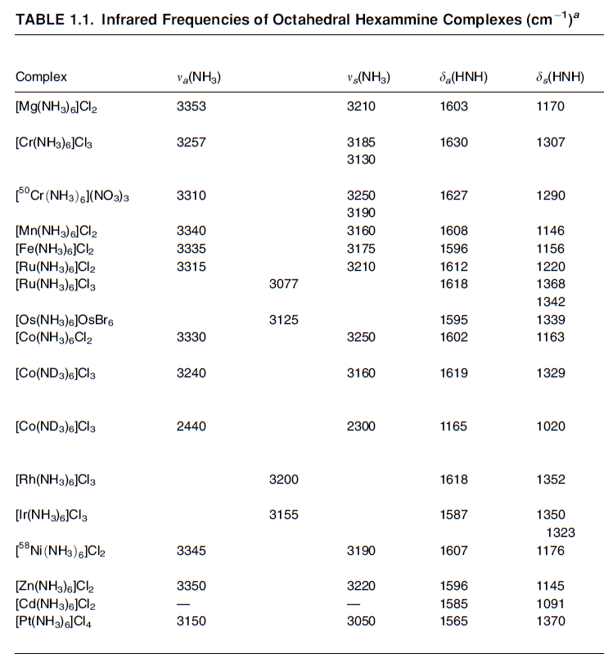

Slide 14
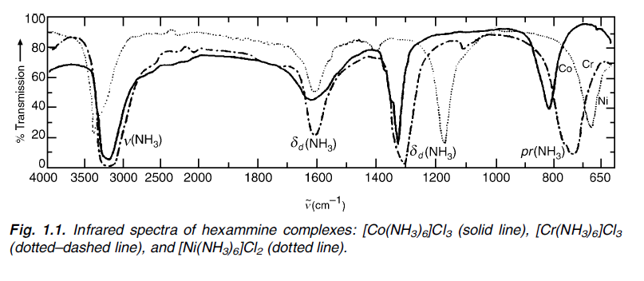

Slide 15
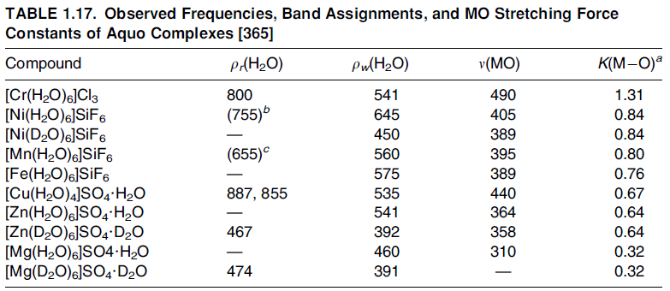
H₂O
In general, lattice water absorbs at 3550–3200 cm⁻¹ (assymmetric and symmetric OH stretching) and at 1630–1600 cm⁻¹ (HOH bending).
In addition to the three fundamental modes of the free water molecule, coordinated water exhibits other modes
rocking (ρ_{r}), twisting (ρ_{t}), and wagging (ρ_{w}) modes of the coordinate water molecule

Slide 16
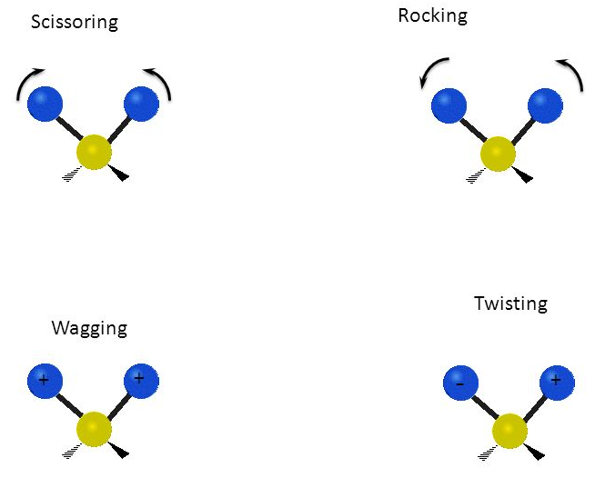

Slide 17
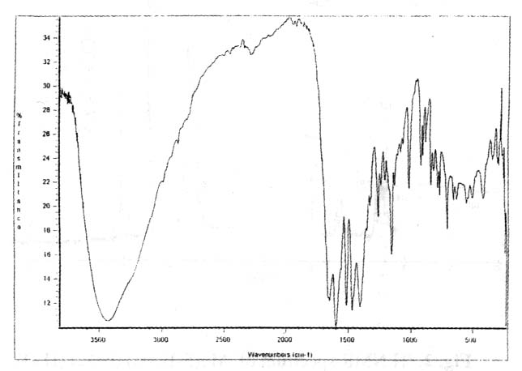
Mg(5-Brsal)(acac)(H2O)2
5-bromosalicylaldehyde

Slide 18
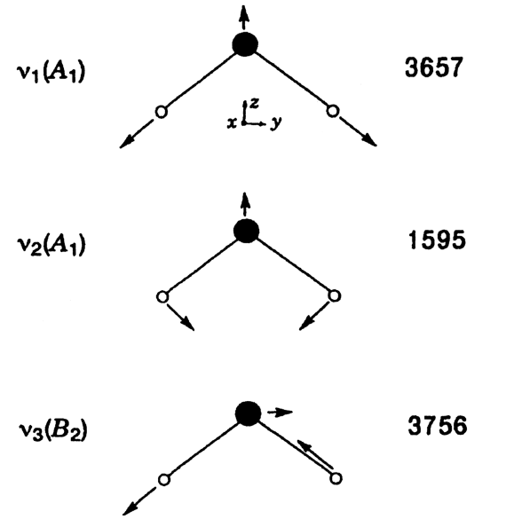

Slide 19
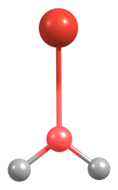
Red Shift (decrease of IR absorption frequency) in O-H Stretches
The HOMO of water has partial
bonding character. Polarization of
the electron due to metal cation
removes the electron
density from the O-H bond –Red shift
Intensity Pattern
The intensity ratio of symmetric and
asymmetric stretches 1: 18 for water molecule.
Combination band
Asymmetric Stretch
Asymmetric Stretch-perpendicular
type vibration- less change in dynamical dipole moment than the
symmetric stretch
Symmetric Stretch
Symmetric Stretch-parallel type
vibration- Involves greater change in dynamical dipole moment-gains
greater intensity
C₂

Slide 20
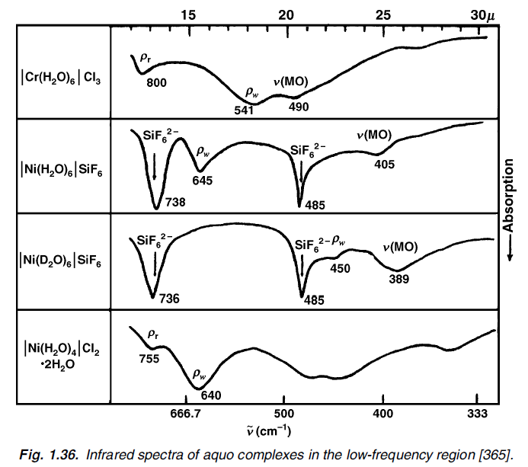
OH stretching frequencies are red shifted
Symmetric stretch gains IR intensity relative to asymmetric stretch
Shifts in band positions and IR intensities greater for dications

Slide 21
CO
Most carbonyl complexes exhibit strong and sharp ν(CO) bands at 2100– 1800 cm⁻¹.
Since ν(CO) is generally free from coupling with other modes and is not obscured by the presence of other vibrations, studies of ν(CO) alone often provide valuable information about the structure and bonding of carbonyl complexes.
In the majority of compounds, ν(CO) of free CO(2155 cm⁻¹) is shifted to lower frequencies.

Slide 22
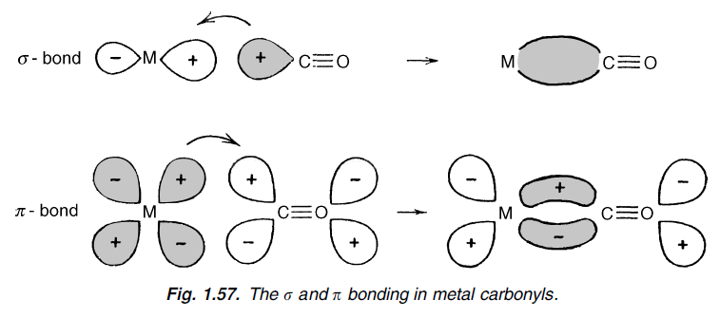
(1) The σ-bond is formed by donating 5s electrons of CO to the empty orbital of the metal which tends to raise ν(CO), since the 5s orbital is slightly antibonding; and
(2) the π-bond is formed by backdonating the dπ-electrons of the metal to an empty antibonding orbital, the 2pπ* orbital of CO. This tends to lower ν(CO). Although these two components of bonding are synergic, the net result is a drift of electrons from the metal to CO when the metal is in a relatively low oxidation state. Thus the ν(CO) of metal carbonyl complexes are generally lower than the value for free CO. The opposite trend is observed, however, when CO is complexed with metal halides in which the metals are in a relatively higher oxidation state

Slide 23
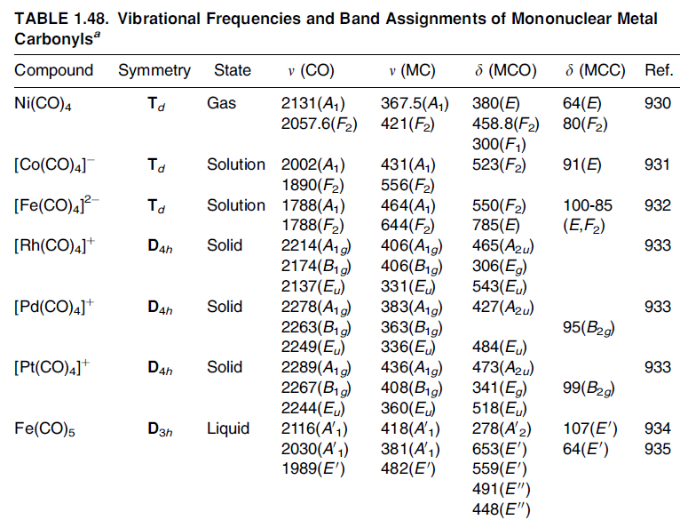
If CO forms a bridge between two metals, its ν(CO) (1900–1800 cm⁻¹) is much lower than that of the terminal CO group (2100–2000 cm⁻¹). An extremely low ν(CO) (1300 cm⁻¹) is observed when the bridging CO group forms an adduct via its O atom

Slide 24

In general, the ν(CO) is lowered as the negative charge on the metal carbonyl increases.
the metal- CO π-back bonding increases as the negative charge increases.
Conversely, as the positive charge of the complex increases, the ν(CO) is shifted to higher frequency because the σ-bonding becomes more predominant
[Hg(CO)₂]²⁺ (ν_{s}, 2281 and ν_{a}, 2278 cm⁻¹) and [Au(CO)₂]⁺ (ν_{s}, 2246.0 and ν_{a}, 2210.5 cm⁻¹) show extremely high ν(CO)

Slide 25
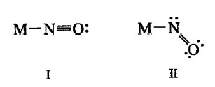
NO
Like CO, NO acts as a σ-donor and a π-acceptor. The NO contains one more electron than CO, and this electron is in the 2pπ* orbital.
The loss of this electron gives the nitrosonium ion, (NO)+, which is much more stable than NO.
Thus, the ν(NO) of the nitrosonium ion (2273 cm⁻¹) is much higher than that of the latter (1880 cm⁻¹).
On the other hand, the addition of one electron to this orbital produces the (NO)- ion, which is less stable and gives a lower frequency (1366 cm⁻¹) than does NO
In nitrosyl complexes, ν(NO) ranges from 1900 to 1500 cm⁻¹

Slide 26
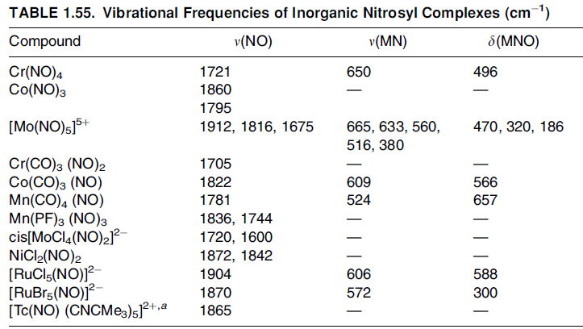
the distinction between linear and bent geometry can be made by using properly corrected ν(NO) values; the MNO group is linear or bent, respectively, if this value is above or below 1620–1610 cm⁻¹

Slide 27
OH⁻
The hydroxo group can be distinguished from the aquo group since the former lacks the HOH bending mode near 1600 cm⁻¹.
Furthermore, the hydroxo complex exhibits the MOH bending mode below 1200 cm⁻¹.
For example, this mode is at 1150 cm⁻¹ for the [Sn(OH)₆]²⁻ ion and at 1065 cm⁻¹ for the [Pt (OH)₆]²⁻ ion.
The [P(OH)₄]+ ion exhibits ν(OH), δa(POH), and δs(POH) vibrations at 3379/3262, 1112, and 1017 cm⁻¹, respectively

Slide 28
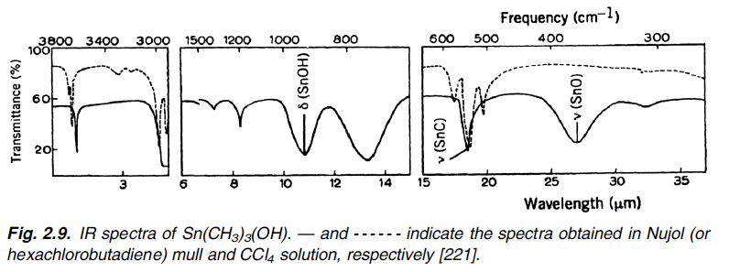
Compounds containing the hydroxo (OH) group exhibit ν(OH), δ(MOH), and ν(MO) at 3760–3000, 1200–700, and 900–300 cm⁻¹, respectively. As expected, these frequencies depend heavily on the metal and the strength of the hydrogen bond involved.

Slide 29
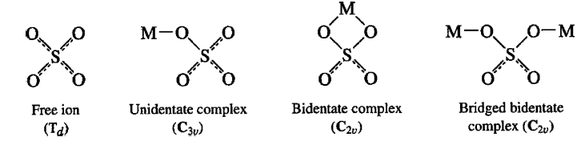
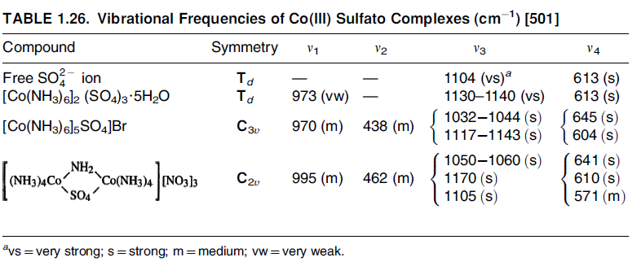
SO₄⁻

Slide 30
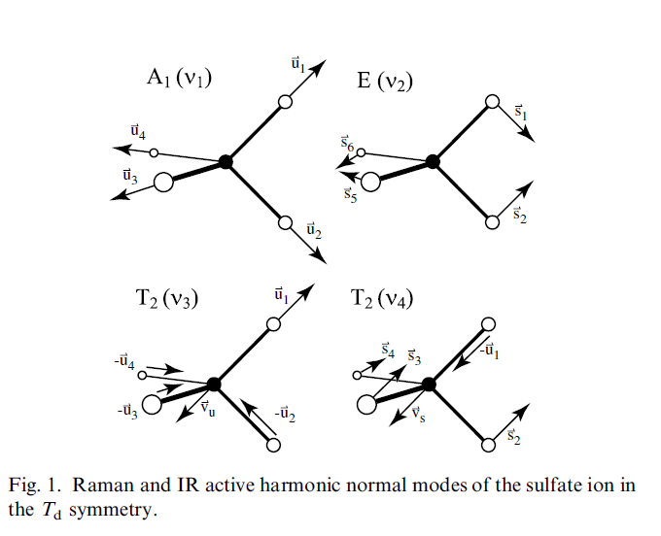
Of the four fundamentals, only ν3 and ν4 are infrared-active. If the symmetry of the ion is lowered by complex formation, the degenerate vibrations split and Raman-active modes appear in the infrared spectrum. The lowering of symmetry caused by coordination is different for the unidentate and bidentate complexes

Slide 31
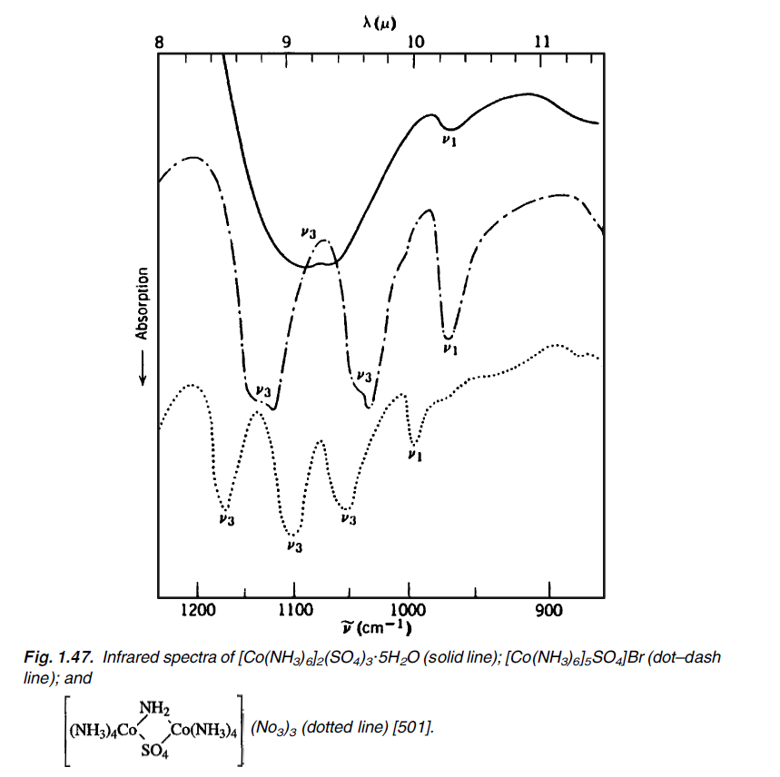

Slide 32
CN⁻
Cyano complexes can be identified easily since they exhibit sharp ν(CN) at 2200–2000 cm⁻¹. The ν (CN) of free CN is 2080 cm⁻¹ (aqueous solution).
On coordination to a metal, the ν (CN) shift to higher frequencies, as shown in Table

Slide 33
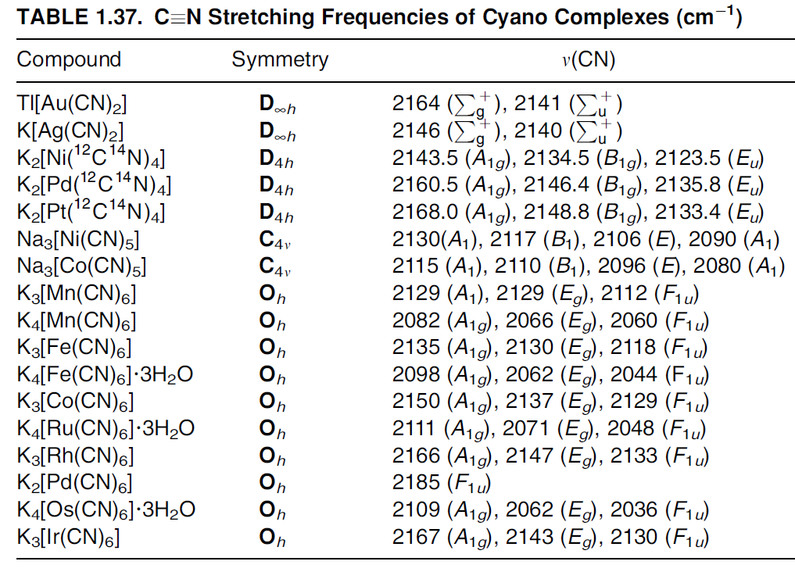

Slide 34
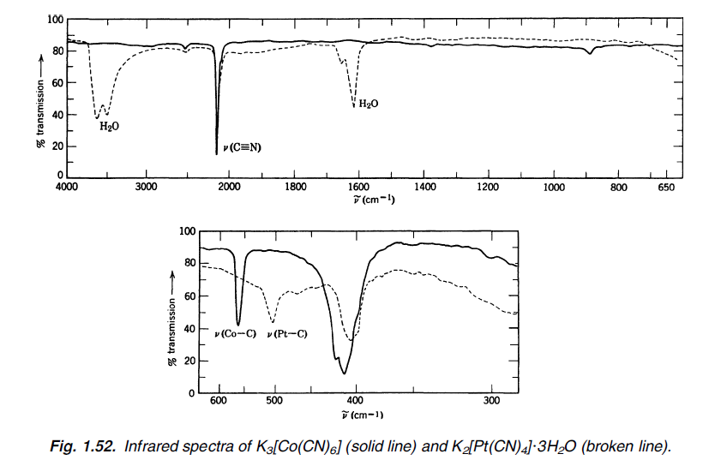

Slide 35
The CN⁻ ion acts as a σ-donor by donating electrons to the metal and also as a π-acceptor by accepting electrons from the metal.
σ-Donation tends to raise the ν(CN) since electrons are removed from the 5s orbital, which is weakly antibonding, while π-backbonding tends to decrease the ν(CN) because the electrons enter into the antibonding 2pπ* orbital.
In general, CN is a better σ-donor and a poorer π-acceptor than is CO. Thus, the ν(CN) of the complexes are generally higher than the value for free CN⁻, whereas the opposite prevails for the CO complexes

Slide 36



ν(CN) of cyano complexes are governed by
the electronegativity, (2) the oxidation state (3) the coordination number of the metal.
The effect of electronegativity is seen in the following order:
Since the electronegativity of Ni(II) is smallest, the σ-donation will be the least, and the ν(CN) is expected to be the lowest.
The effect of oxidation state is seen in the following frequency order
The higher the oxidation state, the stronger theσ-bonding, and the higher the ν(CN).
The effect of coordination number is evident in the frequency order:
Here an increase in the coordination number results in a decrease in the positive
charge on the metal, which, in turn, weakens the σ-bonding, thus decreasing the ν(CN).

Slide 37
Low energy absorptions
ν(MC), δ(MCN), and δ(CMC) vibrations appear in the regions 600–350, 500–350, and 130–60 cm⁻¹
MC stretching force constant increases in the order Fe(III)<Co(III)<Fe(II)<Ru(II)<Os(II), and the CN⁻ stretching force constant decreases in the same order of metals. This result was interpreted as indicating that the MC π-bonding increases in the above-mentioned order.
Bridged Cyano Complexes
If the M-C≡N group forms a
M-C ≡ N-M’-type bridge, n(C ≡ N) shifts to a higher, and n(MC) to a lower, frequency.
n(C ≡ N) of K₂[Ni(CN)₄] at 2130 cm⁻¹ shifts to 2250 cm⁻¹ in K₂[Ni(CN)₄]4BF₃ because of the formation of the Ni-C ≡ N-BF₃-type bridge.

Slide 38
SCN⁻
The SCN group may coordinate to a metal through the nitrogen or the sulfur or both (M-NCS-M’). In general, class A metals (first transition series, such as Cr, Mn, Fe, Co, Ni, Cu, and Zn) form M-N bonds, whereas class B metals (second half of the second and third transition series, such as Rh, Pd, Ag, Cd, Ir, Pt, Au, and Hg) form M-S bonds .However, other factors, such as the oxidation state of the metal, the nature of other ligands in a complex, and steric consideration, also influence the mode of coordination.
The CN stretching frequencies are generally lower in N-bonded complexes (near and below 2050 cm⁻¹) than in S-bonded complexes (near 2100 cm1) . The bridging (M-NCS-M’) complexes exhibit ν(CN) well above 2100 cm⁻¹

Slide 39
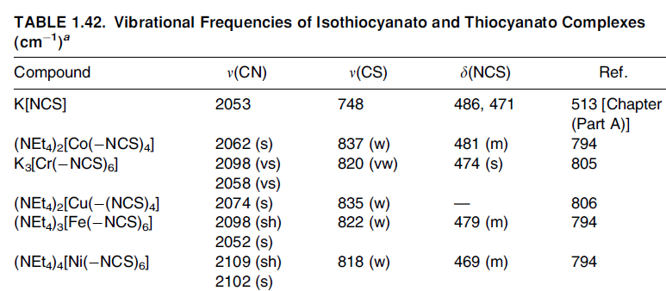
ν(CS) as a structural diagnosis: 860– 780 cm⁻¹ for N-bonded, and 720–690 cm⁻¹ for S-bonded, complexes. However, this band is rather weak and is often obscured by the presence of other bands in the same region.
N-bonded complex exhibits a single sharp
δ(NCS) near 480 cm⁻¹, whereas the S-bonded complex shows several bands of low intensity near 420 cm⁻¹

Slide 40
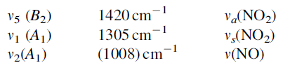
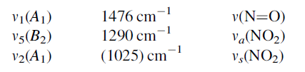
NO₃⁻
The NO₃ ion coordinates to a metal as a unidentate, symmetric, and asymmetric chelating bidentate, and bridging bidentate ligand of various structures
[Ni(en)₂(NO₃)₂] (unidentate) exhibits three bands as follows
[Ni(en)₂NO₃]ClO₄ (chelating bidentate) exhibits three bands at the following
The order of these frequencies is ν₅>ν₁>ν₂ for unidentate, and ν₁>ν₅>ν₂ for chelating bidentate complexes.

Slide 41
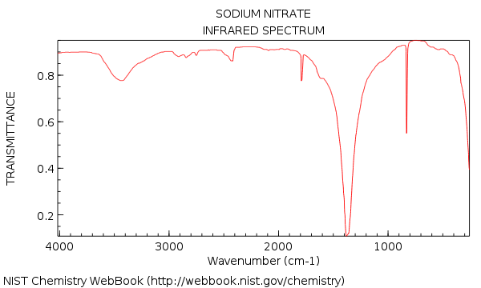

Slide 42
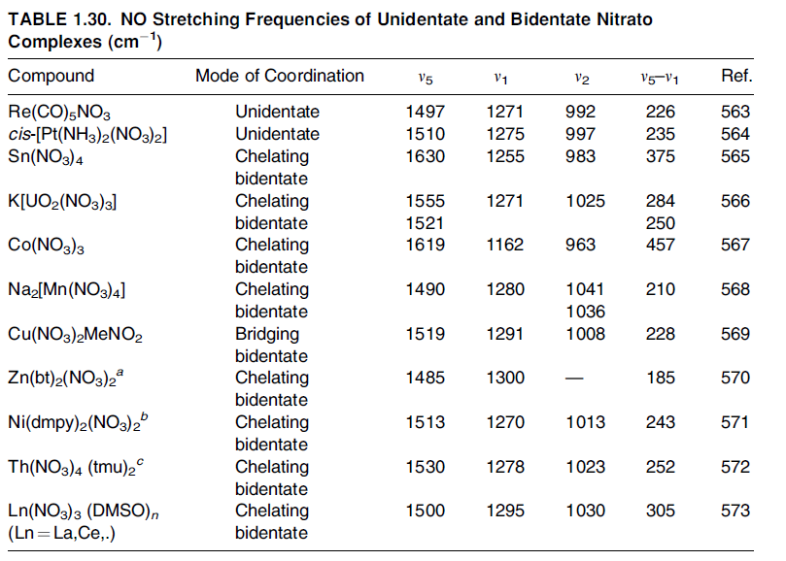

Slide 43
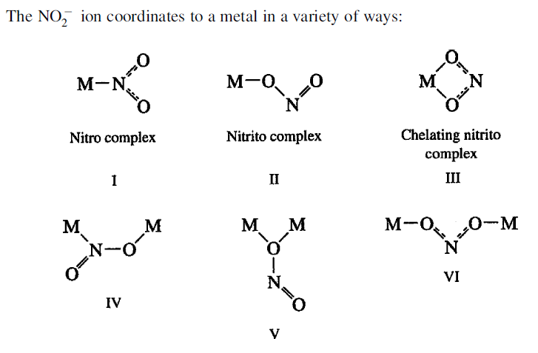
NO₂⁻

Slide 44
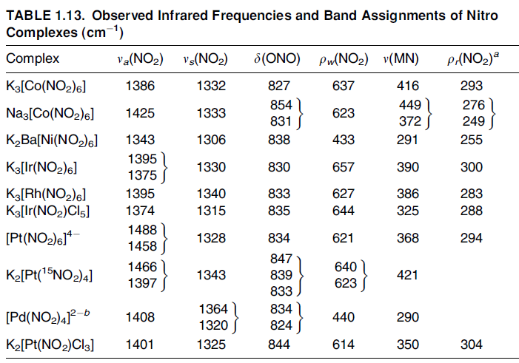
complexes exhibit ν_{a}(NO₂) and ν_{s}(NO₂) in the 1470–1370 and 1340–1320 cm⁻¹ regions, respectively. On the other hand, the free NO₂ ion exhibits these modes at 1250 and 1335 cm⁻¹, respectively. Thus ν_{a}(NO₂) shifts markedly to a higher frequency, whereas ν_{s}(NO₂) changes very little on coordination.

Slide 45
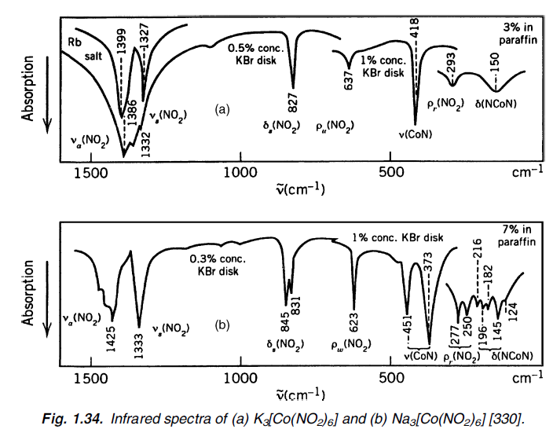

Slide 46
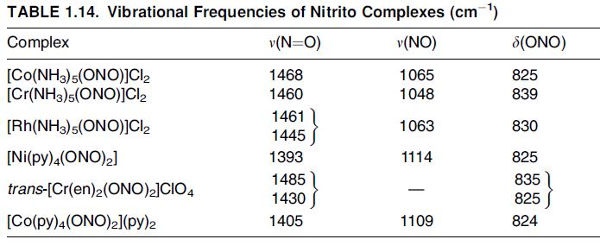
Nitrito Complexes
If the NO₂ group is bonded to a metal through one of its O atoms, it is called a nitrito complex. The two ν(NO2) of nitrito complexes are well separated, ν(N=O) and ν(NO) with at 1485–1400 and 1110–1050 cm⁻¹, respectively. Distinction between the nitro and
nitrito coordination can be made on this basis.
It is to be noted that nitrito complexes lack the wagging modes near 620 cm⁻¹ that appear in all nitro complexes. The ν(MO)
of nitrito complexes were assigned in the 360–340 cm⁻¹ region for metals such as Cr (III), Rh(III), and Ir(III)

Slide 47
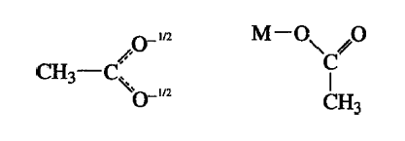
CH₃COO⁻
The free acetate ion (CH₃COO) exhibits the ν_{a}(COO) and ν_{s}(COO) at 1578 and 1414 cm⁻¹, respectively
If it is covalently bonded to a metal as a unidentate ligand, the ν_{a} and ν_{s} are shifted to higher and lower frequencies, respectively:

Slide 48
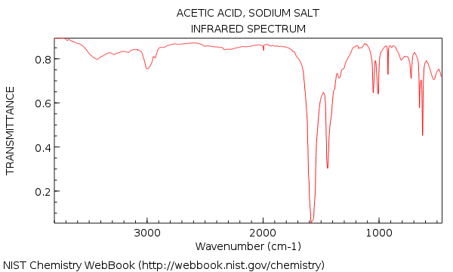

Slide 49
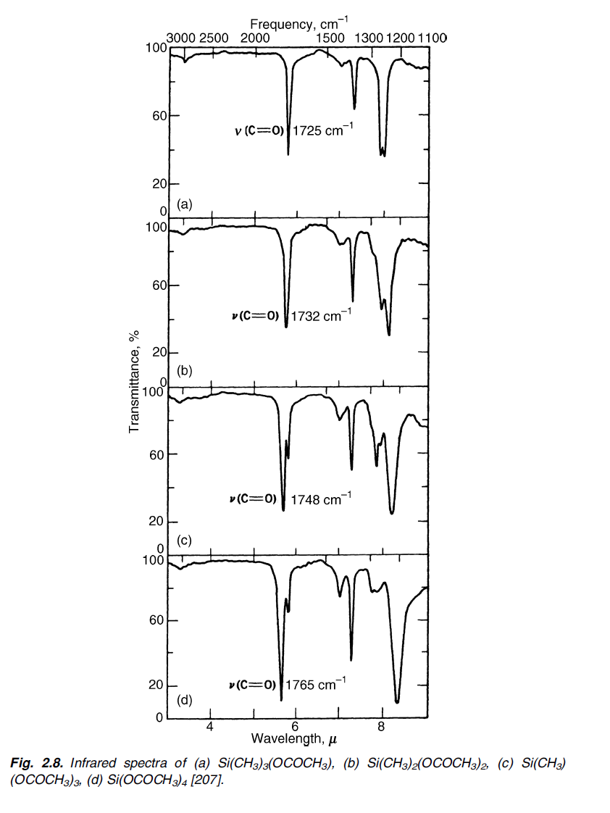
Sn compounds such as Sn(CH₃)₃(CH₃COO) and Sn(CH₃)₂Cl(CH₃COO) exhibit two ν(COO) near 1600 and 1420 cm⁻¹, indicating the ionic character of the tin-acetate interaction

Slide 50
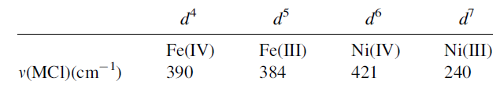
X - Halo
Terminal MX stretching bands appear in the regions of 750–500 cm⁻¹ for MF, 400–200 cm⁻¹ for MCl, 300–200 cm⁻¹ for MBr, and 200–100 cm⁻¹ for MI
the ν(MBr)/ν(MCl) and ν(MI)/ν(MCL) ratios are 0.77–0.74 and 0.65, respectively
If other conditions are equal, ν(MX) is higher as the oxidation state of the metal is higher
[M(dias)₂Cl₂]^{n+} series
[dias=o-phenylenebis(dimethylarsine)]
presence of one electron in the antibonding e_{g} orbital in the Ni(III) complex

Slide 51
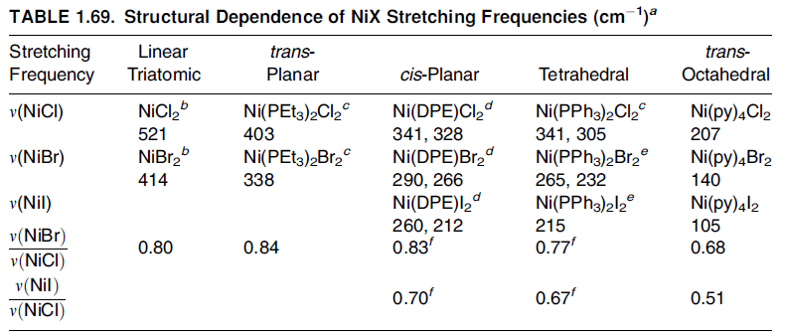

Slide 52
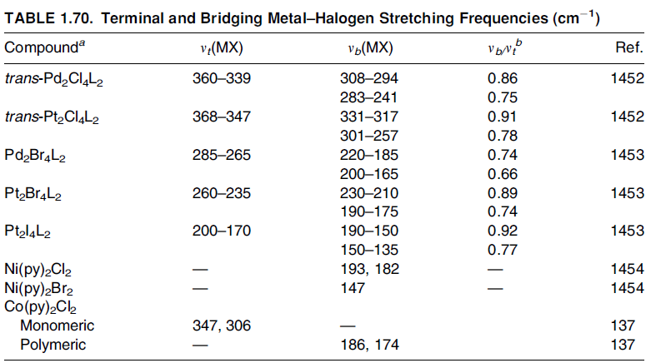
In general, bridging MX stretching frequencies [ν_{b}(MX)] are lower than terminal MX stretching frequencies [ν_{t}(MX)]

Slide 53
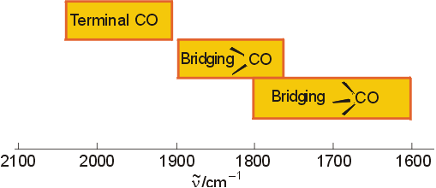
IR - Metal Carbonyls
ν for free CO = 2143 cm⁻¹

Slide 54
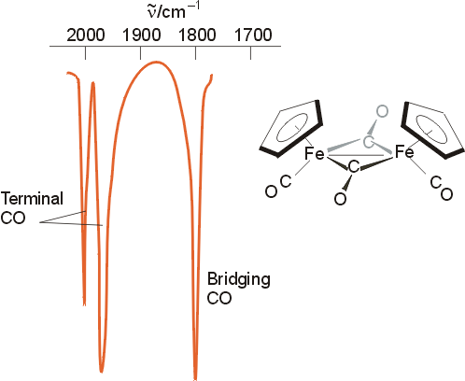
Metal Carbonyls
ν for free CO = 2143 cm⁻¹

Slide 55
Metal Carbonyls
The IR spectra of transition metal carbonyl compounds are consistent with the predictions based on the symmetry of the molecule and group theory.
The more symmetrical the structure, the fewer CO stretches are observed in the IR spectra.

Slide 56
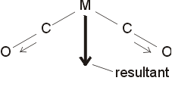
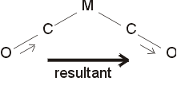
If CO ligands are cis to each other, both the symmetric stretch and the asymmetric stretch will involve a change in dipole moment, and hence two peaks will be seen in the IR spectrum.

Slide 57
Metal Carbonyls
Metal carbonyls with a center of symmetry typically show only 1 C-O stretch in their IR spectra, since the symmetric stretch doesn’t change the dipole moment of the compound. Combined with the Raman spectrum, the structure of these compounds can be determined.

Slide 58
Bond Mode of CO to Metals
The CO ligand usually binds via the carbon atom to the metal
The lone pair on the carbon forms a σ-bond with a suitable d-orbital of the metal
The metal can form a π-back bond via the p*-orbital of the CO ligand
Electron-rich metals i.e., late transition metals in low oxidation states are more likely to donate electrons for the back bonding
A strong π-back bond results in a shorter the M-C bond and a longer the C-O bond due to the population of an anti-bonding orbital in the CO ligand

Slide 59
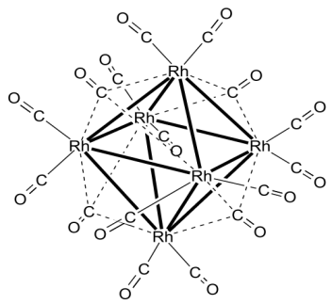
Structures
Three bond modes found in metal carbonyl compounds
The terminal mode is the most frequently one mode found exhibiting a carbon oxygen triple bond i.e., Ni(CO)₄
The double or triply-bridged mode is found in many polynuclear metals carbonyl compounds with an electron deficiency i.e., Rh₆(CO)₁₆ (four triply bridged CO groups)
Which modes are present in a given compound can often be determined by infrared spectroscopy

Slide 60
IR spectra and Metal-Carbon bonding in carbonyl complexes
The υ_{CO} stretching frequency of the coordinated CO is very informative as to the nature of the bonding. Recall that the stronger a bond gets, the higher its stretching frequency. Thus, the more important the M=C=O (C=O is a double bond) canonical structure, the lower the υ_{CO} stretching frequency as compared to the M-C≡O structure (C≡O is a triple bond): (Note: υ_{CO} for free CO is 2041 cm⁻¹)
[Ti(CO)₆]²⁻ [V(CO)₆]⁻ [Cr(CO)₆] [Mn(CO)₆]⁺ [Fe(CO)₆]²⁺
υ_{CO} 1748 1858 1984 2094 2204 cm⁻¹
increasing M=C double
bonding
decreasing M=C double
bonding

Slide 61
IR spectra and bridging versus terminal carbonyls
Bridging CO groups can be regarded as having a double bond C=O group, as compared to a terminal C≡O, which is more like a triple bond:
M-C≡O
One can thus use the CO stretching frequencies around
1700-2200 cm⁻¹ to detect the presence of bridging CO groups.
the C=O group
in a bridging
carbonyl is more
like the C=O in
a ketone, which
typically has
υ_{C=O} = 1750 cm⁻¹
~ triple bond
~ double bond
M
C=O
M
terminal carbonyl bridging carbonyl
(~ 1850-2125 cm⁻¹) (~1700-1860 cm⁻¹)

Slide 62
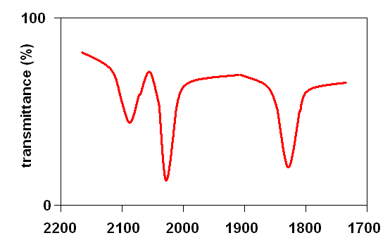
IR spectrum and bridging versus terminal carbonyls in [Fe₂(CO)₉]
terminal
carbonyls
bridging
carbonyls

Slide 63
Structures
Mononuclear compounds
Dinuclear compounds
M(CO)₆ (O_{h}) M(CO)₅ (D_{3h}) M(CO)₄ (T_{d})
i.e., Cr(CO)₆ i.e., Fe(CO)₅ i.e., Ni(CO)₄
M₂(CO)₁₀ (D_{4d}) Fe₂(CO)₉ (D_{3h})
Co₂(CO)₈ Co₂(CO)₈ (solid state, C_{2v}) (solution, D_{3d})

Slide 64
Infrared Spectroscopy
Free CO: 2143 cm⁻¹
Terminal CO groups: 1850-2120 cm⁻¹
μ₂-brigding CO groups: 1750-1850 cm⁻¹
μ₃-bridging CO groups: 1620-1730 cm⁻¹
Non-classical metal carbonyl compounds can have ν(CO) greater than the one observed in free CO
Compound | ν(CO) (cm⁻¹)
Ni(CO)₄ | 2057
Fe(CO)₅ | 2013, 2034
Cr(CO)₆ | 2000
Re₂(CO)₁₀ | 1976, 2014, 2070
Fe₂(CO)₉ | 1829, 2019, 2082
Rh₆(CO)₁₆ | 1800, 2026, 2073
Ag(CO)⁺ | 2185

Slide 65


Characteristics of CO complexes
Infrared Spectroscopy
Free CO stretch ν = 2143 cm⁻¹
Cr(CO)₆ CO stretch ν = 2000 cm⁻¹
because π-back donation from metal weakens the C≡O bond by adding e- to antibonding π* orbital
Negative charge on complex further weakens CO bond:
[V(CO)₆]⁻ n = 1858 cm⁻¹ [Mn(CO)₆]⁺ n = 2095 cm⁻¹
Bridging CO further weakened by extra π-back donation

Slide 66


Slide 67


Slide 68


Slide 69
Electron Spin Resonance (ESR)
Spectroscopy

Slide 70
ESR
Applicable for species with one or more unpaired electrons
Free radicals
Transition metal compounds
Useful for unstable paramagnetic compounds generated in situ
Electrochemical oxidation or reduction

Slide 71


Resulting energy levels of an electron in a magnetic field
Based upon the spin of an electron and its associated magnetic moment
for a molecule with one unpaired electron
In the presence of a magnetic field, the two electron spin energy levels are
E = gμ_{B}B₀M_{S}
g = proportionality factor
M_{S} = electron spin quantum number (+½ or -½)
μ_{B} = Bohr magneton
B₀ = Magnetic field

Slide 72

The Zeeman Effect
EPR spectroscopy are due to the interaction of unpaired electrons in the sample with a magnetic field produced by the external magnet field B₀. This effect is called the Zeeman Effect.
the energies for an electron with ms = +½ and ms = -½ are
E_{1/2} = 1/2geβB₀ E_{1/2} = -1/2geβB₀

Slide 73












The Zeeman Effect

Slide 74

Hyperfine Interactions
EPR signal is ‘split’ by neighboring nuclei
Called hyperfine interactions
Can be used to provide information
Number and identity of nuclei
Distance from unpaired electron
Interactions with neighboring nuclei
E = g_{e}μ_{B}B₀M_{S} + aM_{s}m_{I}
a = hyperfine coupling constant
m_{I} = nuclear spin quantum^{EPR} number

Slide 75
Which nuclei will interact?
Every isotope of every element has a ground state nuclear spin quantum number, I
has value of n/2, n is an integer
Isotopes with even atomic number and even
mass number have I = 0, and have no HYPERFINE INTERACTIONS
▪ ¹²C, ²⁸Si, ⁵⁶Fe, …
Isotopes with odd atomic number and even mass number have n even
▪ ²H, ¹⁰B, ¹⁴N, … (I – INTEGRAL)
Isotopes with odd mass number have n odd
▪ ¹H, ¹³C, ¹⁹F, ⁵⁵Mn, … (I – half INTEGRAL)

Slide 76

Hyperfine Interaction
Interaction with a single nucleus of spin ½

Slide 77
Hyperfine Interactions
❑ Coupling patterns same as in NMR
❑ The number of lines:
2NI + 1
N = number of equivalent nuclei; I = spin
❑ Only determines the number of lines--not the intensities
If only one nucleus interacting
All lines have equal intensity
If multiple nuclei interacting
Distributions derived based upon spin
For spin ½ (most common), intensities follow binomial distribution

Slide 78

Relative Intensities for I = ½

Slide 79


Interpreting EPR.2
(Nuclear) Hyperfine Coupling
. CH₃ radical
e- localized on C
Hyperfine coupled to 3H (quartet)
A_{H}
A_{H}
. CH₂(OCH₃) radical
e- localized on C
Larger hyperfine (A_{H}) coupled to 2H (triplet) and smaller hyperfine (A_{H}) to 3H (quartet)
A_{H}

Slide 80

Hyperfine Interactions
Example:
Radical anion of benzene [C₆H₆]⁻
Electron is delocalized over all six carbon atoms
Exhibits coupling to six equivalent hydrogen atoms
So
2NI + 1 = 2(6)(1/2) + 1 = 7
So spectrum should be seven lines with relative intensities 1:6:15:20:15:6:1

Slide 81

Hyperfine Interactions
EPR spectrum of benzene radical anion

Slide 82

Superhyperfine splitting
If the odd, unpaired electron spends time around multiple sets of equivalent nuclei, additional splitting is observed: 2nI + 1; this is called “superhyperfine splitting.”
Example:
Pyrazine anion
Electron delocalized over ring
Exhibits coupling to two equivalent N (I = 1)
2NI + 1 = 2(2)(1) + 1 = 5
Then couples to four equivalent H (I = ½)
2NI + 1 = 2(4)(1/2) + 1 = 5
So spectrum should be a quintet with intensities 1:2:3:2:1 and each of those lines should be split into quintets with intensities 1:4:6:4:1

Slide 83

superhyperfine splitting
EPR spectrum of pyrazine radical anion

Slide 84

Superhyperfine splitting
ESR spectrum of the cyclopentadienyl radical

Slide 85

Interpreting EPR. Isotropic vs Anisotropic Spectra
Depends on sample type:
- liquid solution room temp
- frozen solution
- powder
- single crystal (oriented)
Depends on symmetry around metal ion
g_{iso}
x = y = z
g||
x = y ≠ z
g⊥
g_{yy}
x ≠ y ≠ z
g_{xx}
g_{zz}
The EPR spin Hamiltonian operator with x,y,z tensors:

Slide 86


F₂– radical anion
2nI+1 = (2 x 2 x ½) + 1 = 3
F₂⁻ trapped in neon matrices near 4 K.

Slide 87

PH₄ radical
P ; I = ½
(2n_{P}I_{P}+ 1) x (2n_{H}I_{H}+ 1) = 2 x 5 = 10 lines

Slide 88

ESR spectrum of γ irradiated 5% PH3 in neopentane at 100 K.

Slide 89

ESR Spectrum of BH₃^{-.}
¹¹B (I=3/2)
(2n_{B}I_{B}+ 1) x (2n_{H}I_{H}+ 1) = 4 x 4 = 16 lines
EPR spectrum of [BH₃●]— in solution. The stick diagram marks the resonances for the ¹¹B(I=3/2) and the three protons. The remaining weak resonances are due to the radicals containing ¹⁰B(I=3).
Physical Methods – Magnetic Resonance

Slide 90

APPLICATIONS OF
ESR TO METAL COMPLEXES

Slide 91
THINGS TO BE CONSIDERED
Nature of the metal
Number of ligands
Geometry
No of d electrons
●
Ground term of the ion

Slide 92
Electronic degeneracy
Inherent magnetic field
Nature of sample
Energy gap between g.s and e.s
Experimental temperature

Slide 93
NATURE OF THE METAL ION
Since d metal ions have 5 d orbitals situations are complicated
But the spectra are informative
In 4d and 5d series L-S / j-j coupling is strong making the ESR hard to interpret

Slide 94
Crystal field is not affecting the 4f and 5f e- so the ESR spectra of lanthanides and actinides are quite simple.
If ion contains more than one unpaired e- ZFS may be operative

Slide 95
GEOMETRY OF THE COMPLEX
Ligands and their arrangement –CFS
CFS in turn affect the electronic levels hence the ESR transitions
The relative magnitude of CFS and L-S coupling is giving three situations.

Slide 96
If the complex ion is having cubic symmetry (octahedral or cubic) – g is isotropic
Complexes with at least one axis of symmetry show two g values
Ions with no symmetry element will show three values for g.

Slide 97
NUMBER OF d ELECTRONS
Magnetically active nucleus cause hyperfine splitting.
If more than one unpaired e- present in the ion, more no of transitions possible leads to fine structure in ESR spectrum.
Here we have to consider two things
Zero field splitting – due to dipolar interaction Kramer’s degeneracy

Slide 98

ZERO FIELD SPLITTING
●
Considering a system with two unpaired e-s
Three combinations possible
In absence of external field all three states are having equal energy
With external field three levels are no longer with same energy.
Two transitions possible; both with same energy
●
S = +1
●
∆E₂
S = 0
∆E₁
●
S = -1
●
H ≠ 0
ZFS = 0

Slide 99
SPLITTING OF ELECTRONIC LEVELS EVEN IN ABSENCE OF EXTERNAL MAGNETIC FIELD IS CALLED ZERO FIELD SPLITTING (ZFS)
The splitting may be assisted by distortion and L-S coupling also.

Slide 100
When there is a strong dipolar interaction the +1 level is raised in energy –Dipolar shift (D)
This dipolar shift reduces the gap between S = -1 and S = 0 state
Now the two transitions do not have same energy
Results in two lines

Slide 101
EFFECT OF DIPOLAR SHIFT
Ms = +1
D
Ms = ±1
∆E₁ = ∆E₂
Ms = ±1,0
Ms = 0
Ms = 0
D
Ms = -1
ZFS = 0

Slide 102
KRAMER’S THEOREM
Systems with even no. of unpaired e-s will contain a state with S = 0
But in the case of odd e- s no state with S = 0 since Ms = ½
In such cases even after ZFS the spin states with opposite Ms values remain degenerate which is called Kramer’s degeneracy

Slide 103
The levels are called Kramer’s doublets
“ IN ANY SYSTEM WITH ODD NUMBER OF UNPAIRED e^{-s} THE ZFS LEAVES THE GROUND STATE AT LEAST TWO FOLD DEGENERATE ”

Slide 104
EFFECT OF ZFS ON Mn(II)
+5/2
+3/2
+1/2
±5/2
6_{S}
±3/2
±1/2
- 1/2
- 3/2
- 5/2
FREE ION
ZFS AND RESULTING KRAMER’S DOUBLETS

Slide 105
CONSEQUENCES OF ZFS
In some cases ZFS magnitude is very high than the splitting by external field.
Then transitions require very high energy
Some times only one or no transitions occur.
Examples V³⁺ and Co²⁺

Slide 106
EFFECTIVE SPIN STATE - Co(II)
Co(II) in cubic field has a ground term of ⁴F.Since it is a d⁸ system it have ±3/2 and ±1/2 levels.
ZFS splits the levels by 200 cm⁻¹
Since the energy gap is higher only the transition -1/2 to + 1/2 is seen.
So it appears as if Co(II) has only one unpaired e- (Effective spin S’ = ½)

Slide 107

+3/2
±3/2
- 3/2
±3/2,
±1/2
≈ 200 cm⁻¹
+1/2
±1/2
ONLY OBS.TRANSITION
-1/2

Slide 108
BREAK DOWN OF SELECTION RULE
In some cases like V(III) the magnitude of ZFS very high.
It exceeds the normal energy range of ESR transitions
Normal transitions occur with ∆Ms = ±1 . But its energy exceeds the microwave region
Then the transition from -1 to +1 levels with ∆Ms = ±2 occurs ,which is a forbidden one

Slide 109

+1
FORBIDDEN TRANSITION
Ms= ±1
-1
Ms = 0, ±1
NOT OCURRING
Ms =0
0

Slide 110
ESR AND JAHN-TELLER DISTORTION
Jahn – Teller theorem :
Any non-linear electronically
degenerate system
is unstable, hence it will to reduce the symmetry,
undergo remove stability.
distortion
the degeneracy and hence increase its
But this theorem does not predict the type of distortion
Because of J-T distortion the electronic levels are split and hence the number of ESR lines may increase or decrease.

Slide 111
Cu (II) in a tetragonal field
Cu (II) a d⁹ system. Ground term ² D
●
2 _{D}
² E_{g} + ² T_{2 g} ( CFS)
Since Cu (II) is a d⁹ system it must undergo J-T distortion.
So the O_{h} field becomes tetragonal.

Slide 112
●
^{2 T}2g
² E_{g} + ² B_{2 g} (J-T distortion)
●
2 _{Eg}
^{2 B}1 g ^{+ 2 A}1 g
The unpaired e- is present in ²A_{1g}
on applying the magnetic field the spin levels are split and we get an ESR line.
●

Slide 113

Cu (II) in various fields
2_{Eg}
(E )
3
^{2T}2g
2_{D}
2_{Eg}
^{2B}2g
(E₂)
(E )
2
B
1
1g
+ 1/2
ESR
- 1/2
^{2A}1g
(E )
0
Free ion
O_{h} field
Tetragonal field
H

Slide 114


Slide 115


Slide 116


Puri, Sharma and Pathania

Slide 117
Nuclear Magnetic Resonance (NMR)
Spectroscopy

Slide 118
Like proton, electron also has spin ½. However, electron spins are paired during the formation of chemical bonds.
Therefore, most molecules are diamagnetic.
Paramagnetism arises from the presence of a free electron spin(s) in molecules.
In several molecules, it arises from a metal ion having odd number of electrons.

Slide 119

Paramagnetic metal ions are integral part of several biological molecules, such as heme proteins and metalloenzymes. A paramagnetic centre can also be introduced exogenously.

Slide 120


Slide 121
The magnetic moment (m_{S}) due to unpaired electrons in a molecule is given by:
μ_{S} = gμ_{B}[S(S+1)]^{1/2}
Here, g the ratio of the angular and magnetic moment of electron,
S is the electron spin quantum number (1/2 for single unpaired electron)
μ_{B} is electron Bohr magneton.
Like the chemical shift, g is also a tensor quantity.
Its value for free electron is 2.0023, but is significantly different in molecules.

Slide 122
In the presence of paramagnetic ions, both the chemical shifts and relaxation rates change significantly.
The mechanism of interaction of electron spin with nuclear spin is similar to the nuclear spin-spin interactions.
However, the electronic magnetic moment is several times larger than the nuclear moments.
Therefore interactions between electron and nuclear spins, dominate over nuclear spin-spin interactions.

Slide 123
Even beyond the sphere of broadened resonances, chemical shifts and relaxation rates in paramagnetic molecules are dominated by the electron spins due to paramagnetic ions.
Under favourable situations, such molecules show highly dispersed NMR spectra with chemical shifts extending much beyond the normal range observed in diamagnetic molecules.
A number of methods have been designed to locate such broad resonances, and to exploit the advantages that such systems offer.

Slide 124
The chemical shifts in paramagnetic molecules are determined by two mechanisms:
(i) a direct delocalization of the electron spin at various nuclear sites (called the contact shift δc), and
(ii) an effect arising from the anisotropy of the g tensor of the electron spin (leading to pseudo-contact shifts, δpc).

Slide 125
Organometallic with paramagnetic metal, shows chemical shift values covering a range of 200 ppm for protons , and even greater for other nuclei. This can be due to the contact and pseudo contact shifts.
Contact Shift
These shifts can occur due to transfer of some unpaired electron density from metal to the ligand containing target nuclei, causing shielding/deshielding , depending on electron spin correlation effects and electron distribution.
The contact shift has been shown to be proportional to the amount of unpaired electron spin density delocalized on the observed nucleus.

Slide 126

Contact shift in a Nickel complex
Complexation with the paramagnetic nickel ion results in the α, β, and γ
protons indicated having chemical shifts of -42, +47, and -64 ppm, respectively.
These large shifts are thought to arise because of donation of unpaired electrons from the paramagnetic ion (nickel in the complex cited) through the bonding atom (nitrogen) to the rest of the molecule. In order for such a shift to occur, a finite electron density at the nucleus has to be postulated. This type of electron nucleus "contact" interaction was first described by Fermi.

Slide 127
The contact shift arises from the presence of finite electron spin-density at the site of the nucleus. The interaction of the nuclear and electron spins is given by:
H = AI.S
Where A is a constant, which is related to the spin density at the site of the nucleus and is called the Fermi contact hyperfine coupling constant. A general expression for the contact shift, taking into account of the anisotropy of the g and the magnetic susceptibility tensor χ (which are related to each other), is given by the empirical relation :
where, B is a constant.

Slide 128
Pseudocontact shift
In an external magnetic field the magnetic moment of the paramagnetic part of the molecule partially orients itself in such a way as to give a non-zero time average, i.e. an induced magnetic moment.
The effect of this induced magnetic moment on nuclei is that of creating a dipolar magnetic field which adds to the external one.
A nucleus will sense this new magnetic field depending on its position within the dipolar field.
This neglects other mechanisms of interaction between the unpaired electrons and the nuclei and is referred to as dipolar or through-space interaction.

Slide 129
The orientational average of this interaction is zero. However, the electron magnetic moment is constituted by a spin (isotropic) and an orbital (anisotropic) contribution.
In the presence of sizeable orbital contributions to the electron magnetic moment, the induced magnetic moment changes in intensity upon molecular rotation in an external magnetic field and the magnetic susceptibility tensor associated with the molecule becomes anisotropic.
Under these circumstances, the above dipolar energy does not average to zero, and the average magnetic field that is added to the external magnetic field resulting in a change in chemical shift called pseudo contact shift.

Slide 130
The pseudo-contact shift interaction arises from dipole-dipole interaction between the electron and nuclear spins. It is similar in nature to the dipolar nuclear spin-spin interaction. For systems having axial symmetry, the change in chemical shift due to the pseudo-contact term is given by:
D is a constant which depends on the properties of the ion, r_{i} is the distance between the nucleus i and the paramagnetic metal centre and θ_{i} is the angle between the vector r_{i} and the principle symmetry axis of the molecule. Thus, the ratios of pseudo contact terms provide information on molecular shapes, much in the same way as the nuclear dipole-dipole interactions. However, the interaction between nuclear and electron spin can manifest much beyond the 5 Å distance limit of in NOE measurements and can provide long-range information.

Slide 131
Applications in biological systems
A large number of metalloproteins carry paramagnetic ions. The most common naturally occurring metal ions are Fe in its various oxidation states, Cu²⁺, Ni²⁺, Zn²⁺ and Ca²⁺. While former three are paramagnetic, Zn²⁺ and Ca²⁺ diamagnetic.
Molecules containing and , have been conveniently studied both in their diamagnetic form and by substituting these ions by paramagnetic Co²⁺ and lanthanides, respectively.
By using both the paramagnetic and diamagnetic analogues, additional information can be obtained. One of these is the ability to obtain additional structural information using paramagnetic effects on the relaxation times of various spins.

Slide 132

The electronic properties of these metal ions depend not only on their electronic states but also on the nature of binding. Oxygen carrying protein haemoglobin is paramagnetic in the deoxy- form and diamagnetic in the oxygenated form, a property which forms the basis of fMRI.

Slide 133

¹H NMR spectra of metmyoglobin (Mr 16 kDa) from a number of sources, recorded at 298 K in deuterated water

Slide 134
High Spin Iron (II)
Present in the penta-coordinated porphyrins. The NMR spectra in these cases are fairly broad, but meaningful information has been obtained in several cases.
NMR spectroscopy has helped in detecting tertiary and quaternary changes in the structure of haemoglobin during oxygen binding, mechanism of interaction with ligands, Bohr’s effect, and cooperativity in oxygen binding.
Several heme proteins, including oxy-Hb and oxy-Mb, are diamagnetic. In these cases, complete sequence specific resonance assignments has been achieved. The information thus obtained can be used for analysis of the spectra for paramagnetic analogue.

Slide 135


NMR studies of iron-sulfur proteins have been very useful in characterizing cluster patterns. The spectra of such proteins normally show distinct peaks for α-CH and β-CH₂ protons. In reduced rubredoxin (+3 to +2) four signals in the 11-17 ppm range - α-CH - and four signals in the 150-260 ppm range - β-CH₂ ₋ in 1:2 ratio are observed.
Low Spin Iron (III)
This class includes haemoglobin, ferricytochromes, cytochrome P-450 and a number of other important proteins. Determination of reliable magnetic susceptibility tensor has allowed interpretation of pseudo-contact shifts. The contact shifts which dominate in such cases have been estimated for different sites.

Slide 136


Slide 137
Fluorine-19 NMR
Fluorine-19 nuclear magnetic resonance is an analytical technique used to identify fluorine-containing compounds.
¹⁹F is one of the most important nuclei for NMR Spectroscopy
¹⁹F has a nuclear spin of 1/2 and a high magnetogyric ratio, which means that this isotope is highly responsive to NMR measurements.
¹⁹F comprises 100% of naturally-occurring fluorine.

Slide 138

Chemical shifts of The reference compound for ¹⁹F is CFCl₃. organofluorine compounds using CFCl₃ as standard range from 50 to -250 ppm, a maximum range is as wide 900ppm
¹⁹F spectra is very much more sensitive to the structural and environmental changes of molecules.
Fluorine like hydrogen gives characteristic coupling constants
depending on the spacial displacement and number of bonds between a coupling partner atom.
Homonuclear coupling constants between fluorine atoms are
usually relatively large compared with those between
hydrogen atoms

Slide 139


Slide 140


Slide 141


Slide 142


Slide 143



Slide 144


¹⁹F N.M.R. Spectra of Iron(III) Porphyrins Substituted with CF₃ Groups
The large differences in the fluorine chemical shifts between the low- and high-spin states are comparable with the differences in the CH₃ chemical shifts d (PMR) 13 and 48 for the low- and high-spin states due to the Fermi
contact and dipole-dipole interactions
The ¹⁹F resonances of the low-spin iron(III) complex (3) (S = 1/2) and the high-spin iron(III) complex (4) (S = 5/2) showed 5 and 60 p.p.m. downfield shifts respectively, compared with the spectrum of the zinc(II) complex

Slide 145



Chemical shifts and contact shifts for trinuclear chromium(III) complexes.
¹⁹F NMR of [Cr₃O(O₂CCH₂CH₃)₆(4-CF₃-py)₃]⁺ in acetonitrile. * - free 4-CF₃-py.
¹⁹F NMR of [Cr₃O(O₂CEt)₆(3-F-py)₃]⁺ in acetonitrile. * - free 3-F-py.

Slide 146

Mutual Coupling - the ¹⁹F and ³¹P NMR spectra of K[PF₆].
The spectra were recorded for a solution of K[PF₆] in DMSO. The six fluorines are all equivalent in the [PF₆]⁻anion and so the ³¹P NMR spectrum consists of a septet. The P-F coupling constant, in this case 711 Hz.
Since all six fluorine nuclei are equivalent they couple to just the phosphorus nucleus to give a doublet, again separated by 711 Hz.

Slide 147


Slide 148

¹⁹F NMR spectrum of Hg(CF₃)₂

Slide 149
Spectrum shows mercury satellites. The three peaks arise in a similar way because mercury has a number of different isotopes, one of these ¹⁹⁹Hg is spin-active (I=1/2) and 16.8% abundant.
Of all the molecules of Hg(CF₃)₂, 83.2% (100% - 16.8%) will not contain spin-active mercury, and so the six equivalent fluorine nuclei will not couple to any other spin-active nuclei, so a singlet is observed.
However, for the 16.8% of molecules containing ¹⁹⁹Hg coupling will occur between the ¹⁹⁹Hg and ¹⁹F nuclei, so a doublet would arise (2nI+1 = 2). The actual spectrum observed is a combination of these two components - a singlet [83.2%] and a doublet [total intensity 16.8%, ie 8.4% each line] with one peak of the doublet either side of the singlet.
The ²J(HgF) coupling constant is measured across the doublet, ie from one satellite peak to the other, in this case that is 1253 Hz.

Slide 150

Solid State

Slide 151
Phosporus-31 NMR
Phosporus-31 nuclear magnetic resonance is an analytical
Technique used to identify phosphorus- containingcompounds, Such as organic compounds and metalcomplexes.
Phosphorus-31 nuclearmagneticresonance (³¹PNMR) is conceptually same as (¹HNMR). ³¹P is one of th emostimportant nuclei for NMR spectroscopy
Due to its nuclear spin of 1/2,high gyromagneticratio (17.235 MHzT⁻¹) and has 100% natural isotopic abundance.

Slide 152


Slide 153
Phosphanes possess an electron lone pair with which they can bond to a transition metal. As this bonding interaction results in the transfer of electron density from phosphorus to the metal atom, we would expect a downfield shift in the ³¹P-NMR spectrum relative to the value for the free ligand that depends both on the σ-donor strength of the phosphane, and the Lewis acidity of the transition metal fragment.
Since most phosphane ligands also show some π-acceptor ability, coordination to a transition metal can result in π-backbonding that would increase the electron density on phosphorus, and thus result in an upfield shift of the signal in the ³¹P-NMR spectrum. Depending on the magnitude of the downfield shift due to the σ-donicity, and the upfield shift due to the π-acceptor strength of the phosphane, either a net downfield or net upfield shift is observed upon coordination of a phosphane to a transition metal.

Slide 154
Coordination chemical shift
The chemical shift difference observed upon coordination to a transition metal is known as the coordination chemical shift, and defined as:
coordination chemical shift: Δδ = δP (complex) − δP (ligand)
Tricoordinate phosphorus ligands are usually strong σ-donors, resulting in downfield coordination shifts of around δP = 20–70 ppm in the absence of appreciable π-acceptor strength, and depending on the transition metal fragment they coordinate to.

Slide 155



Slide 156


Slide 157

Spectra of some Phosphorus compounds
A decrease of PCr concentration and the increase of Pi concentration during exercise can be monitored by ³¹P NMR.
The energy supply in cells is provided by molecules that contain phosphorus. Especially PCr (Phosphocreatine) and ATP (Adenosine-Tri-Phosphate) carry the energy needed for most processes in the brain and other organs. Magnetic Resonance Spectroscopy has the potential to quantitatively detect these substances in living subjects noninvasively.

Slide 158

In each case, the actual downfield shift depends on the Lewis base. Factors are the geometry around the metal (cis or trans), and the substituent's on phosphorus (P⁺ or PPh² ⁺ ).
In the two phosphanes for PMe₃ and PPh₃, the downfield shift for PPh₃ upon coordination ranges from Δδ = 21–40 ppm, and that for PMe₃ is in an even narrower band of Δδ = 46–60 ppm.

Slide 159


Slide 160
At the upfield end, white phosphorus P₄ resonates at δ_{P} = −488 ppm. This is readily explained by an electron rich cluster structure with P-P-P angles of 60°. Coordination to a transition metal causes a reduction in electron density on phosphorus, as a P₄ lone pair is used to create a donor bond.
Coordinating the phosphane PMe₃ to a transition metal again results in the expected downfield shift of Δδ = 107 ppm, since the phosphorus lone pair is utilized for the donor bond, resulting in a decrease of electron density on phosphorus.
Similarly, substitution of a phosphorus atom by an isolobal transition metal fragment causes a downfield shift, as electron density is transferred from the electron rich phosphorus atoms to the “poorer” transition metal. In general, negative coordination shifts are possible.

Slide 161

The two ³¹P-NMR signals in [Cp₂ Hf(PCy₂ )₂ ]
When covalent bond is formed between phosphorus and the metal, the picture changes. In [Cp₂ Hf(PCy₂)₂], one can see two different phosphorus resonances at δ_{P} = 270.2 ppm and d P = −15.3 ppm, respectively.
It is to be noted that the two phosphorus atoms are trigonal planar and tetrahedrally coordinated, and suspect that they are part of a P = Hf double and a P-Hf single bond, respectively.

Slide 162


Slide 163
MOSSBAUER SPECTROSCOPY
Also known as Nuclear Gamma Resonance
Spectroscopy.
In this method nucleus absorbs an gamma ray photon and undergoes transition.
First the concept of γ photon resonant
absorption was suggested by Kuhn-1929
First observed by Mossbauer in 1958
Awarded Nobel prize for this work

Slide 164

164

Slide 165


Slide 166
Conditions for MB spectra
The energy of nuclear transition must be large enough to give, useful γ ray photon ; but not large enough to cause recoil effect.
The energy of the γ ray photon must be in
the range of 10 – 150keV.
A substantial amount of the nuclear decay must be with γ ray emission.

Slide 167
The lifetime of the excited state must be long enough give a reasonably broad emission range. Since, extremely narrow lines are not useful (τ must be 001 – 100 nS)
The excited state of the emitter should be having a long-lived precursor, and easy to handle.

Slide 168
The ground state of the isotope should be stable. Its natural abundance should be high or at least the enrichment of that isotope should be easy.
The cross section of for absorption should be high.

Slide 169
Why Fe is the most studied?
57 _{Co}
270
days
⁵⁷Fe*
127.90 k.eV / 91%
⁵⁷Fe* (99.3 nS)
136.32 k.eV / 9 %
14.41 k.eV
57_{Fe}

Slide 170
Why Fe is the most studied?
The precursor of ⁵⁷Fe is ⁵⁷Co which decays to ⁵⁷Fe* with a half life of 270 days (highly stable precursor)
9% of ⁵⁷Fe* decays to ground state directly with emission of ϒ photon of energy 136.32 keV.
91% of ⁵⁷Fe* decays to another excited state
with emission of 121.91 keV energy

Slide 171
The lower excited state is having a life time of 99.3nS (more stable)
This decays to ground state with emission of 14.41 keV.
This transition satisfies all the conditions for MB spectra except 2nd condition.
But it is compensated by larger absorption cross section.
Other elements that can be studied- are ¹¹⁹Sn, ¹²¹Sb,125_{Te,} 129_{I,} 129_{Xe and} 197_{Au}

Slide 172
ISOMER SHIFT / CENTRE SHIFT / CHEMICAL SHIFT
The E_{t} value is affected by the interaction between the nucleus and the e⁻s present around it.
This arises because of the different sizes of
nucleus in ground and excited states.
The change in nuclear radius when going from g.s to e.s is ΔR
Z is the atomic number

Slide 173
Isomer shift
The change in electrostatic energy on decay is
given by (chemical shift / Isomer shift)
δ= (ε₀/5) (Ze²R²)(Δ R/R)[|ψ_{s}(abs)|²-|ψ_{s}(source)|²] where
ε₀
Z
e ψ_{s}(abs)
ψ_{s}(source)
– Permittivity of free space
atomic number of the nucleus
electronic charge
s orbital wave function of absorber
s orbital wave function of source

Slide 174


Slide 175
Since s electron wave functions have their maxima at the nucleus, s electron density affects the isomer shift to a great extent.
But changes in p & d orbital occupancies affect the s electron through screening hence have a smaller effect on isomer shift.
When ΔR/R is positive the isomer shift is also positive and negative ΔR/R reflected as negative shift

Slide 176
Chemical shift values for Fe compounds
Fe isomer shift cannot be used for
determining the O.S of Fe in a molecule.
Fe O.S from 0 to 4, often differ in unit charge only.
The electrons involved are from d orbital. So
effect on the s electrons is smaller.
Varying spin states(which depends on the
ligands present) also affect the shift value.

Slide 177
Electric Quadruple Interactions
Nuclei in
states with an angular momentum
quantum number I>1/2 have a non-spherical charge distribution. This produces a nuclear quadruple moment.
In the presence of an asymmetrical electric field (produced by an asymmetric electronic charge distribution or ligand arrangement) this splits the nuclear energy levels.
The charge distribution is characterized by a single
quantity called the Electric Field Gradient (EFG).

Slide 178
In the case of an isotope with a I=3/2 excited state, such as ⁵⁷Fe or ¹¹⁹Sn, the excited state is split into two sub states m_{I}=±1/2 and m_{I}=±3/2.
This gives a two line spectrum or 'doublet'.
The magnitude of splitting, Delta, is related to the nuclear quadrupole moment, Q, and the principle component of the EFG, V_{zz}, by the relation Δ=eQV_{zz}/2

Slide 179


Quadruple Splitting for ⁵⁷Fe and ¹¹⁹Sn

Slide 180



Slide 181
Informations from quadruple splitting
Appearance of quadruple splitting shows the
presence of efg at the nucleus.
The efg may be created by the ligand field or by the electron distribution aroung the nucleus.
Single crystal or application of magnetic field gives more information.
If a nucleus distribution is expected.
with symmetric electron
in an O_{h} field, efg is not

Slide 182

Symmetric-No efg
Symmetric-No efg
Octahedral high spin
Symmetric-No efg
Symmetric-No efg

Slide 183

Symmetric-No efg
Symmetric-No efg
Symmetric-No efg
Octahedral low spin
Symmetric -No efg

Slide 184

A singlet for Fe(II)-LS and Fe(III)-HS and a quadruple doublet for Fe(II)-HS and Fe(III)-HS
Quadrupolar spitting
No Quadrupolar spitting

Slide 185
The isomer shift
It is useful for determining
valency states,
ligand bonding states,
electron shielding
and the electron-drawing power of electronegative groups.
For example, the electron configurations for Fe²⁺ and Fe³⁺ are (3d)⁶ and (3d)⁵respectively. The ferrous ions have less s-electrons at the nucleus due to the greater screening of the d-electrons. Thus ferrous ions have larger positive isomer shifts than ferric ions.

Slide 186


Spectra of spin free Fe(II) – FeSO₄.7H₂O

Slide 187
From the crystallographic data it was initially
concluded perfect O_{h} vertex.
that FeSO₄.7H₂O is having a
symmetry, with six H₂O on each
But the MB spectrum recorded showed a
large quadruple splitting, which is not
(for
possible in a regular O_{h} symmetry.
perfect O_{h} field efg is zero)

Slide 188
Fe(II) is a d⁶ system.
In weak field created by H₂O, an orbitally degenerate system results.
This under goes J-T distortion (Z _{in})to remove the degeneracy and forms a tetragonal field.
This creates an efg at the nucleus and hence quadruple splitting.

Slide 189



Slide 190



Slide 191




Spin free Fe(II) – FeSO₄.7H₂O
Spin free Fe(III) – FeCl₃
Spin paired Fe(II) – K₄Fe(CN)₆
Spin paired Fe(III) – K₃Fe(CN)₆

Slide 192
Sodium nitroprusside – Na₂[Fe(CN)₅(NO)]
The O.S of Fe in nitroprusside was a matter of controversy for a long time.
Initially it was assumed that it contained Fe(II) and NO⁺ since it was diamagnetic. [Fe(II)-d⁶; Fe(III) –d⁵]
But the MB spectrum of the sample showed a doublet with δ = -0.165 mm/S
This value is too negative for a Fe(II) complex.

Slide 193


Slide 194
This suggests that the Fe may bein Fe(IV) state.
The magnetism and MB spectrum are in consistent with the structure which has an extensive π-bonding with ⁺NO ligand .
The t₂g orbitals of Fe and the π-orbital of N present in ⁺NO containing the odd e-, to form a π-bond

Slide 195
The Fe(II) is transferring the e⁻s form filled t₂g level to the vacant π- antibonding orbital of NO.
This makes the shift value to approach Fe(IV) values.
Now because of this the shielding of s-e⁻ by the d e⁻s decreases and hence the shift becomes more.
This is supported by the decrease in N-O stretching frequency in IR, since the anti bonding level is filled.

Slide 196
K₄[Fe(CN)₆]
symmetry,
is a 3d⁶
LS complex
with O_{h}
where all six
electrons are
accommodated in the three t_{2g} orbitals.
Contributions of (EFG)
vanish; there is no quadrupolar interaction.
Na₂[Fe(CN)₅NO]2H₂O has C_{4v} d-orbital splitting as shown.
symmetry with

Slide 197


Slide 198


The ferrous ions have less s-electrons at the nucleus due to the greater screening of the d-electrons. Thus ferrous ions have larger positive isomer shifts than ferric ions.

Slide 199


• Isomer shift is related to the oxidation state
of the metal.
• In
119
Sn MB spectra Sn(II) shows a positive
shift (ΔR/R ) w.r.to Sn where as for Sn(IV) it is
negative
s - electron density decreased so
negative shift
Species
configuration
δ
Sn(IV)
0
0
5s 5p
-ive
Sn
2
2
5s 5p
0
Sn(II)
2
0
5S 5p
+ive
s - electron density increased – p screening
not present, so positive shift
33

Slide 200
• In ¹¹⁹Sn compounds, the shift values depend
on the ligands present and the coordination
number of tin.
• The isomer shift values are useful in characterizing tin derivatives
Many Sn compounds appear to contain Sn(II) from the formulae but on analyzing with MB spectra Sn(IV) is present in them.

Slide 201
Many of them are polymeric and contain Sn(IV).
Generally Sn(II) compounds show shift > than 2.1 mm/s and Sn(IV) show shift < 2.1 mm/s (With relative to SnO₂ ).
The point of changeover is a dispute but shifts less than 2 are for Sn(IV) and above 2.5 are clearly for Sn(II).

Slide 202
The isomer shift of (SnPh₂)_{n} is 1.5 mm/s clearly showing the presence of Sn(IV).
A similar formula Sn(C₅H₃)₂ monomeric structure in the solid state and shows a shift of 3.74 mm/S.

Slide 203

¹¹⁹Sn Mössbauer spectrum of a representative frozen solution tin(II)-hydroxide complex formed in hyper-alkaline aqueous solution

Slide 204

The spectrum could only be satisfactorily analyzed in terms of a quadrupole split doublet rather than a single line.

Slide 205


Slide 206
Very large shift values accompanied by zero quadrupole splitting have been taken to indicate that the 5s electrons are not involved in the metal-ligand bonds (Sn-IV).
But the bonding participation of the 5s electrons is reflected in the Mossbauer parameters where the isomer shift is lower than expected with a clearly resolved quadrupole splitting (Sn-II).

Slide 207
Sn (IV)

Slide 208
Lower IS <2
No Quadrupolar splitting

Slide 209

Higher IS >2
With
Quadrupolar splitting

Slide 210
Thank you
&
Best Wishes….!
gajayakumar@gmail.com

