Slide 1
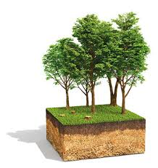
Environmental sensitization
Dr.P.Nikhil Chandra
Asst. Prof. of Chemistry
SN College, Kollam

Slide 2
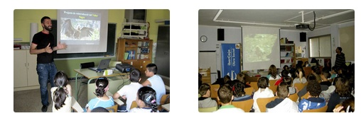
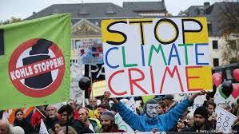
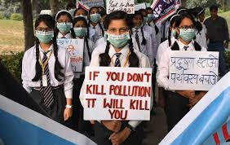


Slide 3
# It is the mass sensitization campaign aiming at creating awareness among the public at large on. # Environmental issues, and fostering a sense of personal environment responsibility, and greater. # Includes motivation and commitment towards the protection of the environment.

Slide 4

Project tiger started in 1972 (1800 to 40000)

Slide 5
Objectives
Encourage a more mindful and conscious attitude towards environmental issues
Create the awareness of the present day issues and its effect on the environment
To be part of solving a global issues through direct and indirect issues
To have a room to be innovative and create around environment issues

Slide 6

Former Initiatives
In Man and Nature, first published in 1864, polymath scholar and diplomat George Perkins Marsh (polymath scholar) challenged the general belief that human impact on nature

Slide 7

The book was published on September 27, 1962 by Carson (American biologist), documenting the adverse environmental effects caused by the indiscriminate use of pesticides.

Slide 8
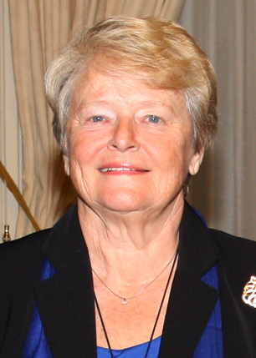
World Commission on Environment and Development (WCED)/ Brundtland Commission
To rally countries to work and pursue sustainable development together, the UN decided to establish the Brundtland Commission
The Brundtland Commission was created by the United Nations in 1983 to reflect about ways to save the human environment and natural resources and prevent deterioration of economic and social development.

Slide 9
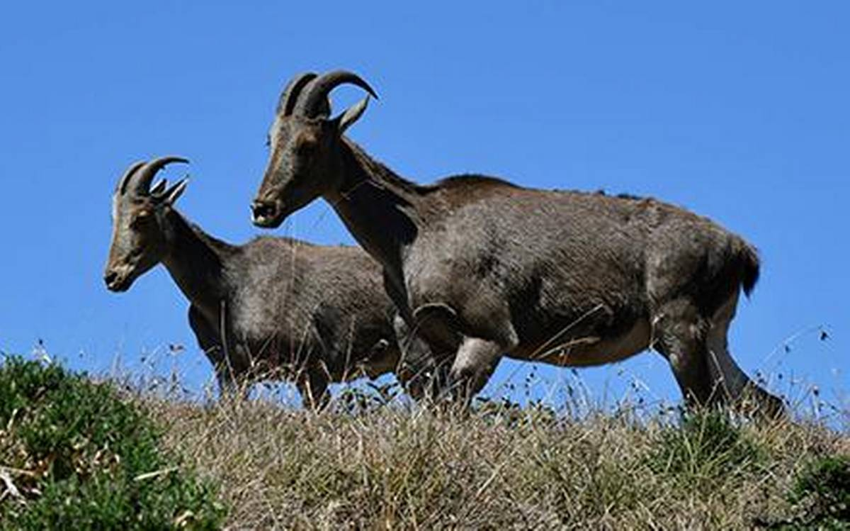
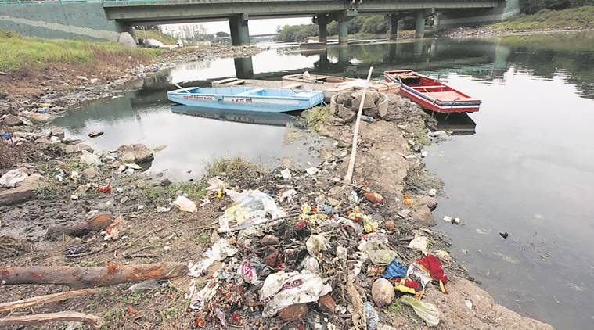
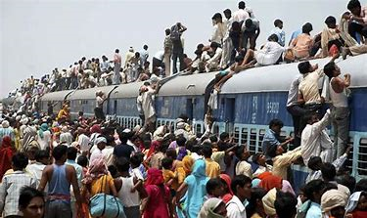
Areas of interest
Wildlife Conservation
River conservation
Global warming
Pollution
Habitat devastation
Overpopulation
Waste disposal
Diminishing resources

Slide 10




Government bodies
Ministry of Environment, Forest and Climate Change (MoEFCC)
The ministry is responsible for planning, promoting, coordinating, and overseeing the implementation of environmental and forestry programmes in the country
It has responsibilities to conduct monitoring of water and air quality and maintains monitoring data.
Issues of conservation, sustainable use of biological resources
Prevention of Cruelty to Animals
National Biodiversity Authority
Animal Welfare Board of India

Slide 11






National Tiger Conservation Authority
National Ganga River Basin Authority
European Environment
Agency (EEA)
Environmental Protection Agency (EPA) is an independent agency, specifically an independent executive agency, of the United States federal government for environmental protection

Slide 12
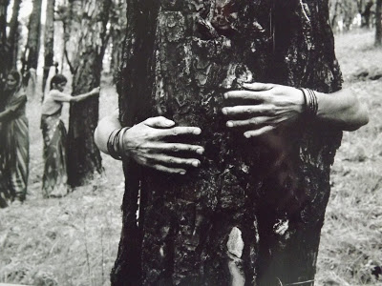
Important environmental movements
Chipko Movement
Year: 1973
Place: In Chamoli district and later at Tehri-Garhwal district of Uttarakhand.
Leaders: Sundarlal Bahuguna, Gaura Devi, Sudesha Devi, Bachni Devi,

Slide 13
Appiko Movement (South Indian version)
The movement happened in the Uttara Kanada district of Karnataka in the Western Ghats.
Pravin Sheth (1997) stated that, "the Appiko movement succeeded in its three-fold objectives which include;
Protecting the existing forest cover.
Regeneration of trees in denuded land.
Utilizing forest wealth with proper consideration to conservation of natural resources.

Slide 14
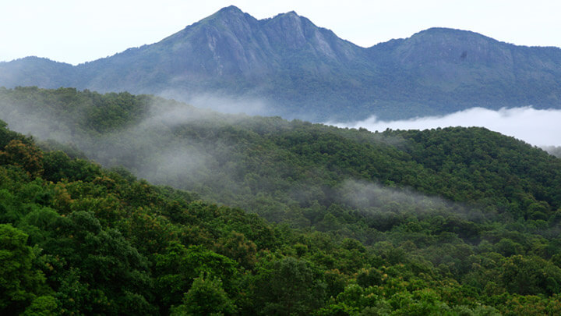
Silent Valley Movement
Year: 1978
Place: Silent Valley, an evergreen tropical forest in the Palakkad district of Kerala, India.
Leaders: The Kerala Sastra Sahitya Parishad (KSSP) an NGO, and the poet-activist Sughathakumari played an important role in the Silent Valley protests.
Aim: In order to protect the Silent Valley, the moist evergreen forest from being destroyed by a hydroelectric project.

Slide 15
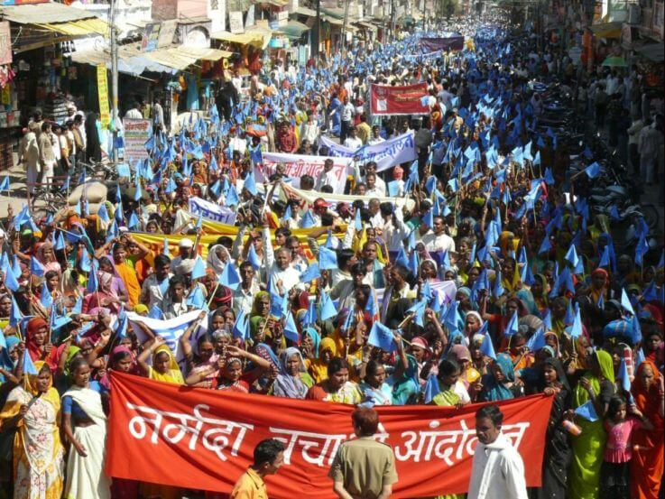
Narmada Bachao Andholan (NBA)
Year: 1985
Place: Narmada River, which flows through the states of Gujarat, Madhya Pradesh and Maharashtra.
Leaders: Medha Patker, Baba Amte, adivasis, farmers, environmentalists and human rights activists.
Aim: A social movement against a number of large dams being built across the Narmada River.

Slide 16
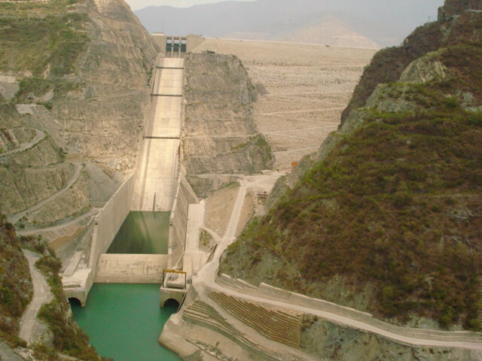
Tehri Dam Conflict
Year: 1990’s
Place: Bhagirathi River near Tehri in Uttarakhand.
Leaders: Sundarlal Bahuguna
Aim: The protest was against the displacement of town inhabitants and environmental consequence of the weak ecosystem.

Slide 17
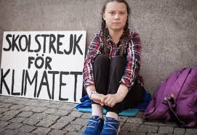
Greta Tintin Eleonora Ernman Thunberg is a Swedish environmental activist whose campaign has gained international recognition for holding world leaders accountable for their inadequate responses to climate change. Thunberg has inspired a number of her school-aged peers in what has been described as "The Greta effect"

Slide 18
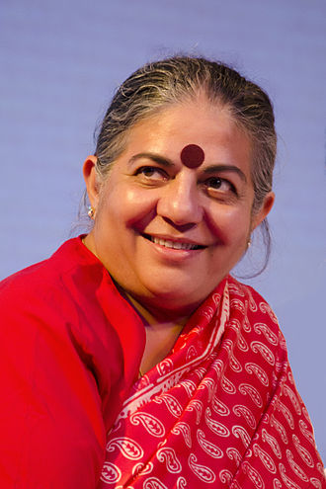
Famous Indian environmental activists
Vandana Shiva is one of the leaders and board members of the International Forum on and a figure of the anti-globalization movement. She has argued in favor of many traditional practices, as in her interview in the book Vedic Ecology . Shiva has worked to promote biodiversity in agriculture to increase productivity, nutrition, farmer's incomes and it is for this work she was recognized as an 'Environmental Hero' by Time magazine in 2003.

Slide 19
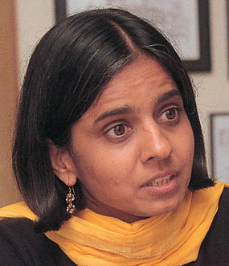
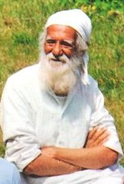
Sunita Narain is an Indian environmentalist and political activist as well as a major proponent of the Green concept of sustainable development.
Sunderlal Bahuguna is a noted Garhwali environmentalist and Chipko movement leader.

Slide 20
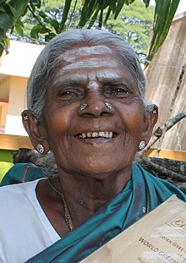
Saalumarada Thimmakka, also known as Timakka, is an Indian environmentalist from the state of Karnataka, noted for her work in planting and tending to 385 banyan trees along a four-kilometre stretch of highway between Hulikal and Kudur. She has also planted nearly 8000 other trees. Nation present the Padma Shri Award to Saalumarada Thimakka on 16 March 2019

Slide 21
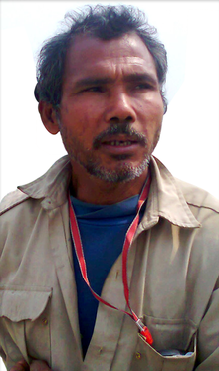
Jadav "Molai" Payeng is an environmental activist and forestry worker from Majuli, popularly known as the Forest Man of India. Over the course of several decades, he has planted and tended trees on a sandbar of the river Brahmaputra turning it into a forest reserve. The forest, called Molai forest after him, is located near Kokilamukh of Jorhat, Assam, India and encompasses an area of about 1,360 acres / 550 hectares.

Slide 22
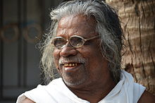
Kallen Pokkudan, was an Indian environmental activist and writer from Kerala. He was known for his efforts for the protection and proliferation of the mangrove forests in Kerala, since 1989

Slide 23
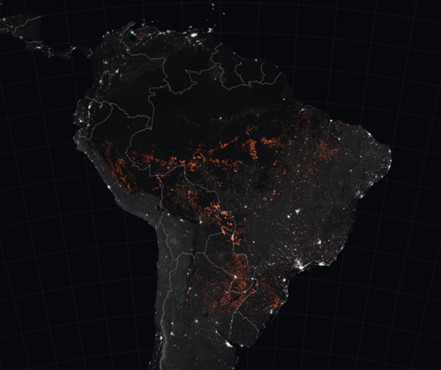
2019 Amazon rainforest wildfires

Slide 24
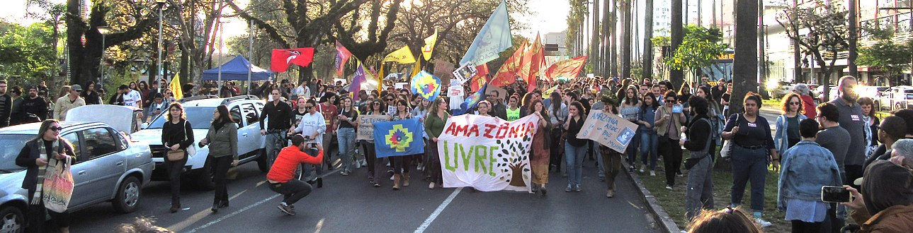
Amazon rainforest, which is the world's largest terrestrial carbon dioxide sink and plays a significant role in mitigating global warming.

Slide 25
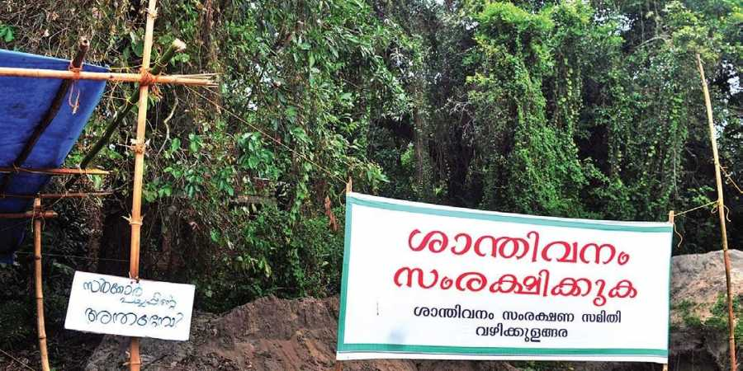
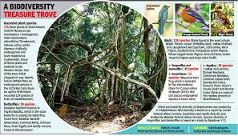
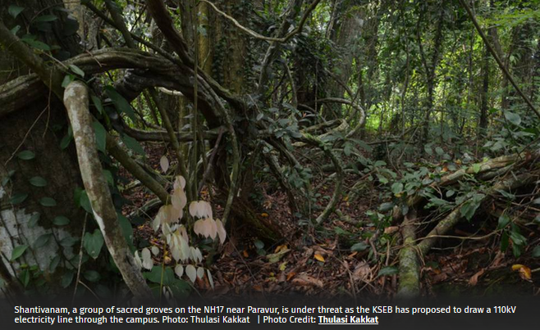
The Kerala State Electricity Board’s proposed Cherai-Mannam 110kV line will pass right through the groves, believed to be at least 200 years old.

Slide 26
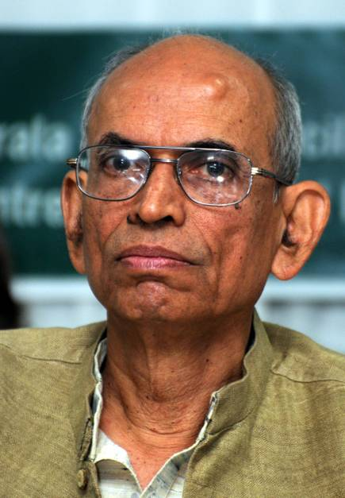
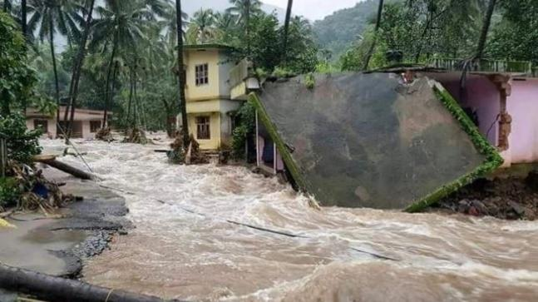
Kerala floods is man-made calamity: Madhav Gadgil

Slide 27
Madhav Dhananjaya Gadgil is an Indian ecologist, academic, writer, columnist and the founder of the Centre for Ecological Sciences, a research forum under the aegis of the Indian Institute of Science. He is a former member of the Scientific Advisory Council to the Prime Minister of India and the Head of the Western Ghats Ecology Expert Panel (WGEEP) of 2010, popularly known as the Gadgil Commission.

Slide 28
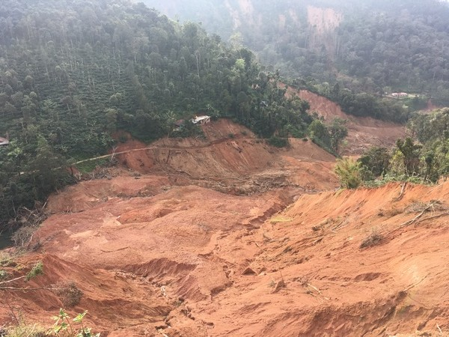
Most of the regions impacted by this monsoon were once classified as ecologically-sensitive zones (ESZs) by the Western Ghats Ecology Expert Panel (WGEEP), also known as the Gadgil Committee.
The committee had suggested that 140,000 kilometres of the Western Ghats be classified in three zones as per the requirement of environmental protection in the areas.
In some areas, the committee recommended strong restrictions on mining and quarrying, use of land for non forest purposes, construction of high rises etc. The report was first submitted to the government in 2011. BUT REJECTED BY GOVT.

Slide 29
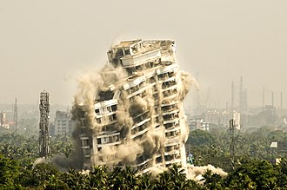
Maradu apartments demolition order
On 8 May 2019, the Supreme Court of India ordered five apartments in Maradu municipality in Kerala to be demolished within one month, for violation of Coastal Regulation Zone (CRZ) rules*
* As per the notification, the coastal land up to 500m from the High Tide Line (HTL) and a stage of 100m along banks of creeks, estuaries, backwater and rivers subject to tidal fluctuations, is called the Coastal Regulation Zone (CRZ).

Slide 30
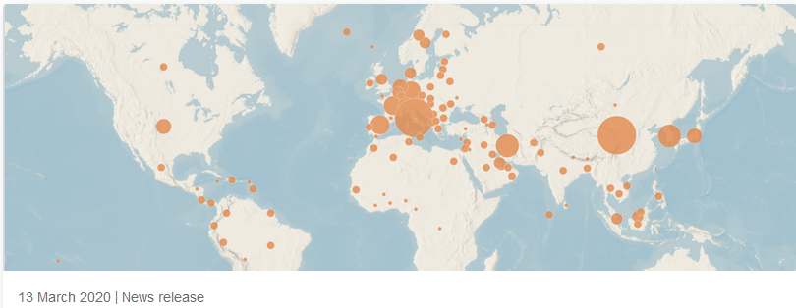
Coronavirus disease (COVID-19) is a new strain that was discovered in 2019 and has not been previously identified in humans.
The recent outbreak of corona virus is believed to have occurred in a market for illegal wildlife in
the central Chinese city of Wuhan.

Slide 31

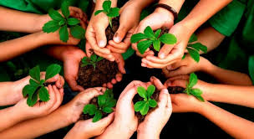
Promote environmental awareness
Make a difference
Share your knowledge
Take a stand for sustainability
Thank you
for your attention
“One of the first conditions of happiness is that the link
between man and nature shall not be broken.” —Leo Tolstoy

